Slide 1


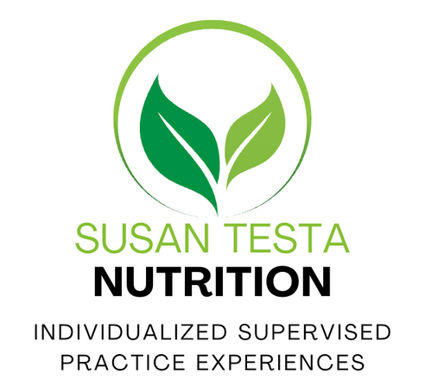
Domain II:Nutritional Biochemistry
CNS EXAM PREP COURSE
1
Caption

Slide 2
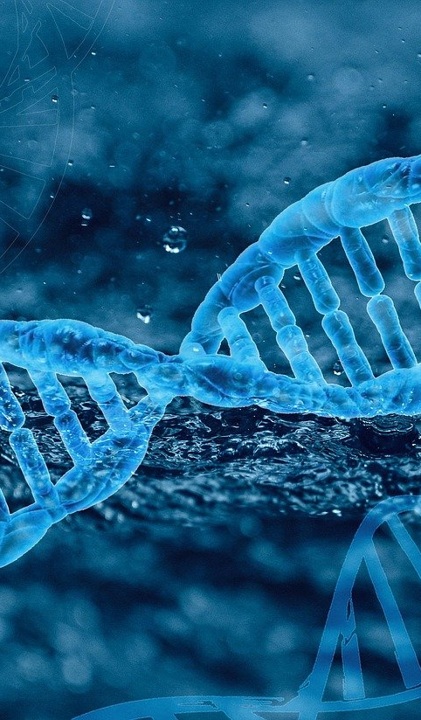
Energy Metabolism
Metabolism (biochemical pathways and reactions) of carbohydrates, lipids, proteins, and micronutrients
Nutritional biochemical pathways, including energy production and detoxification
Role of oxidative stress and detoxification pathways on health status
Lipid metabolism, including cytokine and eicosanoid pathways
**Slides will separate the above domain areas via a blue heading
D
O
M
A
I
N
II
2
Caption

Slide 3


Macronutrient Metabolism-
(biochemical pathways & reactions)
Macronutrient metabolism is the process by which the body breaks down carbohydrates, fats, and proteins to produce ATP, the energy currency of the cell.
Although each macronutrient enters through different pathways, they eventually converge in the TCA cycle and the electron transport chain (ETC) to generate energy.
Macronutrient metabolism allows the body to:
    Produce ATP for all cellular functions
    Maintain blood glucose and energy balance
    Store excess energy (fat storage) or release stored energy (lipolysis)
    Adapt to fed vs fasting states

Slide 4
Carbohydrate Metabolism
Carbohydrates are the body’s primary, most immediate energy source. They can be used directly (glycolysis) or stored for later (glycogenesis). Blood glucose is tightly regulated by hormones, especially insulin and glucagon. The brain and red blood cells rely heavily on glucose because RBCs lack mitochondria and the brain prefers glucose under normal conditions
Primary role: energy (4 kcal/g)
Major pathways: glycolysis, glycogenesis, glycogenolysis, gluconeogenesis, pentose phosphate pathway (PPP)
Notes:
Carbohydrates are the body’s primary and most immediate energy source. Once we ingest carbs, they are broken down into glucose, which enters the bloodstream. Glucose can be used immediately for ATP production or stored as glycogen in the liver and muscles.
The body keeps blood glucose levels very stable because the brain, red blood cells, and nervous tissue rely heavily on glucose. Several pathways are involved in carbohydrate metabolism, including glycolysis, the TCA cycle, glycogenesis, glycogenolysis, the pentose phosphate pathway, and gluconeogenesis. Hormones like insulin and glucagon play a major regulatory role.”

Slide 5
Glycolysis
First major step in glucose metabolism
Occurs in the cytosol of all cells
Does not require oxygen
Converts 1 molecule of glucose → 2 pyruvate
Produces net 2 ATP and 2 NADH
Key regulatory enzymes:
  Hexokinase/Glucokinase (traps glucose inside cells)
  PFK-1 (rate-limiting step)
  Pyruvate kinase
*This pathway provides quick ATP for cells, especially during high-intensity activity.
Notes:
“Glycolysis is the first major step in glucose metabolism. It takes place in the cytosol and does not require oxygen, which is why it can function in all cell types.
Glycolysis splits one molecule of glucose into two molecules of pyruvate. This process generates a small but rapid amount of ATP — specifically a net of 2 ATP — along with 2 NADH. Important regulatory enzymes include hexokinase or glucokinase, phosphofructokinase-1 (PFK-1), and pyruvate kinase. PFK-1 is the rate-limiting step and is tightly regulated because it determines the flow of glucose through the pathway.”

Slide 6
Aerobic vs Anaerobic Metabolism
Aerobic: pyruvate → acetyl-CoA → TCA
  When oxygen is present, pyruvate enters mitochondria and is converted into acetyl-CoA.
  Acetyl-CoA enters the TCA cycle, producing large amounts of NADH and FADH₂
  These electrons then fuel the electron transport chain, allowing oxidative phosphorylation to generate the majority of ATP.
  This is the preferred pathway for long-duration, lower-intensity activity.
  Aerobic metabolism is very efficient, yielding about 30–32 ATP per glucose.
Anaerobic: pyruvate → lactate
“When oxygen is limited — such as during intense exercise — cells cannot send pyruvate into the mitochondria.”
“Instead, pyruvate is converted to lactate by lactate dehydrogenase.”
“This reaction regenerates NAD⁺, which is essential for glycolysis to continue.”
“Although this pathway is fast, it only produces 2 ATP per glucose, making it far less efficient than aerobic metabolism.”
“This is the pathway used by red blood cells and fast-twitch muscle fibers.”
Notes:
“After glycolysis, pyruvate has two possible fates depending on oxygen availability.
In aerobic conditions, pyruvate is transported into mitochondria and converted into acetyl-CoA. This feeds into the TCA cycle and later oxidative phosphorylation, producing around 30–32 ATP per glucose. This is a very efficient process and is used during lower-intensity, long-duration activity.
In anaerobic conditions, such as high-intensity exercise or tissues with low oxygen—like red blood cells—pyruvate is converted into lactate. This reaction regenerates NAD⁺, which is required for glycolysis to continue. Although anaerobic metabolism is much less efficient (only 2 ATP), it allows rapid energy production.
Lactate produced can travel to the liver via the bloodstream and be converted back into glucose through the Cori Cycle.”

Slide 7
Lactate and the Cori Cycle
Lactate doesn’t just accumulate—it can be transported to the liver and converted back to glucose via the Cori cycle.
This recycling system is important during prolonged physical activity.
Notes:
Why This Matters:
“Together, these pathways allow the body to rapidly adapt to changing oxygen levels.”
“Aerobic metabolism supports endurance activities, while anaerobic pathways support high-intensity, short bursts of activity.”

Slide 8
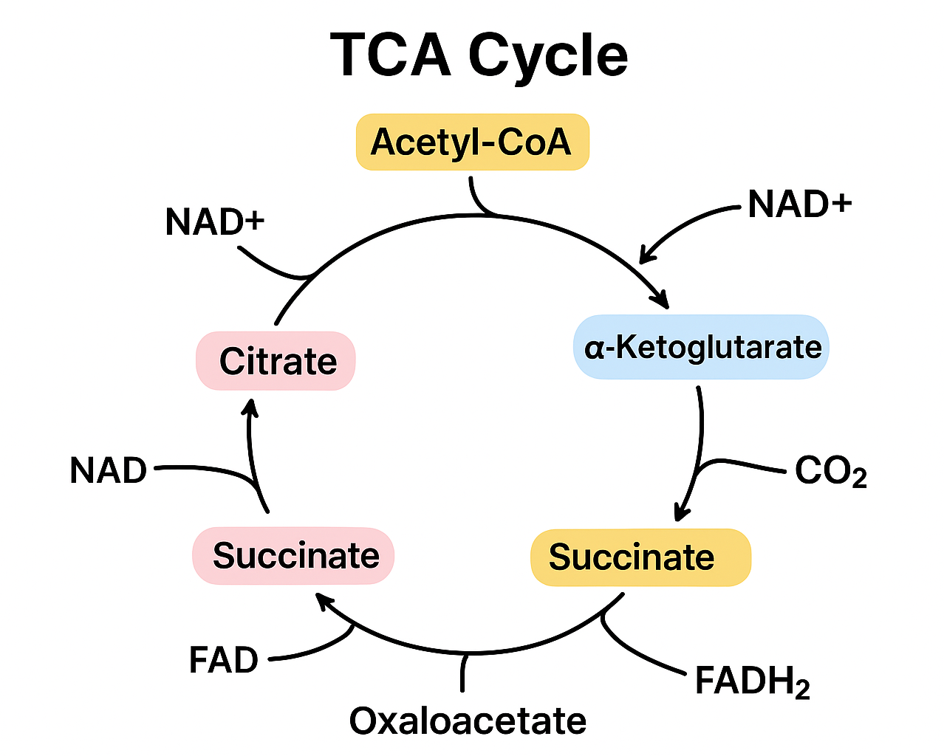
The TCA or Krebs Cycle
Occurs in mitochondria
Acetyl-CoA → CO₂ + NADH + FADH₂
Produces reducing equivalents that feed into oxidative phosphorylation
Generates ~10 ATP per acetyl-CoA
Central hub connecting fat, protein, and carbohydrate metabolism.
Caption
Notes:
“The TCA cycle, or Krebs cycle, takes place in the mitochondria and is the central hub of metabolism for carbohydrates, fats, and proteins. Acetyl-CoA enters the cycle and is oxidized into carbon dioxide. In the process, large amounts of NADH and FADH₂ are produced, which provide the electrons needed for the electron transport chain.
The TCA cycle itself produces only a small amount of ATP directly, but its main purpose is to generate these reducing equivalents that will later produce large amounts of ATP.”

Slide 9
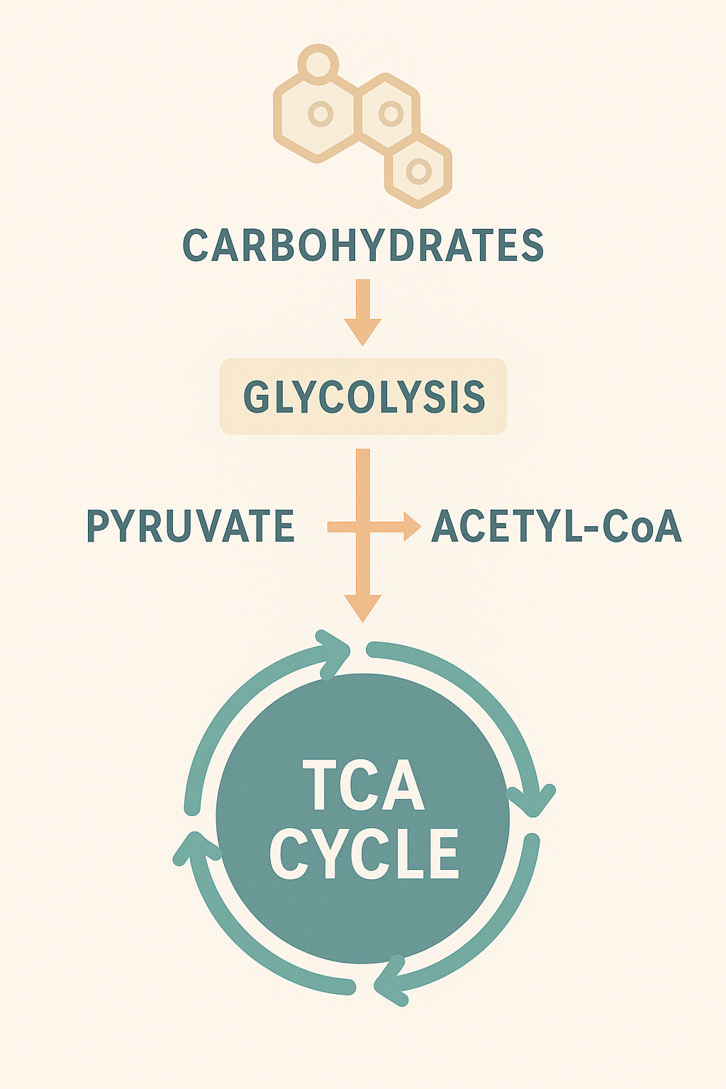
Carbohydrates & TCA Cycle
Carbohydrate → Glucose → Pyruvate → Acetyl-CoA
Glycolysis breaks glucose into pyruvate.
Pyruvate enters the mitochondria and is converted to Acetyl-CoA (requires Vitamin B1 – Thiamine).
Acetyl-CoA enters the TCA cycle and is combined with oxaloacetate to form citrate.
ATP Yield from Carbs (through TCA)
Each pyruvate → ~12.5 ATP (including ETC)
Each glucose → ~25 ATP from TCA + ETC portion (plus glycolysis)
Notes:
“The TCA cycle, or Krebs cycle, takes place in the mitochondria and is the central hub of metabolism for carbohydrates, fats, and proteins. Acetyl-CoA enters the cycle and is oxidized into carbon dioxide. In the process, large amounts of NADH and FADH₂ are produced, which provide the electrons needed for the electron transport chain.
The TCA cycle itself produces only a small amount of ATP directly, but its main purpose is to generate these reducing equivalents that will later produce large amounts of ATP.”

Slide 10
Carbohydrates & Glycolysis
Glycolysis is the central pathway for carbohydrate metabolism.
It converts glucose → pyruvate, producing a small amount of ATP and NADH, and providing the necessary substrate for:
The TCA cycle (aerobic metabolism)
Lactate formation (anaerobic metabolism)
Biosynthesis pathways (pentose phosphate, amino acids, glycerol backbone for fat)
Glycolysis occurs in the cytosol of all cells.
Converts glucose → pyruvate
✔ Generates ATP (energy)
✔ Produces NADH (for the ETC)
✔ Provides intermediates for other pathways:
Fatty acid synthesis
Amino acid synthesis
Ribose (for DNA/RNA) via PPP
✔ Allows anaerobic ATP production (without oxygen)
Notes:
Dietary carbohydrates are digested into:
Glucose (most common)
Fructose
Galactose
All are converted into glucose-6-phosphate (G6P), the first committed molecule of glycolysis.
Sources of glucose:
Dietary carbohydrate
Liver glycogen breakdown
Gluconeogenesis (during fasting)

Slide 11
Glycogenesis & Glycogenolysis
Glycogenesis (storage): Excess glucose is stored as glycogen.
    Enzyme: glycogen synthase
    Stimulated by insulin
Glycogenolysis (breakdown): Glycogen → glucose.
    Enzyme: glycogen phosphorylase
    Stimulated by glucagon & epinephrine
The liver controls blood glucose; muscles use glycogen for their own energy.
Notes:
“Glycogenesis and glycogenolysis are the pathways that regulate glycogen storage and release.
Glycogenesis is the formation of glycogen from glucose and occurs after high-carbohydrate meals. This process is stimulated by insulin, which activates glycogen synthase.
Glycogenolysis is the breakdown of glycogen into glucose, especially important during fasting or high energy demands. It is stimulated by glucagon and epinephrine. The liver releases glucose into the bloodstream, while muscles use glycogen only for themselves.”

Slide 12
Gluconeogenesis
“Gluconeogenesis is the production of new glucose, mainly in the liver but also in the kidneys, during fasting. This pathway is essential when the body’s carbohydrate stores are depleted.
  Occurs mainly in the liver, some in kidney
  Produces glucose during fasting
  Main substrates: Lactate, glycerol, amino acids (alanine)
  Opposes glycolysis; stimulated by glucagon and cortisol
  Essential for maintaining blood glucose during prolonged fasting or low-carb intake.
Notes:
“Gluconeogenesis is the production of new glucose, mainly in the liver but also in the kidneys during fasting. This pathway is essential when the body’s carbohydrate stores are depleted.
The major substrates include lactate, amino acids—especially alanine—and glycerol from fat breakdown. Gluconeogenesis is stimulated by glucagon, cortisol, and epinephrine. This process ensures that blood glucose remains stable during prolonged fasting, starvation, or low-carbohydrate intake.”

Slide 13
Lipid Metabolism
Lipids are the most energy-dense nutrient at 9 calories per gram. They are vital for energy storage, insulation, hormone production, and cell membrane structure.
Fats are the most energy-dense macronutrient (9 kcal/g).
Key processes:
  Lipid digestion & absorption
  Fatty acid transport
  Beta-oxidation (energy production)
  Lipogenesis (fat creation)
  Ketogenesis (fuel during fasting)
Notes:
Lipids are the most energy-dense nutrient at 9 calories per gram. They are vital for energy storage, insulation, hormone production, and cell membrane structure.
Key processes include lipid digestion and absorption, fatty acid transport, beta-oxidation, lipogenesis, and ketogenesis. These pathways work together to store fat during times of abundance and mobilize fat during fasting.”

Slide 14
Lipid Digestion & Transport
Begins in small intestine
Bile salts emulsify fats → micelles
Pancreatic lipase breaks triglycerides into FA + monoglycerides
Absorbed into enterocytes → reassembled → packaged into chylomicrons
Chylomicrons enter lymph → bloodstream → deliver dietary fat to tissues
Notes:
“Fat digestion begins in the small intestine. Bile salts emulsify large fat droplets into smaller micelles, increasing the surface area for pancreatic lipase.
Inside intestinal cells, fatty acids are reassembled into triglycerides and packaged into chylomicrons, which enter the lymphatic system before reaching the bloodstream. Chylomicrons deliver dietary fat to tissues.”

Slide 15
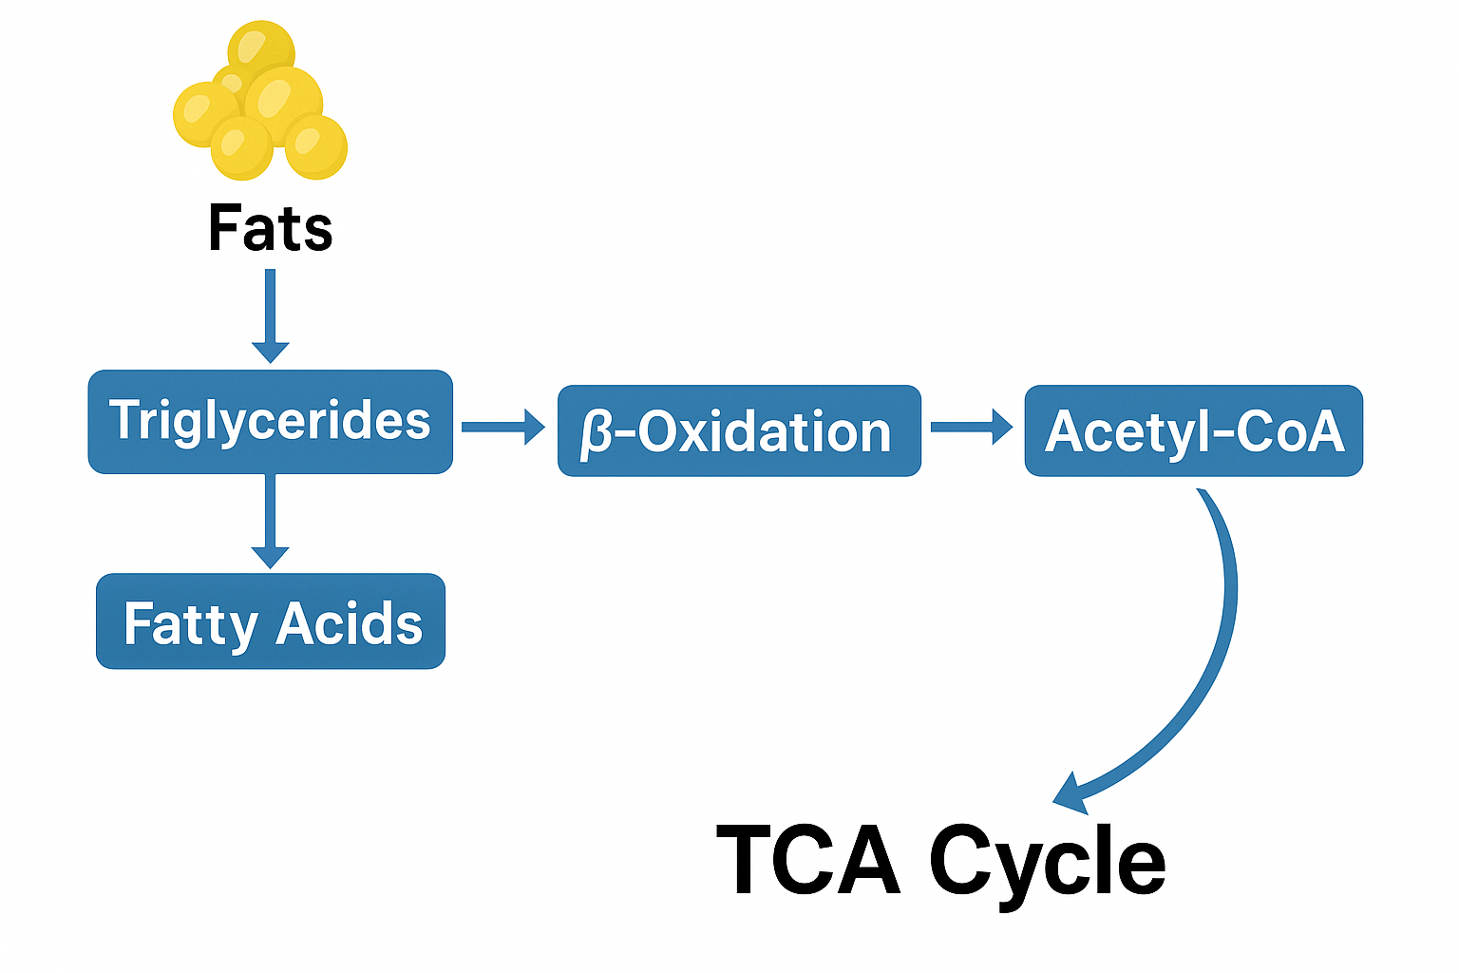
How Fats Feed Into the
TCA Cycle
Fat → Fatty Acids → β-oxidation → Acetyl-CoA
    Fatty acids undergo β-oxidation in mitochondria.
    Each cycle of β-oxidation releases one Acetyl-CoA.
    These Acetyl-CoA molecules enter the TCA cycle.
  Why fats produce more ATP:
    Fatty acids have long carbon chains → many Acetyl-CoA units → multiple turns of the TCA cycle.
Notes:
Fat metabolism happens in three major steps:
Mobilization – breaking down stored fat
β-Oxidation – chopping fatty acids into acetyl-CoA units
TCA Cycle Entry – acetyl-CoA is oxidized for ATP
Acetyl-CoA needs oxaloacetate (OAA) to enter the TCA cycle.
OAA comes primarily from:
Carbohydrate metabolism (pyruvate → OAA via pyruvate carboxylase)
Some amino acids (aspartate → OAA)
If carbs are too low:
OAA drops
Acetyl-CoA cannot enter the TCA cycle
Acetyl-CoA is diverted → ketone body production
This explains:
Why fasting increases ketones
Why low-carb diets enhance fat oxidation
Why extreme carb deficits slow the TCA cycle

Slide 16
Beta-Oxidation
Occurs in mitochondria
Fatty acids broken down 2 carbons at a time → acetyl-CoA
Produces large amounts of NADH/FADH₂ → ATP
Example: Palmitate produces ~106 ATP
Activated during fasting, aerobic exercise, and low-carb diets.
Notes:
“Beta-oxidation occurs in the mitochondria and breaks down fatty acids two carbons at a time into acetyl-CoA.
This is a highly efficient process. For example, a typical fatty acid like palmitate yields about 106 ATP—much more than glucose. Beta-oxidation is especially important during fasting, endurance exercise, or low-carbohydrate diets.”

Slide 17
Lipogenesis
"Creating fat" from carbohydrates and protein
Occurs in liver & adipose
Insulin stimulates lipogenesis after high-carb meals
Fatty acid synthase is key enzyme
Stores excess energy as triglycerides
Notes:
“Lipogenesis is the creation of fat from excess carbohydrates and protein. It occurs mainly in the liver and adipose tissue.
When insulin levels are high, such as after a high-carbohydrate meal, the body stores extra glucose as fat. Fatty acid synthase is a key enzyme in this process.”

Slide 18
Ketogenesis
Occurs in liver mitochondria
When carbs are low: acetyl-CoA builds up → ketone bodies
Provides energy for brain, heart, and muscle during fasting
Ketones: acetoacetate, β-hydroxybutyrate, acetone
Important adaptation for starvation.
Notes:
“When carbohydrate intake is low, or during prolonged fasting, the liver converts acetyl-CoA into ketone bodies.
These ketones—acetoacetate, beta-hydroxybutyrate, and acetone—provide an alternative energy source for the brain, heart, and muscles. Ketogenesis is a crucial survival mechanism during starvation.”

Slide 19
Protein Metabolism
Proteins are broken down into amino acids, used for:
Muscle & tissue growth
Enzymes, hormones, immune function
Energy production when needed
Not a primary energy source unless fasting, illness, or low-carb states.
4 kcal/g
Roles: structure, enzymes, hormones, transport, acid–base balance
Notes:
Proteins are broken into amino acids, used for:
Muscle & tissue growth
Enzymes, hormones, immune function
Energy production when needed
Not a primary energy source unless fasting, illness, or low-carb states.

Slide 20
Digestion and Absorption
Pepsin, pancreatic proteases (trypsin, chymotrypsin)
Absorbed as AAs & small peptides
Notes:
Stomach: HCl denatures proteins, pepsin begins the breakdown
Small intestine: Pancreatic enzymes (trypsin, chymotrypsin) complete digestion
Amino acids absorbed into the bloodstream → liver

Slide 21
Amino Acid Pool
The amino acid pool refers to the constant supply of free amino acids circulating in the body at any given time and is protein synthesis, hormone production, neurotransmitters, immune function, glucose (via gluconeogenesis), and energy production when needed. This pool is dynamic and comes from:
  Dietary protein digestion
  – Amino acids absorbed from the intestines
  Breakdown of endogenous proteins
  – Muscle, enzymes, hormones, cellular proteins
  De novo synthesis
  – The body produces some nonessential amino acids from metabolic intermediates
Notes:
Only ~90–100 grams at a time
Constantly turning over
Much smaller than carbohydrate or fat stores
Must be continually replenished because the body does not store excess amino acids

Slide 22
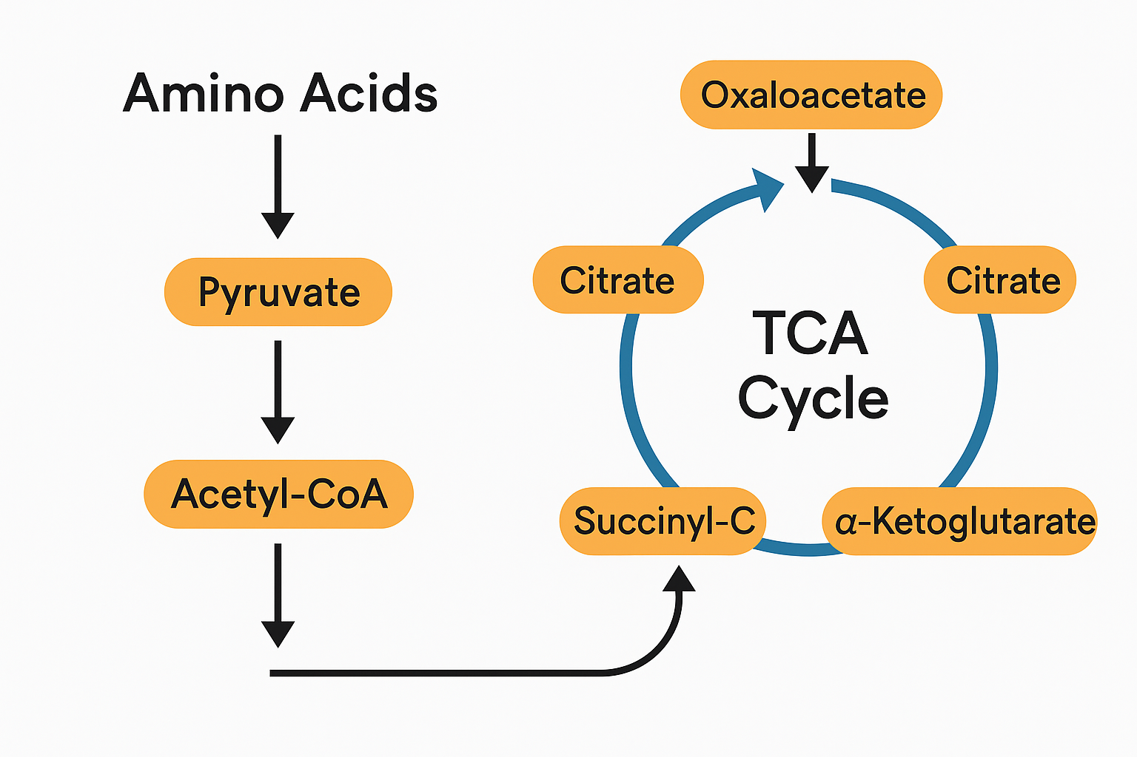
How Amino Acids Feed into
the TCA Cycle
Amino acids enter the TCA cycle by being converted into intermediates of the cycle after undergoing:
Transamination
Transfer of the amino group to form α-keto acids.
Deamination
Removal of the amino group, often producing ammonia → urea cycle.
The remaining carbon skeletons then enter the TCA cycle.
Notes:
Amino acid entry into the TCA cycle affects:
ATP production
Ketone formation
Glucose synthesis (gluconeogenesis)
Hormone synthesis
Detoxification (requires ATP)
Brain neurotransmitters
Muscle recovery & metabolism
Proteins are not just structural—they are major metabolic fuels.

Slide 23
Deamination & Transamination
Amino acids cannot be used for energy unless the nitrogen-containing amino group (–NH₂) is removed or transferred. This happens through two key reactions:
  Transamination is the process of transferring an amino group from one amino acid to a keto acid to form a new amino acid (creates non-essential amino acids, moves nitrogen safely to glutamate, the central collector of nitrogen, prepares amino acids for energy metabolism, gluconeogenesis, or fat synthesis) *all requires vitamin B6
  Deamination is the direct removal of an amino group (NH₂) from glutamate, resulting in the release of free ammonia (NH₃) (makes carbon skeletons available for energy use (TCA cycle intermediates, produces ammonia → converted to urea, regulates nitrogen levels in the body)
**Transamination moves nitrogen → Deamination releases it
→ Urea cycle removes it
Notes:
Amino acids cannot be used for energy until their nitrogen (amino group) is removed or transferred. This requires two major biochemical processes.
Convert amino acids into TCA cycle intermediates - This allows amino acids to be used for energy production.
Transamination: swap amino groups between amino acids—important for synthesis
Deamination: removal of NH₃ group → toxic ammonia
Ammonia enters urea cycle to be detoxified

Slide 24
Urea Cycle
The urea cycle (also called the ornithine cycle) is the body’s primary pathway for safely eliminating ammonia, a toxic byproduct of amino acid catabolism. It primarily occurs in the liver, with some activity also present in the kidneys.
Amino acids are deaminated, removing the amino (NH₂) group.
This produces ammonia (NH₃) — extremely toxic to the brain even at modest levels.
The liver converts ammonia → urea, which is far less toxic and water-soluble.
Urea travels via the bloodstream → kidneys → urine.
Notes:
The urea cycle is the body’s primary biochemical pathway for removing toxic ammonia generated during protein and amino acid metabolism.
It takes place mainly in the liver, partly in the mitochondria and partly in the cytosol.
The urea cycle converts:
Ammonia (NH₃) → Urea → urine (safe for excretion)
This prevents ammonia from accumulating in the blood, where it would quickly become life-threatening.

Slide 25
Summary Table: Metabolism & Biochemical Pathways of Macronutrients
Macronutrient | Entry to TCA Cycle | Key Notes
Carbohydrates | Pyruvate → Acetyl-CoA | Requires O₂; depends on B1
Fats | β-oxidation → Acetyl-CoA | High ATP yield; requires B2, B3, B5, Carnitine
Proteins | Various intermediates | Requires B6, B9, B12

Slide 26
Micronutrient Metabolism-
(biochemical pathways & reactions)
B-vitamins act as coenzymes in metabolic pathways (glycolysis, TCA, AA metabolism)
Vitamin C roles: collagen synthesis, immune support, antioxidant
Excess water-soluble vitamins are generally excreted, not stored. (water- & fat-soluble)
Minerals & trace elements
Notes:
B-vitamins act as coenzymes in metabolic pathways (glycolysis, TCA, AA metabolism)
Vitamin C roles: collagen synthesis, immune support, antioxidant
Excess water-soluble vitamins generally excreted, not stored.

Slide 27
Key Water-Soluble Vitamins
Water-soluble vitamins serve primarily as coenzymes—helpers that activate metabolic enzymes. They are not stored extensively, so regular dietary intake is essential.
B-vitamins as coenzymes in:
    Carbohydrate metabolism (B1, B2, B3)
    Amino acid metabolism (B6)
    DNA synthesis (B9, B12)
Vitamin C: antioxidant, collagen synthesis
Notes:
B-vitamins act as coenzymes in metabolic pathways (glycolysis, TCA, AA metabolism)

Slide 28
Vitamin B1 (Thiamine)
Metabolic Role
Thiamin is converted to Thiamin Pyrophosphate (TPP), a coenzyme used in carbohydrate metabolism.
Key Pathways Requiring TPP
Pyruvate → Acetyl-CoA (pyruvate dehydrogenase complex)
→ Bridges glycolysis to the TCA cycle
α-ketoglutarate → succinyl-CoA (TCA cycle)
Branched-chain amino acid metabolism (leucine, isoleucine, valine)
Pentose Phosphate Pathway (transketolase)
→ generates NADPH for fatty acid synthesis and antioxidant defense
Why It Matters
Without B1, carbohydrates cannot be fully oxidized → leading to lactic acidosis and low ATP.

Slide 29
Vitamin B2 (Riboflavin)
Metabolic Role
Converted to:
FAD (Flavin Adenine Dinucleotide)
FMN (Flavin Mononucleotide)
These are critical electron carriers.
Key Pathways Requiring FAD or FMN
TCA cycle: succinate → fumarate (succinate dehydrogenase uses FAD)
Fatty acid β-oxidation: acyl-CoA dehydrogenase requires FAD
Electron Transport Chain: Complex I and II use FMN/FAD
Why It Matters
Riboflavin deficiency reduces ATP generation from both fats and carbohydrates.

Slide 30
Vitamin B3 (Niacin)
Metabolic Role
Converted to NAD⁺ and NADP⁺.
Key Roles
NAD⁺: Catabolic reactions → ATP production
  glycolysis
  pyruvate dehydrogenase
  TCA cycle
  Beta oxidation
NADP⁺: Anabolic reactions
  Fatty acid synthesis
  Cholesterol synthesis
  Detoxification (cytochrome P450)
Special Note
The body can synthesize niacin from tryptophan—needs B6 for conversion.

Slide 31
Vitamin B5 (Pantothenic Acid)
Metabolic Role
Component of CoA (Coenzyme A) and Acyl Carrier Protein (ACP).
Key Pathways
Formation of Acetyl-CoA → central to ALL macronutrient metabolism
Fatty acid synthesis & oxidation
Cholesterol synthesis
Steroid hormone synthesis
Pantothenic acid is everywhere in metabolism—deficiency is rare.

Slide 32
Vitamin B6 (Pyridoxine)
Metabolic Role
Converted to PLP (Pyridoxal phosphate).
Key Functions
Transamination reactions → amino acid metabolism
Glycogen breakdown: glycogen phosphorylase requires PLP
Neurotransmitter synthesis (serotonin, dopamine, GABA)
Hemoglobin synthesis
Required for conversion of:
  tryptophan → niacin
  homocysteine → cysteine
Importance
Central to protein metabolism, nitrogen balance, and neurotransmitter production.

Slide 33
Vitamin B7 (Biotin)
Metabolic Role
Converted to PLP (Pyridoxal phosphate).
Key Functions
Transamination reactions → amino acid metabolism
Glycogen breakdown: glycogen phosphorylase requires PLP
Neurotransmitter synthesis (serotonin, dopamine, GABA)
Hemoglobin synthesis
Required for conversion of:
  tryptophan → niacin
  homocysteine → cysteine
Importance
Central to protein metabolism, nitrogen balance, and neurotransmitter production.

Slide 34
Vitamin B9 (Folate)
Metabolic Role
Converted to THF (tetrahydrofolate), a one-carbon donor.
Key Functions
DNA and RNA synthesis (purines & thymidine)
Methionine cycling (homocysteine → methionine)
Growth and cell division (important in pregnancy)
Metabolic Interaction
Folate is tightly linked with B12 metabolism.

Slide 35
Vitamin B12 (Cobalamin)
Metabolic Role
Coenzyme for:
Methionine synthase
  Regenerates methionine from homocysteine
  Works with folate
Methylmalonyl-CoA mutase
  Converts methylmalonyl-CoA to succinyl-CoA
  → Important for fat and amino acid metabolism
Absorption Dependency
Requires:
Intrinsic factor (stomach)
Healthy ileum
Adequate stomach acid
Why It Matters
Deficiency causes both neurological and hematologic problems.

Slide 36
Vitamin C (Ascorbic Acid)
Metabolic Role
Powerful antioxidant and enzyme cofactor.
Functions
Collagen synthesis
(cofactor for prolyl and lysyl hydroxylases)
Enhances iron absorption (Fe³⁺ → Fe²⁺)
Involved in bile acid synthesis
Supports immune function
Catecholamine (epinephrine) synthesis
Regenerates vitamin E
Why It Matters
Essential for connective tissue strength, wound healing, and antioxidant responses.

Slide 37
Summary Table: Metabolism & Biochemical Pathways of Water-Soluble Vitamins
Vitamin | Coenzyme Form | Major Metabolic Role
B1 | TPP | Carbohydrate metabolism, TCA entry, PPP
B2 | FAD/FMN | Redox reactions, ETC, beta-oxidation
B3 | NAD⁺/NADP⁺ | Energy metabolism & anabolic synthesis
B5 | CoA | Central hub for carbs, fats, proteins
B6 | PLP | Amino acid metabolism, neurotransmitters
B7 | Biotin | Carboxylation reactions
B9 | THF | DNA synthesis, one-carbon metabolism
B12 | Methylcobalamin/adenosylcobalamin | Fat & amino acid metabolism, methionine cycle
C | Ascorbate | Antioxidant, collagen formation

Slide 38
Fat Soluble Vitamins
Fat-soluble vitamins are absorbed with dietary lipids, transported in chylomicrons, stored in liver and adipose tissue, and used in gene regulation, enzymatic reactions, antioxidant defense, and coagulation pathways.
Their metabolism is deeply tied to lipid digestion, bile acid secretion, and liver function.
Notes:
Vitamin A: vision, gene expression
Vitamin D: calcium absorption, bone health
Vitamin E: antioxidant
Vitamin K: blood clotting
Stored in liver and fatty tissue; toxicity more likely than water-soluble vitamins.

Slide 39
Vitamin A (Retinoids & Carotenoids)
Metabolic Roles
Regulates gene expression in epithelial cells, immune cells, adipocytes, and stem cells.
Essential for visual phototransduction via the retinoid cycle.
Supports growth, reproduction, immune function, and tissue repair.
B. Activation Pathway
Retinol → Retinal
Enzyme: Retinol dehydrogenase (RDH)
Retinal → Retinoic Acid
Enzyme: Retinaldehyde dehydrogenase (RALDH)
Retinoic acid → nuclear receptors (RAR, RXR)
→ Gene transcription
→ Cell differentiation, epithelial integrity
C. Vision (Retinoid Cycle)
11-cis-retinal forms rhodopsin in rods
Light converts it to all-trans retinal
Recycled back to cis form in RPE cells
Why It Matters
Deficiency → night blindness, keratinization, impaired immunity, Essential for growth and tissue repair, Required for the integrity of the skin, GI tract, respiratory tissue, Toxicity is possible due to liver storage
10
Notes:
After absorption, retinol is re-esterified and enters chylomicrons for transport to the liver.
The liver stores large amounts of vitamin A as retinyl esters and releases retinol bound to RBP (retinol-binding protein).
In the metabolic pathway, retinol is oxidized to retinal, and then to retinoic acid, the hormonally active form.
Retinoic acid regulates gene expression through nuclear receptors RAR and RXR, influencing cell differentiation, immune function, and epithelial integrity.
The retinoid cycle in the eye is a separate biochemical pathway where 11-cis retinal converts light into nerve signals.
Vitamin A deficiency impairs immunity, disrupts epithelial tissue, and leads to night blindness because the retinoid cycle cannot regenerate 11-cis retinal.
Excess intake may cause toxicity because the liver stores significant amounts.

Slide 40
Vitamin D (D₂/D₃)
Metabolic Roles
Acts as a hormone, not just a vitamin
Regulates calcium and phosphate homeostasis
Influences muscle function, immunity, bone remodeling, gene expression
Biochemical Pathways
A. Absorption & Endogenous Production
D3 synthesized from UVB + 7-dehydrocholesterol in skin
Dietary D2/D3 absorbed with fats → chylomicrons → liver
B. Activation Steps (“Hydroxylation Pathway”)
In Liver
Vitamin D → 25-hydroxy Vitamin D (Calcidiol)
Enzyme: CYP2R1
In Kidney
25-OH-D → 1,25-dihydroxy Vitamin D (Calcitriol)
Enzyme: CYP27B1
Regulated by PTH, Ca²⁺, phosphate
C. Hormone Action
Calcitriol binds Vitamin D Receptor (VDR) → nuclear modulation of:
Calcium transporter synthesis
Bone mineralization pathways
Immune cell regulation
Insulin secretion and sensitivity
Functions
↑ Ca and P absorption in gut
Maintains bone structure
Enhances neuromuscular function
Regulates >900 genes
Why It Matters
Deficiency → rickets, osteomalacia, muscle weakness
Linked to autoimmune risk, insulin dysregulation
Liver or kidney disease severely affects activation
Notes:
Vitamin D functions more like a steroid hormone than a traditional vitamin.
It is obtained from sunlight (conversion of 7-dehydrocholesterol) or dietary sources and absorbed with fats.
The first step of activation occurs in the liver, where vitamin D is converted to 25-hydroxyvitamin D, the major circulating form used to assess status.
The second step happens in the kidney, generating 1,25-dihydroxyvitamin D (calcitriol), the biologically active hormone.
Calcitriol binds the Vitamin D receptor (VDR), forming a VDR–RXR complex that influences transcription of calcium-binding proteins and hundreds of genes related to immunity, muscle function, growth, and inflammation.
Vitamin D enhances intestinal absorption of calcium and phosphate, helps maintain bone mineralization, and regulates PTH.
Deficiency leads to rickets in children, osteomalacia in adults, muscle weakness, and increased fracture risk.
Activation depends on kidney function; patients with kidney disease cannot fully activate vitamin D.

Slide 41
Vitamin E (α-Tocopherol)
Metabolic Roles
Primary lipid-soluble antioxidant
Protects membranes, LDL particles, mitochondrial lipids
Required for protecting PUFAs from peroxidation
Biochemical Pathways
A. Absorption
Micelle → enterocyte → chylomicrons → liver
Liver selects α-tocopherol using α-TTP
Transported to tissues in VLDLs
B. Antioxidant Pathway
Vitamin E donates hydrogen → neutralizes lipid radicals
Becomes tocopheroxyl radical
Regenerated by:
  Vitamin C
  Glutathione (via glutathione reductase)
C. Interactions With Other Nutrients
Works with selenium via glutathione peroxidase system
Protects Vitamin A from oxidation
Prevents hemolysis in RBCs
Functions
Prevents oxidative damage to:
  Cell membranes
  Lipoproteins
  Mitochondrial membranes
Supports immune function
Regulates inflammatory signaling (inhibits PKC)
Why It Matters
Deficiency → hemolytic anemia, neuropathy, muscle weakness
Critical when PUFA intake is high
Protects cardiovascular and neurological health
Notes:
Vitamin E (α-tocopherol) is the primary lipid-soluble antioxidant in human tissues.
It is absorbed with dietary fat into chylomicrons and transported to the liver, where α-TTP selects α-tocopherol and loads it into VLDL for systemic release.
Its central biochemical role is preventing lipid peroxidation in cell membranes and lipoproteins.
When a free radical attacks a fatty acid, vitamin E donates an electron or hydrogen to neutralize it.
This converts vitamin E to a tocopheroxyl radical, which must be regenerated by vitamin C or glutathione enzymes.
Vitamin E protects PUFAs, mitochondrial membranes, RBCs, and LDL particles from oxidative damage.
It also modulates signaling pathways such as PKC and reduces inflammatory responses.
Deficiency is rare but can occur in fat-malabsorption conditions, causing neuromuscular problems and hemolytic anemia due to fragile RBC membranes.
Adequate vitamin E is especially important with high-PUFA diets because PUFAs are highly vulnerable to oxidation.

Slide 42
Vitamin K (K₁ & K₂)
Metabolic Roles
Required for γ-carboxylation reactions
Allows proteins to bind calcium
Essential for coagulation and bone metabolism
Biochemical Pathways
Absorption
Similar to other fat-soluble vitamins
K₂ also produced by gut bacteria
Vitamin K Cycle (Key Metabolic Pathway)
Vitamin K quinone → reduced to hydroquinone. Enzyme: Vitamin K reductase
Hydroquinone is cofactor for γ-glutamyl carboxylase
  Adds CO₂ to glutamate → Gla residues
Gla-containing proteins:
  Prothrombin (II)
  Factors VII, IX, X
  Proteins C & S
  Osteocalcin, MGP (bone proteins)
Vitamin K epoxide is recycled by VKORC1
  Warfarin blocks this → anticoagulation
Functions
Blood clotting cascade activation
Bone mineralization
Prevention of vascular calcification
Activation of osteocalcin
Why It Matters
Deficiency → bleeding risk, weak bones
Crucial for patients on warfarin
Important for cardiovascular and bone health
Notes:
Vitamin K includes phylloquinone (K₁ from plants) and menaquinones (K₂ from bacteria and fermented foods).
Like all fat-soluble vitamins, it requires bile and dietary fat for absorption and travels in chylomicrons to the liver.
The Vitamin K cycle is the major biochemical pathway:
Vitamin K is reduced to its hydroquinone form.
Hydroquinone acts as a cofactor for γ-glutamyl carboxylase, an enzyme that adds CO₂ to glutamate residues on specific proteins.
These modified proteins (Gla-proteins) can now bind calcium.
This pathway is critical for activation of coagulation proteins II, VII, IX, X, and proteins C and S.
Vitamin K is also required for osteocalcin and matrix Gla-protein, which regulate bone mineralization and prevent vascular calcification.
The oxidized form of vitamin K is recycled by VKORC1, which is inhibited by warfarin, explaining drug–nutrient interactions.
Deficiency leads to poor blood clotting and bone abnormalities but is rare in adults unless fat malabsorption or liver disease is present.

Slide 43
Summary Table: Metabolism & Biochemical Pathways of Fat-Soluble Vitamins
Vitamin | Main Metabolic Role | Biochemical Pathways | Why It Matters
A | Gene regulation, vision | Retinoid cycle, RA nuclear signaling | Immunity, epithelial health, vision, development
D | Hormone regulating Ca/P | Liver 25-hydroxylation, kidney 1-α-hydroxylation | Bone, muscle, immune health
E | Lipid antioxidant | Antioxidant cycle, α-TTP transport | Protects cells from oxidation, neurological health
K | Ca-binding protein activation | Vitamin K epoxide cycle | Coagulation, bone health, prevents calcification

Slide 44
Minerals
Minerals support metabolism at three essential levels:
Structural Roles
  Some minerals (such as calcium, phosphorus, magnesium, and fluoride) form the hydroxyapatite matrix of bone and teeth.
  These minerals determine the body’s structural integrity, and deficiencies weaken foundational tissues.
Cofactor Roles in Enzyme Pathways
  Many minerals serve as enzyme cofactors, meaning they activate key enzymes throughout metabolic pathways.
  Minerals often act as “molecular switches” that turn biochemical pathways on or off.
Regulatory & Signaling Roles
  Minerals such as sodium, potassium, calcium, chloride, and magnesium support:
  These minerals ensure that metabolic processes across cells and organs coordinate effectively.
Notes:
Minerals are essential inorganic elements that play foundational roles in human metabolism. Although needed in much smaller amounts than macronutrients, minerals are critical for enzyme activation, energy production, nerve function, cellular signaling, and structural integrity of tissues such as bone and teeth.
Unlike macronutrients, minerals do not provide energy directly, nor do they undergo catabolic or anabolic changes. Instead, they act as cofactors, structural components, and regulators that allow biochemical pathways to function efficiently and precisely. Without minerals, most metabolic reactions would slow dramatically or stop altogether.

Slide 45
Major Minerals - Calcium
Metabolic Role
Structural component of bones and teeth
Key regulator of nerve transmission, muscle contraction, and vascular function
Second messenger in hormonal signaling
Biochemical Pathways
Vitamin D–D-dependent active transport in intestines
Muscle contraction pathway (Ca binds troponin C → actin–myosin interaction)
Blood clotting cascade (factors II, VII, IX, X require Ca)
Calmodulin signaling in endocrine pathways
Why It Matters
Deficiency → osteoporosis, tetany, arrhythmias
Central to bone health across the lifespan
Calcium metabolism is tightly linked with vitamin D, PTH, and magnesium
Notes:
“Calcium is far more than a structural mineral. It plays a dynamic biochemical role in virtually every cell.”
Metabolic Roles
Acts as a second messenger in hormone signaling (e.g., insulin release).
Drives muscle contraction by binding troponin C.
Supports nerve transmission by triggering neurotransmitter release.
Required for blood clotting as a cofactor in multiple steps of the coagulation cascade.
Biochemical Pathways
Calcium–calmodulin pathway: regulates enzymes involved in metabolism, smooth muscle contraction, and cellular responses.
Vitamin D activation pathway: Vitamin D increases calcium absorption via TRPV6 and calbindin.
Bone remodeling cycle: calcium is constantly deposited and resorbed in hydroxyapatite matrix.
“Emphasize that calcium is not just a bone mineral — it is essential for metabolic communication within cells.”

Slide 46
Phosphorus
Metabolic Role
Primary structural components of ATP, nucleic acids, and phospholipids
Part of the bone and acid–base balance
Biochemical Pathways
Required for phosphorylation reactions (activating enzymes)
Integral to glycolysis and TCA intermediates
Essential for 2,3-BPG in RBCs (oxygen release)
Structural building block of membranes
Why It Matters
Without phosphorus, ATP cannot exist
Deficiency rare but an imbalance affects bone health and acid-base balance
Notes:
“Phosphorus drives every reaction that uses or produces energy.”
Metabolic Roles
Forms the backbone of ATP, ADP, AMP.
Needed for phosphorylation reactions that turn metabolic pathways on and off.
Supports bone mineralization alongside calcium.
Biochemical Pathways
Glycolysis: glucose → glucose-6-phosphate and fructose-1,6-bisphosphate.
TCA intermediates involve multiple phosphate-containing compounds.
2,3-BPG pathway in RBCs regulates oxygen delivery.
Cell membrane synthesis: via phospholipids.
“Without phosphorus, ATP cannot exist — therefore no metabolic pathway can run.”

Slide 47
Magnesium
Metabolic Role
Cofactor in >300 metabolic enzymes
Stabilizes ATP and nucleic acids
Required for muscle and nerve function
Biochemical Pathways
ATP reactions (Mg-ATP is the biologically active form)
Glycolysis & TCA enzymes
DNA/RNA polymerases
Protein synthesis ribosomal activity
Calcium homeostasis (antagonist to Ca)
Why It Matters
Deficiency → cramps, arrhythmias, insulin resistance
Critical in metabolic disorders and cardiovascular health
Notes:
“Magnesium is the most important mineral for ATP function and enzyme activation.”
Metabolic Roles
Stabilizes ATP (true active form is Mg-ATP).
Cofactor for >300 metabolic enzymes.
Supports nerve and muscle function by regulating calcium transport.
Biochemical Pathways
Glycolysis: hexokinase, PFK, pyruvate kinase require magnesium.
TCA cycle: citrate synthase, isocitrate dehydrogenase, α-ketoglutarate dehydrogenase.
β-oxidation: required for acyl-CoA enzymes.
DNA/RNA synthesis: stabilizes nucleic acids and ribosomes.
“Magnesium is the ‘metabolic spark plug’—without it, ATP cannot work.”

Slide 48
Sodium
Metabolic Role
Major extracellular cation
Key to fluid balance, blood volume, and nerve signaling
Biochemical Pathways
Sodium–potassium pump (Na⁺/K⁺ ATPase)
Co-transport of glucose and amino acids
Acid–base balance
Why It Matters
Dysregulation causes hypertension, dehydration, and neurological impairment
Notes:
“Sodium drives the electrical activity of the body and fuels nutrient absorption.”
Metabolic Roles
Maintains extracellular fluid volume.
Drives the Na⁺/K⁺ ATPase pump, which consumes ~40% of resting metabolic energy.
Required for glucose and amino acid absorption via SGLT and symporters.
Biochemical Pathways
Membrane depolarization: essential in nerve transmission.
Renal sodium handling: aldosterone-controlled pathway.
Electrochemical gradients: power secondary active transport.
“Sodium is metabolically expensive to maintain but essential for life.”

Slide 49
Potassium
Metabolic Role
Major intracellular cation
Regulates the electrical activity of cells
Biochemical Pathways
Resting membrane potential
Na⁺/K⁺ ATPase pump
Insulin secretion pathway
Why It Matters
Deficiency causes arrhythmia, fatigue, and muscle weakness
Essential for a healthy heart rhythm
Notes:
“Potassium is the master regulator of cellular electrical activity.”
Metabolic Roles
Maintains resting membrane potential.
Required for insulin secretion in response to rising blood glucose.
Critical for muscle and cardiac electrical activity.
Biochemical Pathways
Na⁺/K⁺ ATPase: potassium enters as sodium exits.
Cardiac action potentials: K⁺ efflux repolarizes the heart.
Protein synthesis: intracellular K⁺ required for ribosomal function.
“Potassium is the key ion that keeps cells electrically stable.”

Slide 50
Chloride
Metabolic Role
Maintains electroneutrality
Assists with digestion (component of HCl)
Biochemical Pathways
HCl production in the stomach
Chloride shift in RBCs (CO₂ transport)
Why It Matters
Essential for GI function and CO₂ transport
Notes:
“Chloride quietly underpins digestion and acid–base balance.”
Metabolic Roles
Maintains electrical neutrality with sodium and potassium.
Forms HCl in the stomach for digestion.
Biochemical Pathways
Chloride shift (Hamburger shift): vital for CO₂ transport.
Acid-base balance via bicarbonate–chloride exchange.
“Without chloride, we couldn't digest protein or transport CO₂.”

Slide 51
Trace Minerals - Iron
Metabolic Role
Central to oxygen transport and oxidative metabolism
Biochemical Pathways
Electron transport chain (cytochromes)
Hemoglobin & myoglobin synthesis
Catalase & peroxidase activity
DNA synthesis (ribonucleotide reductase)
Why It Matters
Deficiency → anemia, fatigue, cognitive impairment
Excess causes oxidative stress
Notes:
“Iron is essential for oxygen transport AND for creating ATP.”
Metabolic Roles
Central to hemoglobin/myoglobin.
Required for immune function and brain development.
Biochemical Pathways
Electron transport chain (cytochromes): iron cycles between Fe²⁺ and Fe³⁺.
DNA synthesis: via ribonucleotide reductase.
Heme synthesis pathway: requires iron-loading via ferrochelatase.
“ATP production collapses in iron deficiency.”

Slide 52
Zinc
Metabolic Role
Cofactor in >300 enzymes
DNA/protein synthesis and immune function
Biochemical Pathways
Zinc finger transcription factors
Superoxide dismutase
RNA/DNA polymerases
Why It Matters
Deficiency → poor wound healing, immune dysfunction
Notes:
Metabolic Roles
Essential for DNA and protein synthesis.
Cofactor in over 300 enzymes.
Biochemical Pathways
Zinc-finger transcription factors control gene expression.
Carbonic anhydrase (acid-base balance).
Superoxide dismutase (antioxidant defense).
Polymerases for DNA/RNA replication.
“Zinc controls gene expression — deficiency affects growth, immunity, and repair.”

Slide 53
Copper
Metabolic Role
Required for redox reactions & iron metabolism
Biochemical Pathways
ETC (cytochrome c oxidase)
Ceruloplasmin (iron transport)
Dopamine → norepinephrine conversion
Collagen cross-linking (lysyl oxidase)
Why It Matters
Deficiency mimics iron deficiency
Critical for mitochondria and connective tissue
Notes:
Metabolic Roles
Redox reactions for energy production.
Required for iron mobilization and collagen formation.
Biochemical Pathways
Cytochrome c oxidase (ETC complex IV).
Ceruloplasmin → iron oxidation (Fe²⁺ → Fe³⁺).
Lysyl oxidase → collagen crosslinking.
Antioxidant enzyme SOD.
“Copper and iron metabolism are deeply linked — deficiency mimics anemia.”

Slide 54
Selenium
Metabolic Role
Antioxidant and thyroid regulator
Biochemical Pathways
Glutathione peroxidase
Thioredoxin reductase
Thyroid hormone conversion (T4→T3)
Why It Matters
Deficiency slows metabolic rate, affects immune function
Notes:
Metabolic Roles
Antioxidant defense (selenoproteins).
Thyroid hormone conversion.
Biochemical Pathways
Glutathione peroxidase (reduces hydrogen peroxide).
Thioredoxin reductase.
Deiodinase converts T4 → T3.
“Selenium deficiency slows metabolism and increases oxidative stress.”

Slide 55
Iodine
Metabolic Role
Essential for thyroid hormone synthesis
Biochemical Pathways
Thyroid peroxidase iodination
T3/T4 hormone production
Regulation of basal metabolic rate
Why It Matters
Deficiency → goiter, hypothyroidism, cognitive impairment in children
Notes:
Metabolic Roles
Required for synthesis of thyroid hormones.
Biochemical Pathways
Iodination of tyrosine residues on thyroglobulin.
Production of T3 and T4.
Regulation of metabolic rate via thyroid receptors.
Key Teaching Message:
“Without iodine, metabolism slows — this is why deficiency causes fatigue and weight gain.”

Slide 56
Manganese
Metabolic Role
Cofactor in bone formation and the urea cycle
Biochemical Pathways
Mn-superoxide dismutase
Arginase (urea cycle
Pyruvate carboxylase
Why It Matters
Deficiency → skeletal abnormalities
Notes:
Metabolic Roles
Bone formation and urea cycle activity.
Antioxidant defense.
Biochemical Pathways
Mn-superoxide dismutase (mitochondrial antioxidant).
Arginase in the urea cycle.
Pyruvate carboxylase (gluconeogenesis).
“Manganese is a silent but essential cofactor in mitochondrial defense.”

Slide 57
Chromium
Metabolic Role
Enhances insulin action
Biochemical Pathways
Chromodulin complex is involved in insulin receptor signaling
Why It Matters
Deficiency may impair glucose tolerance
Notes:
Metabolic Roles
Enhances insulin action.
Biochemical Pathways
Chromodulin binds to insulin receptors → enhances glucose uptake.
“Chromium supports insulin sensitivity — important in glucose regulation.”

Slide 58
Molybdenum
Metabolic Role
Cofactor for detoxification and metabolism enzymes
Biochemical Pathways
Xanthine oxidase
Sulfite oxidase
Aldehyde oxidase
Why It Matters
Necessary for sulfur metabolism
Notes:
Metabolic Roles
Detoxification and amino acid metabolism.
Biochemical Pathways
Xanthine oxidase
Sulfite oxidase
Aldehyde oxidase
“Molybdenum is crucial for sulfur metabolism and detoxification.”

Slide 59
Flouride
Metabolic Role
Strengthens bone and tooth structure
Biochemical Pathways
Conversion of hydroxyapatite → fluorapatite
Remineralization of enamel
Functions
Prevents cavities
Supports bone integrity
Why It Matters
Low fluoride increases dental caries risk
Notes:
Metabolic Roles
Structural support for bones and teeth.
Biochemical Pathways
Converts hydroxyapatite → fluorapatite
Enhances remineralization
Reduces bacterial acid production
“Fluoride strengthens mineralized tissues and protects against decay.”

Slide 60
Why the TCA Cycle is the "Hub" of Metabolism
All macronutrients → Acetyl-CoA → TCA cycle
✔ Requires several micronutrients
B1 (Thiamine) – Pyruvate dehydrogenase
B2 (Riboflavin) – FAD
B3 (Niacin) – NAD
B5 (Pantothenic Acid) – CoA
Magnesium – enzyme cofactor
Lipoic acid – PDH complex
✔ Provides intermediates for biosynthesis
α-Ketoglutarate → neurotransmitters
Succinyl-CoA → heme synthesis
Citrate → fatty acid synthesis
Oxaloacetate → gluconeogenesis
✔ Connects with multiple pathways
Glycolysis
β-oxidation
Amino acid catabolism
Electron transport chain
Anaplerotic reactions (refill cycle intermediates)

Slide 61
The Electron Transport Chain
The TCA cycle and the Electron Transport Chain are tightly linked mitochondrial pathways that together convert nutrients into large amounts of ATP. The TCA Cycle = Electron Generating System.
✔ The TCA cycle provides the electron carriers (NADH and FADH₂) that feed electrons into the Electron Transport Chain, which in turn uses those electrons to produce most of the cell’s ATP.
✔The TCA cycle oxidizes:
Acetyl-CoA from carbohydrates
Fatty acids
Amino acids
And produces the reduced coenzymes:
3 NADH
1 FADH₂
per turn of the cycle.
These reduced coenzymes are high-energy electron carriers.
✔The ETC takes the electrons from:
NADH
FADH₂
And uses them to:
Pump protons (H⁺) into the intermembrane space
Generate a proton motive force
Produce ATP via ATP synthase
Notes:
The TCA cycle depends on a continuous supply of:
NAD⁺
FAD
The only major source of NAD⁺ and FAD regeneration is the ETC.
If ETC slows down:
NADH and FADH₂ accumulate
NAD⁺ and FAD fall
TCA cycle enzymes can’t function
Pyruvate can’t enter TCA
Lactate increases (anaerobic backup)
ATP falls
Fatigue rises
This is why ETC → oxygen availability is the rate-limiting factor in oxidizing macronutrients.

Slide 62
Combined ATP Yield
(from TCA → ETC)
From the TCA cycle (per acetyl-CoA):
    3 NADH → ~7.5 ATP
    1 FADH₂ → ~1.5 ATP
    1 GTP → 1 ATP
    Total → ~10 ATP per acetyl-CoA
Since one glucose produces 2 acetyl-CoA → ~20 ATP from TCA-linked ETC.
Most ATP from glucose and fatty acids comes from the ETC.

Slide 63
Summary Table: Metabolism & Biochemical Pathways of Minerals
Mineral | Metabolic Role | Key Biochemical Pathways | Functions | Why It Matters
Calcium | Second messenger; bone mineral; neuromuscular signaling | Calmodulin system; muscle contraction; blood clotting; vitamin D–regulated absorption | Muscle contraction, nerve transmission, coagulation, bone structure | Deficiency → osteoporosis, tetany, arrhythmias
Phosphorus | Component of ATP, DNA, RNA, phospholipids | Phosphorylation reactions; glycolysis; TCA cycle; 2,3-BPG formation | Energy metabolism, bone health, genetic material | ATP cannot form without phosphorus
Magnesium | Cofactor for >300 enzymes; activates ATP | Glycolysis; TCA; β-oxidation; nucleic acid synthesis | Energy production, muscle/nerve function, protein synthesis | Deficiency → arrhythmias, cramps, insulin resistance
Sodium | Major extracellular cation; drives membrane potential | Na⁺/K⁺ ATPase; co-transport systems; acid–base regulation | Nerve conduction, muscle contraction, fluid balance | Critical for neurological function & hydration
Potassium | Major intracellular cation; regulates electrical activity | Na⁺/K⁺ ATPase; action potentials; insulin signaling | Heart function, muscle contraction, nerve impulses | Deficiency → arrhythmia, muscle weakness
Chloride | Major extracellular anion; acid-base balance | HCl production; chloride shift (CO₂ transport) | Digestion, fluid balance, pH regulation | Needed for CO₂ transport & stomach acid

Slide 64
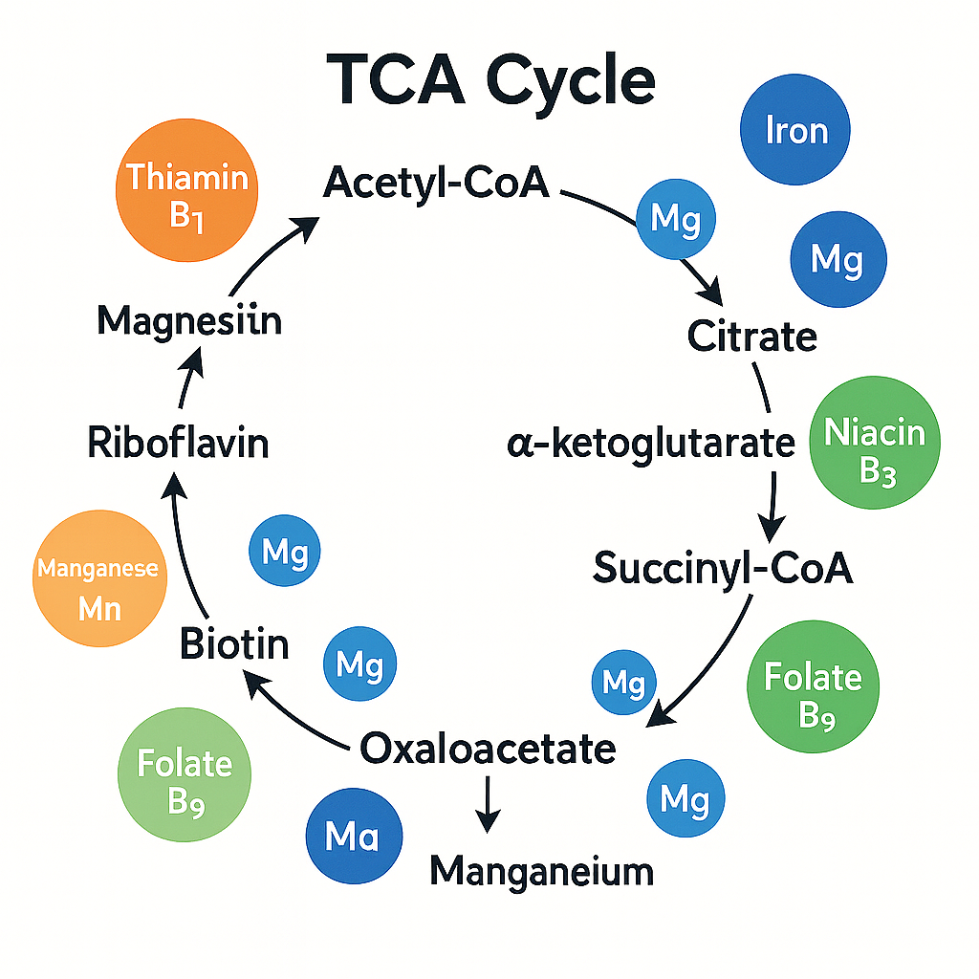
Notes:
Another TCA diagram

Slide 65
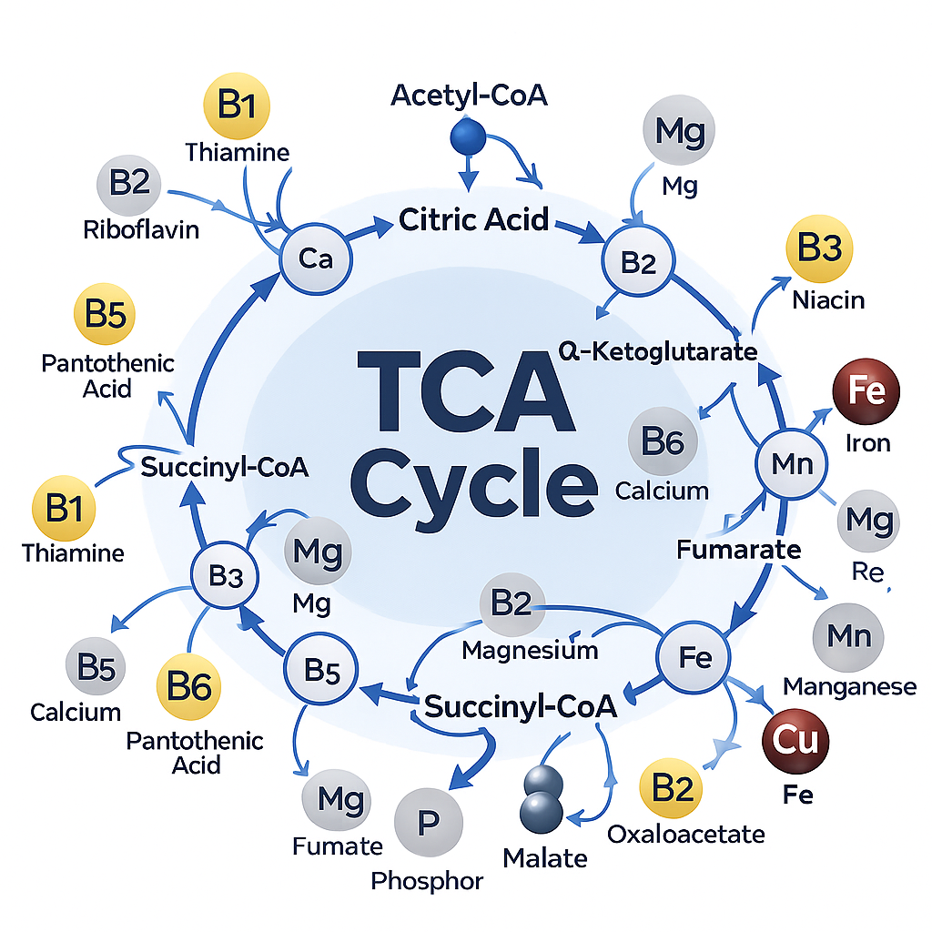
Caption
Notes:
Another TCA diagram

Slide 66
Summary Table - Energy Pathways and Required Nutrients
Pathway | Key Nutrients Required | Why They Matter
Glycolysis | B1, B2, B3, Mg | Glucose → ATP
Pyruvate → Acetyl-CoA | B1, B2, B3, B5, Lipoic acid | Connects glycolysis → TCA
TCA Cycle | B1, B2, B3, B5, Fe, Mg | Generates NADH/FADH₂
ETC | Fe, Cu, CoQ10, O₂ | Produces most ATP
Beta-Oxidation | Carnitine, B2, B3, B5, Mg | Fat → ATP
Amino Acid Catabolism | B6, B12, Folate | Protein → energy
Ketogenesis | B2, B3, CoA | Fats → ketones

Slide 67
Detoxification -
(biochemical pathways)
Detoxification is a two-phase enzymatic system, primarily located in the liver, that transforms fat-soluble toxins, hormones, drugs, xenobiotics, and metabolic byproducts into safer, water-soluble forms for excretion.
Key locations:
Liver (primary)
Intestines
Kidneys
Lungs
Skin
Detoxification requires micronutrient cofactors, amino acids, antioxidants, and functional enzymes.
Detoxification happens in three coordinated steps:
Phase I: Activation (Cytochrome P450 system)
Phase II: Conjugation (biosynthetic pathways)
Phase III: Transport (excretion via kidneys or bile)
All three phases must be balanced.
Notes:
Detoxification is a multi-step biochemical process that converts harmful fat-soluble compounds into safe, water-soluble molecules the body can excrete.
The liver is the primary site, but detox also occurs in the gut, kidneys, lungs, and skin.
Detox is not “flushing toxins” — it is enzyme-driven chemistry requiring micronutrients and antioxidants.
There are three phases:
Phase I (activation)
Phase II (conjugation)
Phase III (transport/excretion)
All phases must be balanced. Fast Phase I with slow Phase II increases toxic load because reactive intermediates accumulate.
Poor nutrient status, inflammation, medications, and genetics affect detoxification capacity.

Slide 68
Phase I Detoxification — Activation (CYP450 System)
Purpose:
Convert a toxin → reactive intermediate (more polar, but often more dangerous).
Biochemical Mechanism:
Phase I uses oxidation, reduction, and hydrolysis reactions.
Main enzymes:
Cytochrome P450 monooxygenases (CYP enzymes)
Flavin-containing monooxygenases (FMO)
Epoxide hydrolases
Alcohol dehydrogenases
Aldehyde dehydrogenases
Key CYP450 Reactions:
Hydroxylation (most common)
Deamination
Dealkylation
Epoxidation
Reduction
Nutrients Required for Phase I:
B2 (FAD)
B3 (NAD⁺/NADP⁺)
Iron (Fe) → cytochrome heme center
Magnesium
Flavonoids (modulate CYP activity)
Notes:
Phase I often forms reactive oxygen species (ROS) and free radicals, requiring strong antioxidant support.
Phase I uses Cytochrome P450 enzymes, which insert or expose reactive groups on toxins.
These enzymes are located in the smooth endoplasmic reticulum and are extremely nutrient dependent.
Phase I is an activation phase — toxins often become more reactive and more dangerous, not less.
Common reactions include:
Hydroxylation
Dehydrogenation
Demethylation
Epoxidation
The most common pathway converts a toxin (RH) → ROH using O₂ and NADPH.
CYPs generate free radicals, so antioxidants must neutralize the oxidative byproducts.
Essential nutrients for Phase I:
B2 & B3 for electron transfer
Iron (heme) for the CYP catalytic core
Magnesium for ATP-dependent steps
Glutathione to mop up reactive species
Phase I is induced by caffeine, alcohol, smoking, and some drugs, which increases oxidative stress unless Phase II is strong.

Slide 69
Summary Table -
Phase I Detoxification Pathways
Category | Details
Location | Smooth endoplasmic reticulum (primarily liver hepatocytes)
Primary Enzymes | Cytochrome P450 monooxygenases (CYP1, CYP2, CYP3 families)
Main Reactions | • Oxidation (most common) • Reduction • Hydrolysis • Dealkylation • Epoxidation
Purpose | Convert fat-soluble toxins → reactive, polar intermediates (prepare for Phase II)
Inputs Required | • NADPH (reducing power) • O₂ (acts as electron acceptor)
Key Nutrient Cofactors | • B2 (FAD) – electron transfer • B3 (NAD/NADPH) – redox cycling • Iron (heme) – catalytic core of CYP450 • Magnesium – stabilizes ATP-dependent enzymes • Phospholipids – ER membrane structure
Inducers (speed up Phase I) | Alcohol, nicotine, caffeine, charred meats, steroids, many drugs, environmental toxins
Inhibitors (slow down Phase I) | Grapefruit, curcumin, quercetin, certain medications, liver dysfunction
Outputs | • More polar compounds • Often more reactive and dangerous metabolites • Reactive oxygen species (ROS)
Risks When Unbalanced | • If Phase I is fast and Phase II is slow → buildup of reactive intermediates → oxidative damage
Antioxidant Needs | • Glutathione • Vitamin C • Vitamin E • Selenium • Superoxide dismutase (Zn/Cu/Mn)
Examples of Compounds Detoxified | Alcohol, caffeine, benzoate, BPA, pollutants, medications, steroids, aromatic hydrocarbons

Slide 70
Phase II Detoxification — Conjugation Pathways
Phase II detoxification is the biochemical process that neutralizes Phase I intermediates by conjugating polar groups to them.
Uses amino acids to neutralize acids and bile-related toxins.
Most common amino acids: glycine, taurine, arginine, glutamine.
Important for detoxifying:
  Benzoates
  Salicylates
  Bile acids
Glycine conjugation produces hippurate, a urinary biomarker of detox capacity.
Protein malnutrition limits amino acid conjugation.
Notes:
Phase II detoxification is the biochemical process that neutralizes Phase I intermediates by conjugating polar groups to them.
The word “conjgate” means….
This makes toxins:
Less electrophilic (less reactive)
Less lipid-soluble
More water-soluble
Easier to excrete via urine or bile
Phase II occurs largely in the cytosol but relies on upstream mitochondrial and endoplasmic reticulum pathways.
Because Phase I produces reactive oxygen species (ROS) and electrophiles, Phase II must be sufficiently fueled to avoid toxic buildup.
Phase II pathways are heavily dependent on:
ATP
Amino acids
B vitamins
Minerals
Reduced glutathione
Healthy methylation and sulfur pathways

Slide 71
Phase II Detoxification — Glutathione Conjugation
Enzyme: Glutathione-S-transferase (GST)
Location: Cytosol and mitochondria
Biochemical Steps
Toxin (electrophile) attacks the -SH (thiol) group of cysteine in glutathione.
GST catalyzes the formation of a GS–R conjugate.
Conjugate is exported via MRP transporters.
In kidneys, conjugate is processed → mercapturic acids → urine.
Why this pathway is vital
Neutralizes the most dangerous Phase I metabolites (epoxides, peroxides).
Prevents damage to proteins, membranes, and DNA.
Is the primary antioxidant buffering system in human cells.
What this requires
Cysteine (rate-limiting)
Glycine, glutamate
Selenium (for glutathione peroxidase)
NADPH (to regenerate GSH from GSSG)
Vitamins B2, B3, B6 for recycling
Healthy mitochondria (NADPH supply)
If glutathione is low, Phase I becomes toxic rather than helpful.
Notes:
Glutathione conjugation is the primary antioxidant detox pathway.
Glutathione (GSH) is a tripeptide: glutamate + cysteine + glycine.
It binds directly to reactive toxins and neutralizes them.
Requires selenium, which activates glutathione peroxidase — the enzyme that prevents oxidative damage.
Low protein intake, chronic stress, malnutrition, or toxin exposure depletes glutathione.
Common compounds detoxified by GSH:
Hydroperoxides
Heavy metals
Electrophilic xenobiotics
Acetaminophen metabolites
GSH is regenerated from GSSG using NADPH, linking detox to energy metabolism and the pentose phosphate pathway
Biochemical Steps
Toxin (electrophile) attacks the -SH (thiol) group of cysteine in glutathione.
GST catalyzes the formation of a GS–R conjugate.
Conjugate is exported via MRP transporters.
In kidneys, conjugate is processed → mercapturic acids → urine.
Why this pathway is vital
Neutralizes the most dangerous Phase I metabolites (epoxides, peroxides).
Prevents damage to proteins, membranes, and DNA.
Is the primary antioxidant buffering system in human cells.
What this requires
Cysteine (rate-limiting)
Glycine, glutamate
Selenium (for glutathione peroxidase)
NADPH (to regenerate GSH from GSSG)
Vitamins B2, B3, B6 for recycling
Healthy mitochondria (NADPH supply)
If glutathione is low, Phase I becomes toxic rather than helpful.

Slide 72
Phase II Detoxification —Methylation (SAMe-dependent conjugation)
Enzymes: Methyltransferases (COMT, NNMT, PEMT, etc.)
Donor molecule: SAMe (S-adenosylmethionine)
Biochemical Steps
Methionine → SAMe (activated form of methionine).
SAMe transfers a CH₃ group to the toxin or molecule.
SAMe → SAH → homocysteine → must be recycled to methionine (B12/folate).
Methylation detoxifies:
Catecholamines (dopamine, epi, norepi)
Histamine
Estrogens
Some environmental toxins
Many xenobiotics
What this requires
Folate (5-MTHF)
Vitamin B12
Vitamin B6
Choline and betaine
Methionine
ATP (energy-intensive pathway)
Why this pathway matters clinically
Impaired methylation = estrogen dominance, anxiety, neurotransmitter imbalances
MTHFR gene variants slow methylation
Low methylation → high homocysteine → cardiovascular risk
Notes:
Purpose:
Regulate hormones, neurotransmitters, toxins, and estrogens.
Required Nutrients:
B12
Folate (B9)
B6
Choline
SAMe (S-adenosyl methionine)
Biochemical Reaction:
Toxin + SAMe → methylated toxin → excreted
Importance:
Critical for estrogen detox, neurotransmitter balance, genomic stability.

Slide 73
Phase II Detoxification —Sulfation (SULT pathway)
Enzymes: Sulfotransferases
Donor molecule: PAPS (activated sulfate)
Biochemical Steps
Sulfate (SO₄²⁻) is activated to PAPS using ATP.
SULT enzymes transfer sulfate to toxin/hormone.
The product becomes highly water-soluble.
Detoxifies:
Steroid hormones (estrogen, DHEA)
Thyroid hormone (T3 → inactive forms)
Neurotransmitters
Phenolic compounds
Drugs and environmental xenobiotics
What this requires
Methionine, cysteine, taurine (sulfur donors)
Vitamin B6
Molybdenum (sulfite oxidase)
ATP
Adequate protein intake
Healthy gut (for sulfate recycling)
Clinical relevance
Highly sensitive to low protein and inflammation
Overloaded by acetaminophen, salicylates
Impaired sulfation → hormone buildup
Notes:
Sulfation is a Phase II detoxification process that adds a sulfate group (SO₄²⁻) to toxins, hormones, drugs, and other molecules to make them more water-soluble and easier to eliminate.
✔ Main Purpose
To neutralize and eliminate:
Excess hormones (estrogen, thyroid hormones)
Neurotransmitters (dopamine, norepinephrine)
Drugs and medications
Environmental chemicals
Phenols and food additives
By attaching a sulfate group, the molecules become inactive, less reactive, and excretable through urine or bile.

Slide 74
Phase II Detoxification —Glucuronidation (UGT pathway)
Enzymes: UDP-glucuronosyltransferases
Donor molecule: UDP-glucuronic acid
Biochemical Steps
Glucose → UDP-glucuronic acid (requires Mg²⁺).
UGT transfers glucuronic acid onto the toxin.
Glucuronide conjugates are excreted into the bile or urine.
Detoxifies:
Steroid hormones
Thyroid hormone
Bilirubin
Alcohol metabolites
Pharmaceuticals
Environmental toxins
What this requires
Magnesium
UDP-glucuronic acid
Healthy carbohydrate metabolism
Critical clinical detail
Gut bacteria produce β-glucuronidase, which can
👉 cleave off glucuronic acid, releasing reactivated toxins.
High β-glucuronidase = higher cancer and toxin recirculation risk.
Dietary fiber reduces this.
Notes:
Glucuronidation is one of the primary Phase II detoxification pathways used by the liver.
Its purpose is to attach glucuronic acid (a sugar-derived molecule) to toxins, hormones, drugs, and metabolic by-products to make them water-soluble, inactive, and easy to excrete.
✔ Main Purpose
To neutralize and eliminate:
Excess estrogens and steroid hormones
Bilirubin (from red blood cell breakdown)
Thyroid hormones
Drugs / medications (NSAIDs, acetaminophen, opioids)
Environmental pollutants
Carcinogens
Fat-soluble toxins
Once glucuronic acid is attached, the compound becomes larger, more polar, and less reactive, allowing efficient removal through bile or urine.

Slide 75
Phase II Detoxification —
Amino Acid Conjugation
Enzymes: various acyl-S-CoA synthetases and conjugases
Biochemical Steps
Toxic acids are activated to acyl-CoA forms.
Conjugated to amino acids (glycine, taurine, glutamine, etc.).
Excreted via urine.
Amino acids used:
Glycine – most common
Taurine – bile acid conjugation
Glutamine
Arginine and ornithine
Detoxifies:
Benzoic acid → hippuric acid
Salicylic acid
Aromatic acids
Bile acids
Requires
Adequate dietary protein
B6 (for transamination)
ATP
This pathway is often stressed in people with high xenobiotic exposure.
Notes:
Amino acid conjugation is a Phase II detoxification pathway in which the liver attaches specific amino acids—most commonly glycine, taurine, glutamine, arginine, or ornithine—to toxins, metabolic waste products, and environmental chemicals to make them more water-soluble and easier to excrete.
✔ Main Purpose
To neutralize and eliminate:
Benzoate and salicylate (common in foods & medications)
Aromatic acids
Bile acids
Some xenobiotics and pollutants
Products of fat metabolism
Certain drugs
By binding an amino acid to the toxin, the body forms a non-toxic, water-soluble conjugate that can be excreted safely in urine.
Handles toxins that other pathways cannot process efficiently
Prevents buildup of acidic or reactive metabolites
Requires and reflects adequate protein intake
Supports detoxification during high metabolic stress
Particularly important for detoxifying benzoic acid → hippurate

Slide 76
Phase II Detoxification —Acetylation (NAT pathway)
Enzymes: NAT1, NAT2
Donor molecule: Acetyl-CoA
Biochemical Steps
The acetyl group is transferred to the toxin → increasing solubility.
Used heavily for pharmaceuticals.
Requires:
Vitamin B5 (for coenzyme A)
Vitamins B2 and B3 (redox)
Protein
Clinically important
People with “slow acetylator” genetics have a higher risk for adverse drug reactions, especially from isoniazid and sulfa drugs.
Notes:
Acetylation is a Phase II detoxification pathway in which the body attaches an acetyl group (from Acetyl-CoA) to drugs, toxins, and metabolic by-products.
This reaction is carried out by N-acetyltransferase (NAT) enzymes, primarily in the liver.
The addition of an acetyl group makes molecules less reactive, less toxic, and easier to eliminate, mainly through the kidneys.
✔ Main Purpose
To neutralize and eliminate:
Certain medications (isoniazid, sulfonamides, hydralazine)
Aromatic amines from food additives, dyes, tobacco smoke
Caffeine and carcinogenic amines
Some environmental toxins
Metabolic intermediates requiring detoxification
Acetylation reduces toxicity and prepares molecules for urinary excretion.
Protects the body from amine-containing toxins
Critical for safe drug metabolism
Prevents buildup of reactive aromatic amines (cancer risk)
Helps regulate neurotransmitters and hormone by-products
Influenced by genetic NAT variations (“slow” and “fast” acetylators)

Slide 77
Why Phase II Detox is
Energy Dependent
Many Phase II pathways rely on:
ATP (especially sulfation and amino acid conjugation)
NADPH (glutathione regeneration)
Acetyl-CoA (acetylation)
Methionine cycle energy flux
This links detoxification DIRECTLY to:
⚡ Energy metabolism pathways
Glycolysis
Pentose phosphate pathway
TCA cycle
Beta-oxidation
Amino acid metabolism
If cellular energy is low → Phase II slows down → toxins accumulate.
Notes:
Phase II detoxification is energy-dependent because it requires ATP, activated nutrients, and enzyme-driven reactions to attach protective “conjugate” groups onto toxins so they can be safely removed from the body.
Here is a clear, brief explanation of why Phase II detox consumes so much energy:

Slide 78
The Relationship Between
Phase I & Phase II
Key concept:
Phase I makes toxins MORE reactive.
Phase II makes them safe and excretable.
Phase II must be:
well-fueled,
nutritionally supported,
and not overloaded for safe detoxification.
Notes:
Phase I and Phase II detoxification are two connected steps that work together to neutralize and eliminate toxins.
They must stay balanced for safe, effective detoxification.
f Phase I is fast but Phase II is slow →
🔸 Reactive intermediates build up
🔸 Increased oxidative stress
🔸 Tissue damage and inflammation
🔸 Chemical sensitivity
If Phase II is strong but Phase I is slow →
🔸 Detox is sluggish
🔸 Toxins persist longer
Optimal detox requires both phases working at the same speed.

Slide 79
Table Summary - Phase II Pathway
Phase II Pathway | Enzyme(s) | Conjugate | Nutrients Needed | Removes | Clinical Notes
Glutathione Conjugation | GST | GSH | Cysteine, Glycine, Gln, Se, B2/B3/B6, NADPH | Electrophiles, ROS | Protection from oxidative stress
Methylation | Methyltransferases | CH₃ | B12, Folate, B6, Choline, Methionine, ATP | Estrogens, NTs | Impaired in MTHFR variants
Sulfation | SULT | SO₄ | Methionine, Cys, B6, Molybdenum, ATP | Hormones, NTs, toxins | Overloaded by acetaminophen
Glucuronidation | UGT | Glucuronic acid | Mg, UDP-GA | Hormones, drugs | Reversible by β-glucuronidase
Amino Acid Conjugation | Various | Gly/Tau/Gln | Amino acids, B6, ATP | Aromatic acids | Requires protein sufficiency
Acetylation | NAT | Acetyl group | B5, B2, B3, protein | Drugs, xenobiotics | Slow acetylators = drug toxicity risk

Slide 80
Phase III Detoxification —
Transport & Excretion
Phase III detoxification is the final step in detoxification.
Once toxins have been activated (Phase I) and conjugated (Phase II), Phase III:
✔ Pumps the conjugated toxins out of cells
✔ Delivers them to organs of elimination
✔ Prevents reabsorption and recirculation
Phase III uses energy-dependent transporter proteins to export toxins into:
Bile → feces
Kidney → urine
Lymphatic system
Sweat/skin
Lungs (for volatile compounds)
Think of Phase III as the body’s export logistics system.
Phase III is critical because Phase II conjugates cannot leave the cell by diffusion.
They are too large and too polar.
Phase III prevents:
Reaccumulation of toxic intermediates
Oxidative stress
Hormone recirculation (estrogen dominance)
Bile stagnation
Enterohepatic recirculation
Without Phase III, detox STOPS — regardless of how strong Phase I or II are.
Notes:
Phase III relies on a family of membrane-bound transporter proteins:
The three major transporter systems:
ATP-Binding Cassette (ABC) Transporters
Multidrug Resistance Proteins (MRP/ABCC family)
Organic Anion Transporters (OAT/OATP family)
These transporters require:
ATP (high energy demand)
Magnesium
Healthy mitochondrial function
Intact cell membranes (phospholipids/choline)

Slide 81
Table Summary - Phase III Pathways
Component | Description | Key Biomolecules | Clinical Relevance
Main Role | Export conjugated toxins | ATP, transporters | Prevents buildup of reactive metabolites
Transporters | ABC, MRP, OAT | ABCB1, MRPs | Determines bile & urine toxin export
Energy Needs | ATP-dependent | Mg, mitochondria | Low ATP = slowed detox
Bile Pathway | Toxins excreted with bile | PC, taurine, glycine | Cholestasis stops Phase III
Kidney Pathway | Water-soluble toxins → urine | Hydration, electrolytes | Dehydration slows elimination
Gut Role | Prevents toxin reabsorption | Fiber, microbiome balance | Constipation → enterohepatic recirculation
Nutrients | Mg, choline, PC, taurine, glycine | Supports transport & bile flow | Deficiencies impair detox

Slide 82
Table Summary - All Detoxification Pathways
Detox Phase | Primary Processes | Key Nutrients | Purpose
Phase I | Oxidation, reduction, hydrolysis | B2, B3, Fe, Mg | Activate toxins; make them reactive
Phase II: GSH | Glutathione conjugation | GSH, selenium, B2, B6 | Neutralize reactive metabolites
Phase II: Methylation | SAMe methylation | B12, folate, B6, choline | Hormone detox, neurotransmitter balance
Phase II: Glucuronidation | Add glucuronic acid | Magnesium | Hormone/drug detox
Phase II: Sulfation | Sulfate addition | Methionine, cysteine, B6, molybdenum | Steroid & neurotransmitter detox
Phase II: AA Conjugation | Add amino acids | Glycine, taurine | Acid & bile detox
Phase III | Transport/excretion | Minerals, ATP | Removal from body
10
Notes:
Detoxification is nutrient-dependent; deficiencies impair clearance of hormones, drugs, and toxins.
Phase I increases reactivity; Phase II neutralizes.
The liver uses amino acids, B vitamins, minerals, and antioxidants to process toxins.
Glutathione is the master antioxidant and detox molecule.
Detoxification burden increases oxidative stress → demand for antioxidants rises.
Adequate hydration, bile flow, gut motility, and nutrient status are essential for proper detoxification.

Slide 83
Role of Oxidative Stress and
Detoxification Pathways on Health Status
Oxidative stress occurs when the production of reactive oxygen species (ROS) exceeds the body’s ability to neutralize them with antioxidants.
Sources of ROS:
    Normal mitochondrial energy production
    Inflammation
    Environmental toxins
    Poor diet, smoking, and alcohol
    Chronic stress
    UV radiation, pollution
    Certain medications
Impact on the body:
  Excess ROS can damage lipids, proteins, DNA, and cell membranes, leading to dysfunction across multiple systems.

Slide 84
How Oxidative Stress & Detoxification Interact
Oxidative stress directly influences the workload and efficiency of detox pathways
A. Excess ROS increases the burden on detoxification.
Phase I generates ROS; if antioxidant systems are overwhelmed, oxidative stress worsens.
High toxin exposure accelerates ROS production.
B. Phase II requires antioxidants to neutralize reactive intermediates.
Glutathione (GSH), vitamin C, vitamin E, selenium, NAC
If unavailable, toxins accumulate or remain reactive → cellular damage.
C. Oxidative stress can impair detox enzymes.
Chronic oxidative damage can reduce:
Liver enzyme activity
Cell membrane function
Energy production is needed for conjugation and transport
D. Impaired detox leads to more oxidative stress.
A vicious cycle:
ROS ↑ → detox overload ↑ → ROS ↑ even more.

Slide 85
Effects on Overall Health Status
Metabolic Health
Insulin resistance
Fatty liver disease
Dyslipidemia
Inflammation & Immune Function
Increased pro-inflammatory cytokines
Reduced immune resilience
Higher infection susceptibility
Mitochondrial Dysfunction
Fatigue
Reduced physical + cognitive performance
Hormone Balance
Reduced clearance of estrogen and cortisol
Symptoms of estrogen dominance
HPA axis dysregulation
Neurological Health
Oxidative damage to neurons
Mood disorders
Cognitive decline
Digestive & Liver Health
Impaired bile flow
Malabsorption of fats
Liver stress or reduced conjugation capacity
Chronic Disease Risk
Long-term oxidative stress is linked to:
Cardiovascular disease
Type 2 diabetes
Certain cancers
Neurodegenerative diseases
Autoimmunity

Slide 86
Factors That Support Detoxification & Reduce Oxidative Stress
Adequate protein & amino acids (glycine, cysteine, methionine)
Antioxidant-rich diet (fruits, vegetables, polyphenols)
Glutathione precursors (NAC, selenium, sulfur-containing foods)
B vitamins (Phase I & II cofactors)
Magnesium, zinc, copper, and iron (enzyme cofactors)
Hydration
Healthy bile flow (fiber, bitters, movement)
Avoiding excessive toxins (alcohol, smoking, endocrine disruptors)
Reducing inflammation
Stress management & sleep

Slide 87
Summary Table: Oxidative Stress & Detoxification Pathways
Category | Key Points
Oxidative Stress | Imbalance between free radicals (ROS) and antioxidant defenses; caused by inflammation, toxins, poor diet, smoking, stress, pollution, mitochondrial activity. Leads to cellular damage (lipids, proteins, DNA).
Major Sources of ROS | Mitochondria, immune activity, toxins, chronic stress, environmental pollutants, medications, UV/radiation, high blood sugar.
Primary Effects on Health | Fatigue, inflammation, mitochondrial dysfunction, immune dysregulation, accelerated aging, hormonal imbalance, increased chronic disease risk (CVD, diabetes, cancer).
Detoxification Pathways | Liver-based system that processes internal and external toxins for elimination through Phase I, Phase II, and Phase III pathways.
Phase I (Oxidation) | Cytochrome P450 enzymes modify toxins to more reactive intermediates; generates ROS. Requires B2, B3, B6, folate, B12, antioxidants.
Phase II (Conjugation) | Adds molecules (glutathione, sulfate, glycine, glucuronic acid) to neutralize and solubilize toxins. Nutrient-dependent (protein, sulfur compounds, magnesium, antioxidants). Critical for reducing oxidative stress.
Phase III (Elimination) | Transporters move conjugated toxins out via bile, urine, feces. Requires adequate bile flow, hydration, fiber, and cell membrane integrity.
Interaction Between Oxidative Stress & Detox | Excess ROS overwhelms detox capacity; impaired detox increases oxidative stress; poor nutrient status weakens both systems → vicious cycle.
Impact on Health Status | Influences metabolic health, inflammation, immunity, cognitive function, hormone balance, and chronic disease risk.
Supportive Factors | Antioxidant-rich diet, adequate protein, sulfur-containing foods, B vitamins, minerals (Mg, Se, Zn), hydration, fiber, healthy bile flow, reduced toxin exposure, stress management.

Slide 88
Lipid Metabolism, Including Cytokine and Eicosanoid Pathways
Lipid metabolism includes the digestion, absorption, transport, storage, and breakdown of fats. Its main purpose is to provide energy, build cell membranes, support hormone synthesis, and generate important signaling molecules.
Key lipid categories:
    Triglycerides → major energy storage
    Phospholipids → membranes, signaling
    Cholesterol → membranes, steroid hormones, bile acids
    Fatty acids → fuel, precursors to eicosanoids

Slide 89
Digestion and Absorption
Bile acids emulsify fats in the small intestine.
Pancreatic lipases break triglycerides into fatty acids + monoglycerides.
Absorbed into enterocytes and re-formed into triglycerides.
Packaged into chylomicrons for lymphatic transport.

Slide 90
Transport of Lipids
Lipoprotein | Primary Role
Chylomicrons | Transport dietary triglycerides from intestine → tissues
VLDL | Liver → tissues (endogenous triglycerides)
LDL | Delivers cholesterol to cells
HDL | Reverse cholesterol transport to liver

Slide 91
Storage & Release
Storage:
Triglycerides are stored in adipose tissue.
Release:
Lipolysis (triggered by glucagon, epinephrine) breaks triglycerides → free fatty acids (FFA) + glycerol.
FFAs circulate bound to albumin and serve as energy during fasting, exercise, or low-carb states.

Slide 92
Fatty Acid Oxidation & Synthesis
Fatty Acid Oxidation (β-Oxidation)
Occurs in mitochondria.
Process:
FFAs → Acetyl-CoA → enter the TCA cycle
Generates NADH & FADH₂, which enter the electron transport chain to produce ATP.
Fat is the most energy-dense macronutrient.
Fatty Acid Synthesis (Lipogenesis)
Occurs when energy intake > need.
Acetyl-CoA → fatty acids (via fatty acid synthase)
Requires insulin and excess carbohydrate intake
Stored as triglycerides in adipose tissue

Slide 93
Integration With Inflammation: Cytokines & Lipids
Lipid metabolism is tightly connected to inflammation.
Inflammatory cytokines influenced by lipid status:
  TNF-α
  IL-6
  IL-1β
In obesity or high visceral fat:
  Adipocytes release excess cytokines → chronic low-grade inflammation
  Alters insulin signaling
  Impairs lipid handling in the liver (↑ VLDL, ↑ triglycerides)
During fasting or ketosis:
  Reduced inflammatory cytokine production

Slide 94
Eicosanoid Pathways (Arachidonic Acid Cascade)
Eicosanoids are lipid-derived signaling molecules made from omega-6 and omega-3 fatty acids.
They regulate:
  Inflammation
  Pain
  Blood flow
  Blood clotting
  Immunity
Core pathway:
  Cell membrane phospholipids → phospholipase A₂ → release arachidonic acid (AA) → converted into specific eicosanoids.

Slide 95
Classes of Eicosanoids
Prostaglandins (PGs)
Produced via COX-1 and COX-2 enzymes
Regulate inflammation, fever, pain, GI protection
B. Thromboxanes (TXs)
Promote platelet aggregation & vasoconstriction
C. Leukotrienes (LTs)
Produced via lipoxygenase (LOX) pathway
Involved in asthma, allergy, bronchoconstriction
D. Specialized Pro-Resolving Mediators (SPMs)
Derived from omega-3s:
Resolvins
Protectins
Maresins
Functions:
Resolve inflammation
Promote healing
Lower cytokine production

Slide 96
Omega-6 vs Omega-3 Balance
Fatty Acid | Source | Impact
Omega-6 (AA) | vegetable oils, meat | more pro-inflammatory eicosanoids
Omega-3 (EPA/DHA) | fish, algae | anti-inflammatory & pro-resolving eicosanoids

Slide 97
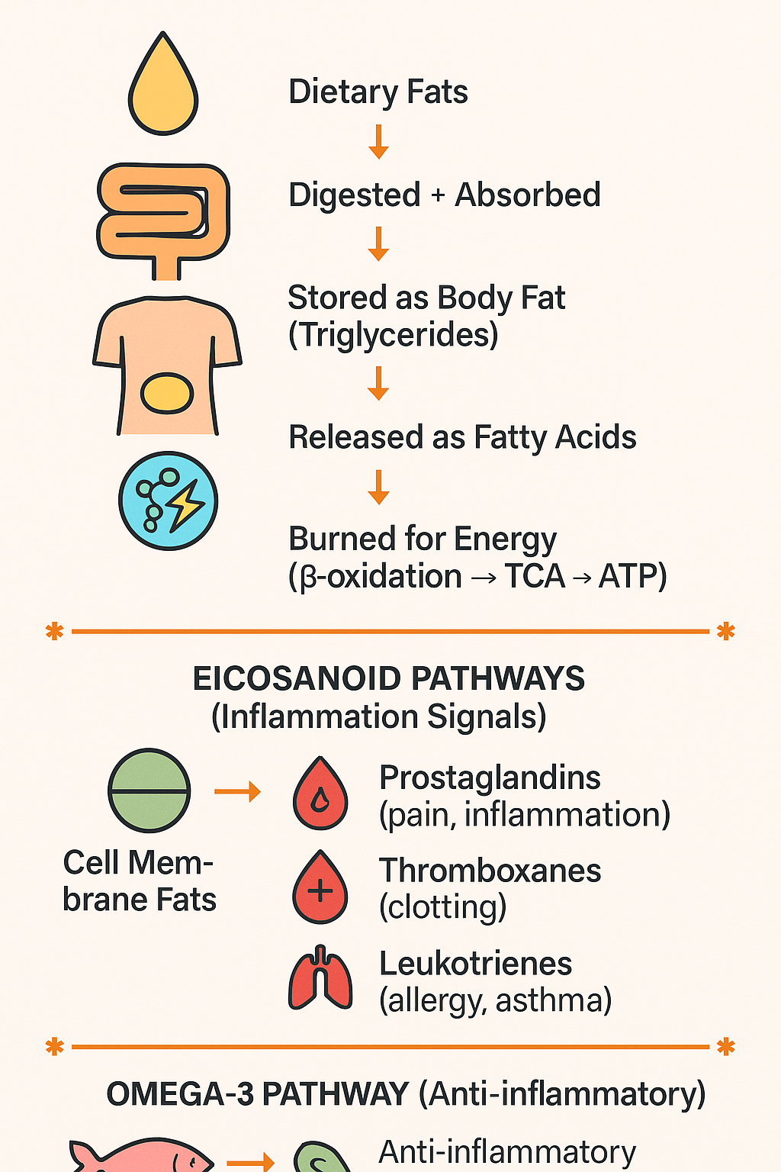
Caption

Slide 98
Lipid Metabolism
Eicosanoid Pathways
Inflammatory Pathway
Cell Membrane Phospholipids
↓
Phospholipase A2 (PLA2)
↓
Arachidonic Acid (AA)
↓
┌──────────────┼────────────────┐
▼ ▼ ▼
COX LOX CYP450
▼ ▼ ▼
Prostaglandins Leukotrienes Epoxides
Thromboxanes (LTs) (vascular)
(PGs/TXs) mediators
Anti-Inflammatory Pathway
EPA / DHA (Omega-3)
↓
Anti-inflammatory mediators:
- Series-3 PGs
- Series-5 LTs
- Resolvins, Protectins, Maresins
Dietary Fat
↓
Digestion (bile + lipase)
↓
Chylomicrons
↓
Adipose Storage (TG)
↓
Lipolysis
↓
Free Fatty Acids (FFA)
↓
β-Oxidation
↓
Acetyl-CoA
↓
TCA Cycle
↓
ATP

Slide 99
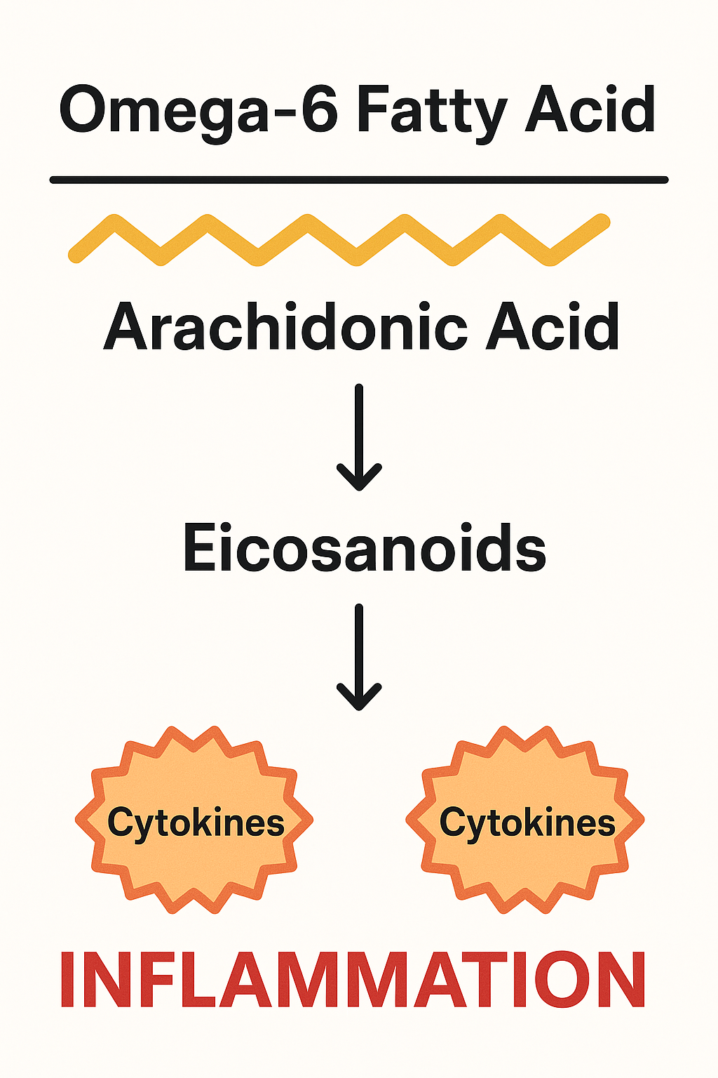
Cytokine-Mediated Inflammation
Inflammatory cytokines (such as TNF-α, IL-6, and IL-1β) released from immune cells alter lipid metabolism by increasing the breakdown of stored fats (lipolysis), reducing fat storage, and impairing fatty-acid oxidation.
They also promote higher circulating triglycerides and changes in lipoprotein production by the liver.
Understanding cytokine-mediated inflammation and lipid metabolism is clinically important because chronic inflammation contributes to abnormal lipid profiles, insulin resistance, metabolic syndrome, fatty liver disease, and cardiovascular disease.
Targeting inflammation through nutrition, lifestyle, and medical interventions can help improve lipid regulation and reduce cardiometabolic disease risk.

Slide 100
Clinical Relevance: Why This Matters
Lipid metabolism, cytokines, and eicosanoids play major roles in:
Metabolic Health
Insulin resistance
Fatty liver
Dyslipidemia
Cardiovascular Health
Blood clotting (thromboxanes)
Endothelial inflammation
Immunity & Inflammation
Cytokine-mediated chronic inflammation
Eicosanoid-driven acute inflammation
Hormones
Steroid hormones are derived from cholesterol
Neurology
Neuronal membranes depend on DHA
Eicosanoids influence neuroinflammation

Slide 101
Summary Table
Pathway | Key Function | Health Impact
Lipolysis | Releases stored fat for energy | Fasting energy, metabolic flexibility
β-Oxidation | Converts fatty acids → ATP | Endurance, mitochondrial health
Lipogenesis | Creates new fat for storage | Excess promotes obesity, NAFLD
Lipoprotein transport | Moves fats in blood | LDL/HDL balance affects CVD risk
Cytokine pathways | Immune signaling | Inflammation, insulin resistance
Eicosanoids | Rapid-response signaling (PGs, TXs, LTs) | Pain, inflammation, clotting, immunity
Omega-3 SPMs | Resolve inflammation | Healing, anti-inflammatory balance

Slide 102
Genomics & Epigenetics
Chemistry of enzymes, co-factors, and organic acids
Basic understanding of nutritional genomics research in practice
Impact of nutritional genomics on health
Epigenetics: methyl donor biochemistry and hypo- and hypermethylation specific to life cycle stage
**Slides will separate the above domain areas via a blue heading
D
O
M
A
I
N
II
2
Caption

Slide 103
Chemistry of Enzymes, Co-factors, and Organic Acids
Enzymes are protein-based catalysts that speed up biochemical reactions by lowering the activation energy required. They are highly specific, with each enzyme designed to act on a specific substrate to produce a particular product.
Cofactors are helper molecules—either vitamins (coenzymes) or minerals (metal ions)—that activate enzymes or enable them to function. Without the correct cofactors, many enzymes cannot carry out their reactions, which slows or blocks metabolic pathways.
Organic acids are small carbon-based molecules produced as intermediates in metabolic pathways such as glycolysis, the TCA cycle, amino acid metabolism, and fatty acid oxidation. Their levels reflect the activity of enzymes and the availability of cofactors, making them useful indicators of metabolic function and nutritional status.
Together, enzymes, cofactors, and organic acids form the chemical foundation of metabolism, energy production, detoxification, and cellular health.

Slide 104
Enzymes: Chemical Catalysts
of the Body
Enzymes are proteins that speed up biochemical reactions by lowering the activation energy required for a reaction to occur.
Key Chemical Features
Made of amino acids folded into complex shapes.
Have an active site—a specific pocket where the substrate binds.
Highly specific: one enzyme typically catalyzes one type of reaction.
It can increase reaction speed millions of times.
They are not consumed in the reaction (reusable).
How Enzymes Work (Chemistry)
The enzyme changes shape slightly when the substrate binds (induced fit model).
Bonds within the substrate are weakened or aligned → easier chemical conversion.
Products are released, and the enzyme returns to its original state.
Enzyme + Substrate → Enzyme–Substrate Complex → Product + Enzyme

Slide 105
Cofactors: Helpers That
Activate Enzymes
Enzymes often require cofactors to function. These are non-protein molecules that assist enzyme activity
Two Types of Cofactors
1. Coenzymes (organic molecules)
Usually vitamins or derived from them
Examples:
  B vitamins → NAD⁺, FAD, TPP, PLP, CoA
  Vitamin C → collagen enzyme cofactor
  Vitamin K → cofactor in clotting enzyme activation
2. Metal ions (inorganic)
Minerals that stabilize or activate enzymes
Examples:
  Mg²⁺ → ATP reactions
  Zn²⁺ → alcohol dehydrogenase
  Cu²⁺ → oxidative enzymes (superoxide dismutase)
  Fe²⁺/Fe³⁺ → heme enzymes, electron transport
What Cofactors Do (Chemical Roles)
Accept or donate electrons
Carry atoms or functional groups
Stabilize the enzyme–substrate complex
Change the enzyme shape to activate the active site
Without cofactors, many enzymes become inactive (“apoenzymes").
With cofactors, they become active enzymes ("holoenzymes").

Slide 106
Organic Acids: Intermediates in Metabolic Chemistry
Organic acids are carbon-based molecules that contain a carboxyl group (-COOH).hey are key intermediates in metabolism and appear in pathways such as
Glycolysis
Pyruvate
Lactate
TCA Cycle
Citrate
α-Ketoglutarate
Succinate
Fumarate
Malate
Oxaloacetate
Amino Acid Metabolism
Homocysteine
Glutamate
α-keto acids
Fatty Acid Oxidation
Acyl-carnitines
β-hydroxybutyrate (ketone)

Slide 107
How Enzymes, Cofactors & Organic Acids Work Together
The relationship is tightly integrated in all metabolic chemistry
Cofactors Activate Enzymes
Example:
NAD⁺ (from niacin/B3) is required by dehydrogenase enzymes.
Mg²⁺ stabilizes ATP in kinase reactions.
B6 (PLP) is essential for transamination.
Enzymes Convert Organic Acids
Enzymes catalyze each step of metabolism:
Pyruvate → Acetyl-CoA (requires thiamine, B5, lipoic acid)
α-Ketoglutarate → Succinyl-CoA (requires B1, B2, B3, B5, Mg²⁺)
Succinate → Fumarate (uses FAD from riboflavin/B2)
Organic Acids Reflect Cofactor Status
If a cofactor is missing, the enzyme slows → organic acids build up.
This is why organic acid profiles can indicate:
B-vitamin deficiencies
Mitochondrial dysfunction
Oxidative stress
Detoxification problems
Dysbiosis (certain acids produced by microbes)

Slide 108
Clinical & Functional Significance
The relationship is tightly integrated in all metabolic chemistry
Enzymes
Drive detoxification (Phase I, II, III)
Digest food (amylases, lipases, proteases)
Support hormone synthesis and neurotransmission
Maintain metabolic rate
Cofactors
Key nutrient deficiencies → pathway blocks
Cofactors determine metabolic efficiency
Often the missing link in fatigue, poor detox, or mitochondrial dysfunction
Organic Acids
Provide a snapshot of cellular metabolism
Reveal blocks in glucose, fat, amino acid pathways
Reflect oxidative stress and nutrient insufficiency
Useful for mapping the health of mitochondria, neurotransmitters, and detox pathways
Notes:
Enzymes catalyze biochemical reactions, cofactors activate and support those enzymes (often vitamins and minerals), and organic acids are the metabolic intermediates produced and consumed through these enzymatic pathways. Together, they form the core chemistry of metabolism, energy production, detoxification, and cellular function.

Slide 109
Summary Table: Enzymes,
Cofactors & Organic Acids
Component | What It Is | Role in Metabolism | Key Examples
Enzymes | Protein-based biological catalysts | Speed up biochemical reactions by lowering activation energy; convert substrates into products | Amylase, dehydrogenases, kinases, lipases
Cofactors | Non-protein helpers (vitamins or minerals) needed for enzyme activity | Activate enzymes, stabilize reactions, transfer electrons or chemical groups | Coenzymes: NAD⁺ (B3), FAD (B2), CoA (B5), PLP (B6); Minerals: Mg²⁺, Zn²⁺, Cu²⁺, Fe²⁺
Organic Acids | Small carbon-based metabolic intermediates with a carboxyl group | Reflect enzyme activity and cofactor sufficiency; essential steps in energy, amino acid, and detox pathways | Pyruvate, lactate, citrate, α-ketoglutarate, succinate, malate

Slide 110
Basic Understanding of Nutritional Genomics Research in Practice
Nutritional genomics (also called nutrigenomics and nutrigenetics) explores how a person’s genes interact with nutrients, diet, and lifestyle to influence health outcomes. In practice, it helps clinicians understand why individuals respond differently to foods, supplements, and dietary patterns.
Nutritional genomics supports:
Personalized nutrition
  More targeted supplementation
  Understanding individual metabolic differences
  Prevention strategies for chronic diseases
  Optimizing detoxification, methylation, and antioxidant pathways
It provides context—not absolute predictions—and must be integrated with clinical history, labs, symptoms, and environment.

Slide 111
Nutrigenetics
Studies how genetic variations (SNPs) affect a person’s response to nutrients.
Helps explain differences in:
• lactose tolerance
• caffeine metabolism
• folate needs (MTHFR variants)
• lipid metabolism and cholesterol response
• detoxification capacity
Practical use: tailoring nutrition plans based on individual genetic variants.

Slide 112
Nutrigenomics
Studies how diet influences gene expression.
Food components can turn genes on or off through epigenetic mechanisms (e.g., methylation, histone modification).
Examples:
Polyphenols reduce inflammatory gene expression
Omega-3 fats lower the expression of inflammatory cytokines
High-sugar diets promote lipogenesis genes

Slide 113
Common Genetic Pathways
Evaluated in Practice
Methylation genes: MTHFR, MTRR, COMT
Detox pathways: GST, CYP450 variants
Lipid metabolism: APOE, FADS1/2
Carbohydrate metabolism: TCF7L2 (diabetes risk)
Inflammation: IL-6, TNF-α
Antioxidant defense: SOD2, GPX1
Caffeine/alcohol metabolism: CYP1A2, ADH genes
These variants do not diagnose disease—they show tendencies or susceptibilities.

Slide 114
Limitations & Best Practices
Methylation genes: MTHFR, MTRR, COMT
Detox pathways: GST, CYP450 variants
Lipid metabolism: APOE, FADS1/2
Carbohydrate metabolism: TCF7L2 (diabetes risk)
Inflammation: IL-6, TNF-α
Antioxidant defense: SOD2, GPX1
Caffeine/alcohol metabolism: CYP1A2, ADH genes
These variants do not diagnose disease—they show tendencies or susceptibilities.

Slide 115
Limitations & Best Practices
Genetic tests identify risk, not destiny.
Results must not be used in isolation.
Many variants have modest effects unless combined with lifestyle factors.
Accredited, scientifically validated labs should be used.
Interpretation requires understanding biochemical pathways, not single SNPs.

Slide 116
Limitations & Best Practices
Genetic tests identify risk, not destiny.
Results must not be used in isolation.
Many variants have modest effects unless combined with lifestyle factors.
Accredited, scientifically validated labs should be used.
Interpretation requires understanding biochemical pathways, not single SNPs.
Notes:
Nutritional genomics research helps clinicians understand how genes influence a person’s response to food—and how diet, in turn, influences gene expression. In practice, it guides personalized nutrition strategies, supports metabolic and detox pathways, and helps prevent chronic disease when integrated with clinical context.

Slide 117
Limitations & Best Practices
Genetic tests identify risk, not destiny.
Results must not be used in isolation.
Many variants have modest effects unless combined with lifestyle factors.
Accredited, scientifically validated labs should be used.
Interpretation requires understanding biochemical pathways, not single SNPs.
Notes:
Nutritional genomics research helps clinicians understand how genes influence a person’s response to food—and how diet, in turn, influences gene expression. In practice, it guides personalized nutrition strategies, supports metabolic and detox pathways, and helps prevent chronic disease when integrated with clinical context.

Slide 118
Impact of Nutritional Genomics
on Health
Personalized Nutrition
Genetic variations (SNPs) affect:
how well nutrients are absorbed or metabolized
how individuals respond to fats, carbs, or supplements
tolerance to lactose, gluten, caffeine, or alcohol
Impact:
More precise dietary recommendations tailored to the individual rather than one-size-fits-all guidelines.
Improved Metabolic Health
Nutrigenomics helps identify predispositions to:
insulin resistance
high cholesterol
obesity
hypertension
Gene-informed nutrition can:
Optimize blood sugar control
improve lipid profiles
support long-term weight management
Better Detoxification & Antioxidant Capacity
Genes in detox and antioxidant pathways (e.g., GST, SOD, CYP450) influence:
ability to neutralize toxins
sensitivity to pollutants, chemicals, and oxidative stress
need for antioxidants (vitamin C, E, glutathione precursors)
Impact:
Diet can be targeted to support weak pathways and reduce toxin-related stress.
Notes:
Nutritional genomics enhances health by enabling personalized nutrition strategies that support metabolism, reduce inflammation, optimize detoxification, and lower chronic disease risk. Genes show predispositions—not destiny—and diet plays a major role in modifying genetic expression and long-term health outcomes.

Slide 119
Impact of Nutritional Genomics
on Health
Optimized Methylation & Mental Health
Gene variants in methylation pathways (MTHFR, COMT) affect:
folate metabolism
neurotransmitter balance
detoxification
hormone regulation
Impact:
Personalized support with methyl donors (folate, B12, choline) and stress-modifying nutrients improves cognitive, emotional, and metabolic health.
Enhanced Inflammation Management
Variants in inflammatory genes (IL-6, TNF-α, CRP) impact susceptibility to chronic inflammation.
Impact:
Targeted nutrition (omega-3s, polyphenols, fiber-rich diets) helps reduce inflammation and chronic disease risk.
Prevention of Chronic Disease
Nutritional genomics identifies risk tendencies, not diagnoses, for conditions like:
cardiovascular disease
type 2 diabetes
certain cancers
autoimmunity
Impact:
Early lifestyle interventions can reduce risk and promote long-term health.
Increased Consumer Empowerment
Understanding one's genetic tendencies can motivate:
healthier dietary choices
consistent lifestyle habits
proactive disease prevention

Slide 120
A Summary Table
Impact Area | How Genetics Influences Health | How Nutrition Modifies Outcomes
Personalized Nutrition | Genetic variations alter nutrient metabolism, absorption, and tolerance | Tailored diets improve digestion, nutrient status, and overall response
Metabolic Health | SNPs affect insulin sensitivity, lipid metabolism, weight regulation | Targeted diets help regulate blood sugar, cholesterol, and weight
Detoxification & Oxidative Stress | Variants in detox/antioxidant genes affect toxin clearance and ROS balance | Antioxidant-rich diets, sulfur foods, and phytochemicals support weak pathways
Inflammation | Genes regulate cytokine production and chronic inflammation risk | Omega-3s, polyphenols, fiber, and anti-inflammatory diets improve outcomes
Methylation & Mental Health | MTHFR/COMT variants influence neurotransmitter balance and methylation | Folate, B12, choline, and stress-support nutrients optimize brain and hormone function
Chronic Disease Risk | Genetics predispose individuals to CVD, diabetes, obesity, cancer | Diet and lifestyle choices can reduce expression of risk genes
Behavior & Engagement | Genetic insights increase motivation and adherence | Personalized plans improve long-term dietary consistency

Slide 121
Epigenetics: Methyl Donor Biochemistry and Hypo-and Hypermethylation Specific to Life Cycle Stage
Epigenetics refers to changes in gene expression that occur without altering DNA sequence, and one of the primary mechanisms is DNA methylation. Methylation depends on nutrients known as methyl donors—including folate (5-MTHF), vitamin B12, choline, betaine, methionine, and SAMe—which supply or transfer methyl groups in the one-carbon cycle. These methyl groups regulate gene expression, detoxification, neurotransmitter production, hormone balance, and DNA stability.
Methylation needs change across the life cycle. Demand is highest during pregnancy, when the developing fetus relies on maternal methyl donors to support DNA synthesis, neural tube development, and long-term epigenetic programming. High methylation needs also occur in infancy, early childhood, and adolescence due to rapid growth and brain development. In adulthood, methylation supports detoxification, cardiovascular health, and inflammation control. In older adults, natural declines in nutrient absorption and increasing oxidative stress contribute to hypomethylation, while certain genes may become hypermethylated, influencing aging and disease risk.
Overall, balanced methyl donor biochemistry throughout life supports healthy gene regulation, development, and long-term health outcomes.

Slide 122
Methyl Donor Biochemistry
(The Methylation Cycle)
Methylation requires one-carbon metabolism, which depends on nutrients that donate or recycle methyl groups.
Key Methyl Donors:
Folate (5-MTHF)
Vitamin B12
Choline / Betaine
Methionine
SAMe (S-adenosylmethionine) → the universal methyl donor
B2, B3, B6 → coenzymes that drive enzyme reactions
How it works chemically:
Folate → 5-MTHF donates a methyl group
B12 transfers the methyl group to homocysteine → making methionine
Methionine becomes SAMe
SAMe donates methyl groups to:
  DNA
  RNA
  histones
  phospholipids
  neurotransmitters
After donation, SAMe → SAH → homocysteine (recycled or excreted)
Balanced methyl donor chemistry supports healthy gene expression.

Slide 123
Hypermethylation vs. Hypomethylation
Hypermethylation
= Too much methylation
→ Often suppresses gene expression
→ Can silence tumor suppressor genes, alter hormone pathways, affect detox enzymes
Hypomethylation
= Too little methylation
→ Can activate genes excessively
→ Often associated with inflammation, oxidative stress, genomic instability, high homocysteine
Methylation balance depends on:
nutrient adequacy
inflammation
oxidative stress
metabolic demands
life stage (very important!)

Slide 124
Life-Cycle Stage Differences in Methylation Needs
Methylation demand is not constant throughout life. Certain stages have dramatically higher requirements.
Pregnancy (Highest Demand Period)
Pregnancy is the peak methylation demand of the human life cycle.
Why:
Fetal DNA synthesis requires continuous methylation
Neural tube formation depends on methyl donors
Placental development uses folate and choline
Maternal epigenetic patterns shift to support fetal growth
Hypomethylation risk: neural tube defects, preeclampsia, gestational complications
Hypermethylation risk: excessive supplementation can potentially silence key fetal genes (rare, but reason dosing is regulated)
Preconception (Both Parents)
Methylation influences DNA integrity and gamete quality.
Poor methylation → increased risk of infertility, miscarriage, and epigenetic errors.
High demand: folate, B12, choline, betaine

Slide 125
Life-Cycle Stage Differences in Methylation Needs
Infancy and Early Childhood
Rapid growth = high DNA turnover → high methylation demand
Examples:
Brain development
Immune system programming
Metabolic pathway imprinting
Behavior/neurotransmitter gene regulation
Environmental inputs (breastfeeding, choline intake, stress exposure) shape epigenetic patterns long-term.
Adolescence
Another growth surge → increased methyl donors needed.
Methylation supports:
Hormone development
Brain maturation
Growth and metabolism
Stress-response programming
Deficiency can contribute to mood disorders, poor detox capacity, or inflammatory tendencies.
Older Adults
Aging is associated with:
Global hypomethylation (gene activation, inflammation)
Local hypermethylation (gene silencing—often tumor suppressor genes)
This imbalance contributes to:
cognitive decline
cancer risk
immune dysregulation
reduced detoxification
frailty and sarcopenia
Older adults often need more B12, folate, and choline for methylation support due to reduced absorption.
Adulthood
Methylation stabilizes but remains essential for:
Detox pathways
Hormone metabolism
Immune regulation
Cardiovascular health (homocysteine control)
DNA repair
Hypomethylation tends to increase with chronic inflammation, stress, and poor diet.

Slide 126
Why This Matters Clinically
Methylation status affects:
  genetic expression patterns
  detoxification capacity
  inflammation
  mental health (neurotransmitter metabolism)
  hormone balance
  cardiovascular risk (via homocysteine)
  fetal development and lifelong health programming
Nutritional genomics helps identify individuals with variants (e.g., MTHFR, MTRR, COMT, PEMT) that alter methyl donor needs.
Notes:
DNA methylation is an epigenetic process driven by nutrients (folate, B12, choline, betaine) that regulate gene expression.
Pregnancy, infancy, adolescence, and aging are the stages with the greatest methylation shifts.
Hypomethylation is often linked to inflammation and genomic instability, while hypermethylation can silence important genes.
Balanced methyl donor support throughout life promotes healthy expression of genes involved in development, detoxification, mental health, and disease prevention

Slide 127
A Summary Table
Topic | Key Points
Epigenetics (General) | Regulates gene expression without changing DNA sequence; primarily through DNA methylation and histone modification.
Methyl Donor Biochemistry | Uses folate (5-MTHF), B12, choline, betaine, methionine, and SAMe to transfer methyl groups in the one-carbon cycle.
Role of Methylation | Controls gene activity, supports detoxification, neurotransmitter synthesis, hormone metabolism, inflammation regulation, and DNA integrity.
Hypomethylation | Too little methylation → can increase inflammation, oxidative stress, genomic instability, and activate harmful genes.
Hypermethylation | Too much methylation → can silence important genes (e.g., tumor suppressor genes), affecting cellular function.
Pregnancy (Highest Demand) | Rapid fetal DNA synthesis and neural tube formation require high methyl donor intake; maternal status influences lifelong epigenetic programming.
Infancy & Early Childhood | High methylation needs due to rapid growth, brain development, and immune system programming.
Adolescence | Growth surge and hormonal maturation increase demand for methyl donors and stable epigenetic regulation.
Adulthood | Methylation supports detoxification, cardiovascular health, cognitive function, inflammation control, and hormone balance.
Older Adults | Tendency toward global hypomethylation and local hypermethylation; increased need for B12, folate, and choline due to reduced absorption and higher oxidative stress.

Slide 128
Sample Quiz Questions
1. Which metabolic pathway represents the common final route for carbohydrate, fat, and protein metabolism toward energy production?
A. Glycolysis
B. Pentose phosphate pathway
C. Tricarboxylic acid (TCA) cycle
D. Urea cycle
2. Which phase of detoxification is primarily responsible for making reactive toxin intermediates water-soluble for excretion?
A. Phase I (Oxidation)
B. Phase II (Conjugation)
C. Phase III (Transport)
D. Antioxidant neutralization
3 .Oxidative stress occurs when:
A. Antioxidant levels exceed reactive oxygen species
B. Detoxification enzymes become hyperactive
C. Reactive oxygen species production exceeds antioxidant capacity
D. Phase II conjugation decreases free radical formation
Notes:
1. Correct Answer: C — TCA cycle
Explanation:
All macronutrients are converted into acetyl-CoA or TCA intermediates before entering the TCA cycle for ATP generation.
2 . Correct Answer: B — Phase II (Conjugation)
Explanation:
Phase II attaches molecules such as glutathione, sulfate, or glycine to detox metabolites to make them excretable.
3. Correct Answer: C
Explanation:
Oxidative stress reflects an imbalance between ROS generation and antioxidant defenses.

Slide 129
Sample Quiz Questions
4. Which eicosanoid class is most directly involved in bronchoconstriction and allergic responses?
A. Prostaglandins
B. Thromboxanes
C. Leukotrienes
D. Resolvins
5. Which nutrient acts as a key cofactor for transamination reactions in amino acid metabolism?
A. Riboflavin (B2)
B. Niacin (B3)
C. Pyridoxal-5-phosphate (B6)
D. Cobalamin (B12)
6. During which life-cycle stage is methyl donor demand highest due to intense DNA synthesis and epigenetic programming?
A. Adolescence
B. Pregnancy
C. Adulthood
D. Older age
Notes:
4. Correct Answer: C — Leukotrienes
Explanation:
Leukotrienes produced via the LOX pathway are major mediators of asthma and allergic inflammation.
5. Correct Answer: C — Vitamin B6 (PLP)
Explanation:
PLP is required for aminotransferase enzymes involved in amino acid metabolism.
6. Correct Answer: B — Pregnancy
Explanation:
Fetal development requires substantial methylation for neural tube formation and long-term gene programming, making pregnancy the highest-demand stage.

Slide 130
References
Berg, J. M., Tymoczko, J. L., Gatto, G. J., & Stryer, L. (2023). Biochemistry (9th ed.). W.H. Freeman & Company.
Nelson, D. L., & Cox, M. M. (2021). Lehninger Principles of Biochemistry (8th ed.). W.H. Freeman & Company.
Ferrier, D. (2021). Lippincott’s Illustrated Reviews: Biochemistry (8th ed.). Wolters Kluwer.
Murray, R. K., Bender, D. A., Botham, K. M., Kennelly, P. J., Rodwell, V. W., & Weil, P. A. (2022). Harper’s Illustrated Biochemistry (32nd ed.). McGraw-Hill Education.
Institute of Medicine. (2005).Dietary Reference Intakes for Energy, Carbohydrate, Fiber, Fat, Fatty Acids, Cholesterol, Protein, and Amino Acids. National Academies Press.
Frayn, K. N. (2019).Metabolic Regulation: A Human Perspective (4th ed.). Wiley-Blackwell.
Ferrannini, E., & DeFronzo, R. A. (2015).Insulin action in normal and altered physiological states.European Journal of Clinical Investigation, 45(4), 447–457.
Klaassen, C. D. (2018). Casarett & Doull’s Toxicology: The Basic Science of Poisons (9th ed.). McGraw-Hill.
Jancova, P., Anzenbacher, P., & Anzenbacherova, E. (2010). Phase II drug metabolizing enzymes. Biomedical Papers, 154(2), 103–116.
Lu, S. C. (2013). Glutathione synthesis.Biochimica et Biophysica Acta, 1830(5), 3143–3153.
Halliwell, B., & Gutteridge, J. M. C. (2015). Free Radicals in Biology and Medicine (5th ed.). Oxford University Press.
Pizzino, G., et al. (2017). Oxidative stress: Harms and benefits for human health. Oxidative Medicine and Cellular Longevity.
Jones, D. P. (2006). Redefining oxidative stress. Antioxidants & Redox Signaling, 8(9–10), 1865–1879.
Halliwell, B., & Gutteridge, J. M. C. (2015). Free Radicals in Biology and Medicine (5th ed.). Oxford University Press.
Pizzino, G., et al. (2017). Oxidative stress: Harms and benefits for human health. Oxidative Medicine and Cellular Longevity.
Jones, D. P. (2006). Redefining oxidative stress. Antioxidants & Redox Signaling, 8(9–10), 1865–1879.

Slide 131
References
Voet, D., Voet, J. G., & Pratt, C. W. (2016). Fundamentals of Biochemistry: Life at the Molecular Level (5th ed.). Wiley.
Butterworth, R. F. (2005). Coenzyme function of B vitamins. American Journal of Clinical Nutrition, 82(5), 1126S–1131S.
O’Dell, B. L. (2000). Role of zinc in enzyme structure and function. Journal of Nutrition, 130(5S), 1432S–1436S.
Ferguson, L. R. (2013). Nutrigenomics approaches to functional food development. Journal of the American College of Nutrition, 29(6), 521–526.
Zeisel, S. H. (2020). Precision nutrition: The role of genetics. American Journal of Clinical Nutrition, 112(4), 873–874.
Fenech, M., et al. (2011). Nutrigenetics and nutrigenomics: View to improve health. Mutagenesis, 26(2), 207–214.
Anderson, O. S., Sant, K. E., & Dolinoy, D. C. (2012). Nutrition and epigenetics: Mechanisms and impacts. Annual Review of Nutrition, 32, 81–110.
Zeisel, S. H., & da Costa, K. A. (2009). Choline and the epigenetic regulation of gene expression. Current Opinion in Clinical Nutrition & Metabolic Care, 12(3), 264–270.
Niculescu, M. D., & Zeisel, S. H. (2002). Diet, methyl donors, and DNA methylation. American Journal of Clinical Nutrition, 76(2), 275–282.
Crider, K. S., et al. (2012). Folic acid and neural tube defect prevention. The American Journal of Clinical Nutrition, 85(1), 345–358.
Institute of Medicine. (2006). Dietary Reference Intakes for Folate, Vitamin B12, and Choline. National Academies Press.
Black, M. M. (2012). Effects of vitamin B12 and folate deficiency during pregnancy. American Journal of Clinical Nutrition, 89(2), 702S–706S.
Steegers-Theunissen, R. P. M., et al. (2014). Periconceptional maternal folate status and epigenetic outcomes. Human Reproduction Update, 20(1), 39–55.
American College of Nutrition (ACN). Certified Nutrition Specialist Examination Content Guidelines.
Institute for Functional Medicine. Applying Functional Medicine in Clinical Practice.
World Health Organization. Guidelines on nutrient requirements and maternal nutrition.

