Slide 1



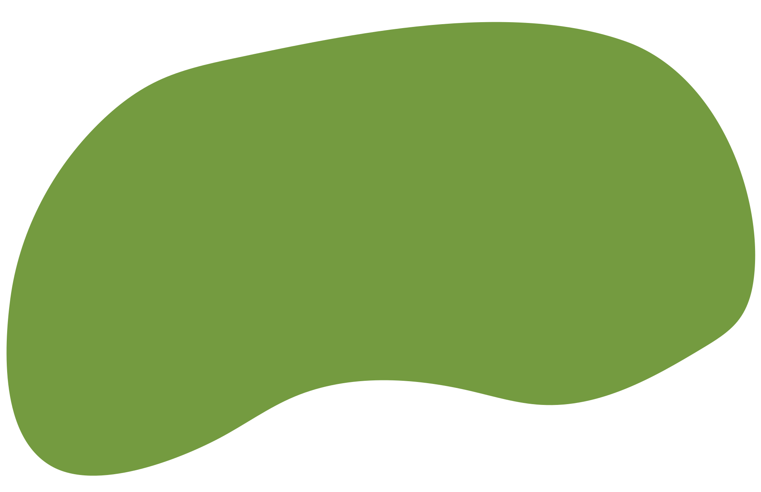
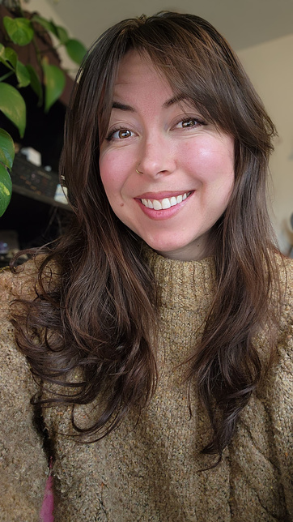

Orientation
for the Susan Testa Nutrition CNS Exam Prep Course 2026
Presented By: Kimberly Hornberg-Payne
www.susantestanutrition.com

Slide 2



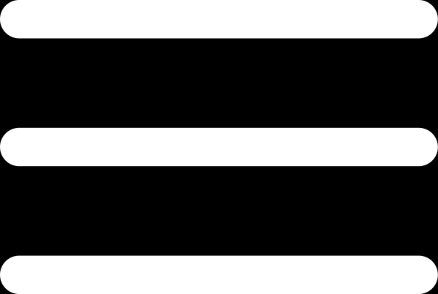
Welcome!
We’re so excited to have you with us!
Today’s purpose & what to expect:
  This is our orientation to talk about the structure and expectations for the test prep program!
    Will be recorded for review and for those who cannot attend live
  Purpose: connect faces with names, build community, and form study groups!
  Reminder: Please complete the Study Group Questionnaire
    Questions to include: time zone, frequency of study, weekly hours available, etc.
    Please be sure to complete those questionnaires by
    Groups matched based on availability, time zone, and effort level.
    **You are not obligated to join a group
Questions?
Please email us at stnexamprep@gmail.com
Notes:
Welcome & Orientation
Welcome, everyone! We’re so excited to have you here and officially get started.
Today is primarily an orientation - an opportunity to connect names with faces and walk through how the prep course will work.
We’ll review the course structure, expectations, schedule, and the resources available to support you.
This session is being recorded so you can revisit it later and so anyone who couldn’t attend can catch up.
One of our goals is also to help anyone interested connect with a study group.
Please complete the Study Group Questionnaire if you haven’t already.
It asks about your time zone, availability, preferred study frequency, and anticipated level of commitment.
Please answer honestly so we can make the strongest matches possible.
Study groups will be matched based on availability, time zone, and desired effort level.
Joining a study group is completely optional - choose what will genuinely support your learning style.
If you have questions after today, email us

Slide 3
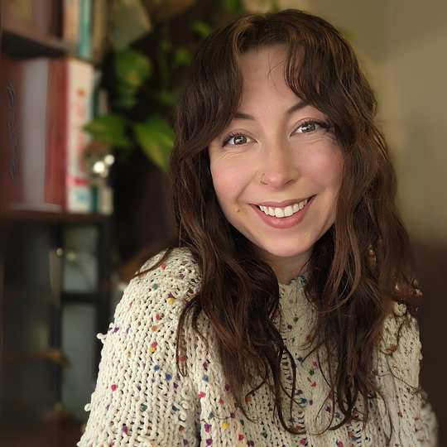
Meet Your Exam
Prep Course
Kimberly Hornberg-Payne
  MS in Nutrition & Integrative Health with a focus in Human Clinical Nutrition & Herbal Medicine
  BS in Business, Entrepreneurship & Small Business Management
  MUIH Alumni
  Licensed Nutritionist in the state of Washington
Facilitator!
& a big shoutout to our course building team!
Susan Testa, MS, RDN, LDN
Alice Lloyd, MS
Shuchita Madan, MS, CNS
Kimberly Hornberg-Payne, MS, CNS
Notes:
Meet Your Facilitator
My name is Kim and I’ll be your primary facilitator throughout the prep course.
I’ll guide our live review sessions, help work through practice questions, and support you as questions come up.
This course was truly a team effort, so I also want to recognize the incredible people who helped build it:
Susan
Alice
Shuchi
Each person brought their own expertise, time, and perspective to make these resources as comprehensive and helpful as possible.
We all continue to refine this work as it grows so thank you for your participation and feedback.

Slide 4


Exam Expectations
  Hard by design: It’s a board exam!
  Passing ≠ perfection: Very few people leave the exam feeling like they’ve ‘nailed it’ (this is normal!)
  The board intentionally prevents 100% scores to maintain rigor.
  Pass rate target: ~65–70%
    For reference: Nursing boards ~70%; Physician boards 85–95%
  There is less guidance/materials for CNS exam than for MD/NP boards → explains lower pass rates.
    That’s why we’re here!
Exam Structure:
  Strong science programs (Bridgeport, etc.) = advantage in biochem.
  Clinical-heavy programs (like MUIH) may need extra review.
  Biochemistry = emphasized more heavily in 2024+ exam cycles.
  Question styles:
    Mix of “easy wins” and extremely detailed/obscure ones.
    Some may feel “out of scope” so reread carefully, and contest if it truly is.
    Trick phrasing (e.g., “best answer” among several possible).
Exam Structure:
Notes:
Exam Expectations
First and foremost: this exam is hard by design - it’s a board exam, and it is meant to challenge you.
Very few people walk out feeling like they completely nailed it. Feeling uncertain afterward is normal and does not mean you failed.
The goal is to pass, not to ace it.
You’ll likely encounter a mix of straightforward questions and very specific or obscure ones.
Recent exam cycles appear to place greater emphasis on biochemistry, so some educational programs may leave you feeling more prepared in that area than others.
Some questions may initially feel outside the CNS scope. Read them carefully and contest a question afterward if you genuinely believe it was inappropriate.
Pay close attention to wording - especially phrases like “best answer.” More than one option may sound reasonable, but one will be the most appropriate.
Our materials are intentionally comprehensive because we cannot predict exactly which topics will appear. It will feel like a random smattering of many topics. That’s normal.
We also recognize that CNS candidates have fewer established prep resources than many other healthcare professions (like nurses or physicians), and that gap is exactly why we created this course.
Bottom line: expect the exam to feel challenging, expect some uncertainty, and don’t let a handful of difficult questions shake your confidence.

Slide 5

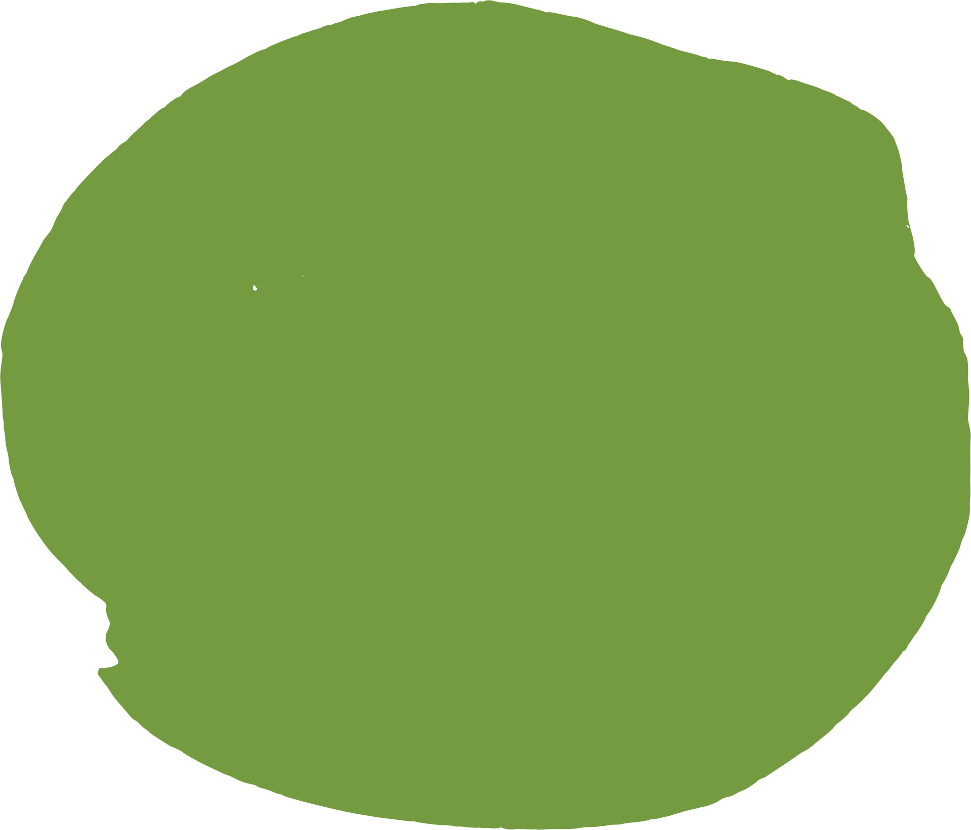
Prep Course Expectations
Cadence & Live Reviews
  Your two-week rhythm:
    Work through the assigned domain materials and slide deck
    Study using the course resources and your own materials
    Complete the available practice questions
    Attend the live session to review, apply, and reinforce
    Meet with your small group (if participating)
  Important: The live review should reinforce your studying, not be your first exposure to the material.
Every two weeks: Live Domain Review
Saturdays at the same time:
7:00 AM PT | 10:00 AM ET
Zoom (link in email & Facebook group)
Notes:
Cadence & Live Reviews
Now that we’ve talked about what to expect from the exam, let’s talk about what to expect from the prep course.
We’ll move through the course in two-week blocks, with each block focused on one domain.
During those two weeks:
Work through the assigned materials and slide deck. (example, you’ll spend the next two weeks working through Domain 1, then we’ll review it together in 2 weeks).
Use the course resources alongside any helpful notes or materials from school.
Complete the available practice tests.
Meet with your small group if you’ve chosen to participate in one.
At the end of each two-week block, we’ll meet for a live domain review.
These sessions will always be held on Saturdays at the same time: 7:00 AM Pacific, 8:00 Mountain, 9:00 Central, and 10:00 Eastern.
The live review is meant to reinforce and solidify what you’ve already studied, not serve as your first exposure to the domain.
The slide decks are intentionally comprehensive, and we won’t be able to review every detail together. I will do my best to parse what I feel is worth the time to review together. I have some slides highlighted and starred for material I feel is crucial to revisit, especially if you’re feeling overwhelmed but that should not be the only material you focus on.
The Zoom link will be shared by email and posted in the Facebook group.

Slide 6


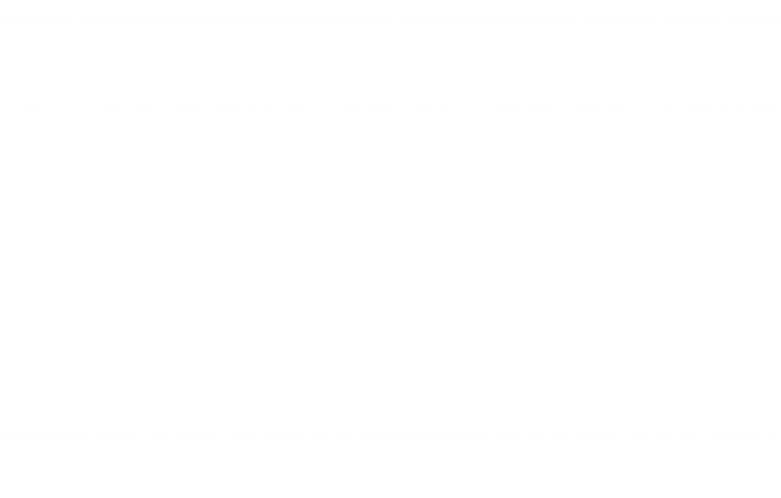
Prep Course Expectations
Getting the Most From Live Reviews
Remember: The course materials are intentionally comprehensive because we cannot predict every topic that may appear on the exam.
You are not expected to master everything at once - focus on consistent progress and repeated exposure.
Before the session:
  Write down questions as you work through the material
  Email me questions ahead of time whenever possible
  Use the Facebook group to ask questions and learn from one another
During the session, we will:
  Prioritize the most relevant and challenging concepts
  Work through sample questions together
  Clarify common areas of confusion
  Reserve time for participant questions
Notes:
Getting the Most From Live Reviews
As you work through each domain, write down your questions as they come up, don’t assume you’ll remember them later.
Whenever possible, please email your questions to me before the live session.
I’ll collect them and reserve time at the end of each review session to address them.
I’m human too, and depending on the question, I may need time to review the material or consult additional resources.
Sending questions early helps me give you the clearest and most accurate answer possible.
You’re still welcome to ask questions during the session, and I’ll answer as many as time allows.
If we run out of time, I’ll follow up with an email and a post in the Facebook group so everyone can benefit from the answers.
I also strongly encourage you to use your study group and our Facebook community:
Bounce questions and challenging concepts off one another.
Someone else may have an answer or a helpful way of explaining it.
Teaching a concept to someone else is one of the best ways to reinforce your own learning.
If you discover a helpful chart, video, Quizlet, mnemonic, study strategy, or other learning resource, please share it in the Facebook group.
If it helped you, there’s a good chance it will help someone else too.
Sharing resources also helps us build community, and community is an integral part of both this course and the broader CNS and integrative-health community.
During our live sessions, we’ll prioritize:
The most relevant and challenging concepts
Sample questions and how to reason through them
Common areas of confusion
Questions submitted by the group
Remember, you are not expected to master everything after seeing it once. Focus on steady progress, repeated exposure, and learning with and from one another.

Slide 7

Study Group Structure
  Groups are self-directed!
    I will not oversee or manage your small groups outside of setting them up
  Keys for success:
    Everyone participates equally!
      Not one person doing all the work
    Match commitment levels
      More study time vs. less study time
      Time & meeting expectations
    Shared responsibility = stronger group outcomes.
  Please fill out your questionnaires asap so we can roll out groups the following week.
If you’re going to be a part of
a small group...
Show up, communicate, engage, and don’t ghost.
If you can’t participate, tell your group!
Notes:
Study Group Structure
Study groups are completely self-directed. I’ll help connect and set up the groups, but I won’t oversee or manage them afterward.
For the group to be successful, everyone needs to participate - one person should not be responsible for organizing or doing all the work.
We’ll do our best to match people with similar availability, study time, and expectations.
Once you’re matched, talk openly about how often you want to meet and what level of commitment everyone can realistically make.
Shared responsibility leads to a stronger and more supportive group experience.
Most importantly:
show up
Communicate
and engage.
If you can’t participate or need to step away, please let your group know rather than disappearing.
Please complete the questionnaire by next Friday so we can send out the study-group matches next week.

Slide 8

Study Group
Best Practices
  Meet weekly (1–2 hours typical)
    Variable based on needs!
  This will need to be determined by you and your groups. This is not something we will manage!
  Align material: Groups often review the same modules, then discuss together.
  Divide topics → use “teach-back” (if you can teach it, you know it).
  Bring questions, insights, and weak areas to meetings.
Suggestions:
  Many groups mix in practice questions (STN CNS Test Prep, Nutrition Test Prep bank with 2,000 questions, Quizlet, Study.com. etc).
  Use real client cases to apply concepts (especially micronutrients, meds, symptoms, family history).
  Best groups: at least 2–3 highly engaged members to keep things running if someone drops.
Notes:
Study Group Best Practices
Most groups meet weekly for about one to two hours, but choose a schedule that works for your group.
Your group is self-directed, we won’t be managing the meetings or deciding how you use that time.
It can help to study the same modules beforehand, then use the meeting to discuss questions and challenging concepts.
You can also divide topics and “teach back” what you learned, if you can explain it, you’re more likely to remember it.
Bring questions, insights, and weak areas to each meeting.
Consider mixing in practice questions from the course or other reputable resources.
Real or sample client cases are another great way to apply concepts like medications, symptoms, micronutrients, and family history.
Aim for at least 2-3 consistently engaged members so the group can continue even if someone has to miss or step away.
Ultimately, adapt the structure based on what helps your group learn best.

Slide 9

Study Content & Resources
Modules:
  Released gradually to help with pacing.
  Mix of easy and harder content to mimic the structure of the exam
  Case studies scattered throughout to help with clinical perspectives of concepts
Content prioritization:
  Biochem + micronutrients = bulk of exam.
    Amino acids are also big!
  Public health is small %, don’t overinvest here.
Practice Exams
  8 practice tests through the course
    Paired with each domain (50 questions each)
  Explanations sent by email → study those, not just the answers.
    **Make sure to put in your email at the top of the Google Form when taking the practice tests to get your answers!
    Each practice test has random and domain-specific questions to test your knowledge right after studying that particular material
  Nutrition Test Prep.com: separate resource with ~2,000 CNS-style questions.
Memorization Strategies
  Smell association (e.g., peppermint/lavender oil while studying & again on exam day)
  Music to help with focus
  Consider the use of memorization tools like mnemonics to help
Notes:
Study Content & Resources
Each domain includes comprehensive modules released gradually to help you pace yourself.
The material includes a mix of foundational and more challenging concepts, plus case studies to build clinical application.
Prioritize based on exam weight—biochemistry and micronutrients make up a large portion, with amino acids being especially important.
Public health represents a smaller percentage, so study it, but don’t overinvest your limited time there.
You’ll receive 8 practice tests (50 questions) - 1 paired with each domain. Ea/ practice test will have a mix of domain-specific questions and random ones to simulate the randomness of the exam itself.
Be sure to enter your email in the Google Form so you receive your responses and explanations.
Don’t just study whether you were right or wrong - study the rationale behind each answer.
NutritionTestPrep.com is a separate optional resource with approximately 2,000 CNS-style questions. A lot of people find this recourse to be helpful, challenging, but helpful.
Experiment with memory tools like mnemonics, music, or sensory associations while studying.
Just confirm testing-center rules before planning to bring or use any scented products on exam day.

Slide 10

Study Time Recommendations
Meet yourself where you’re at
  Not working with clients:
    ~15 hrs/week (≈2 hrs/day).
  Actively working with clients:
    ~10 hrs/week.
  Science-heavy background:
    May get by with 6–10 hrs.
  Time = less important than quality of study (focused sessions, active recall, practice Qs).
  Last 2 weeks: no new material → focus on review and weak areas.
Don’t cram: weekend before, night before, or morning of. By then, you either know it or you don’t.
Use pre-exam time to relax and get focused.
Take study time seriously. Schedule it like an appointment.
Study will be self-guided → stay disciplined.
Notes:
Study Time Recommendations
Study time will look different for everyone, so meet yourself where you’re at.
If you’re not currently working with clients, aim for about 15 hours per week - roughly two hours per day.
If you are actively seeing clients, around 10 hours per week may be more realistic.
If you have a strong science background, you may be comfortable with closer to 6–10 hours. *I did this window of studying but I also work with 40 clients a week*
These are guidelines, not rigid requirements. The quality of your studying matters more than the exact number of hours.
Prioritize focused sessions, active recall, and practice questions - not simply rereading slides.
Schedule study time like an appointment and protect that time.
In the final two weeks, avoid adding new material. Focus on review, practice, and your weaker areas.
Do not cram the weekend or night before - or the morning of the exam. By then, you either know it or you don’t.
Use that final pre-exam time to rest, regulate your nervous system, and arrive focused.
This course is self-guided, so consistency and self-discipline will be important, but your plan should still be realistic for your life.

Slide 11
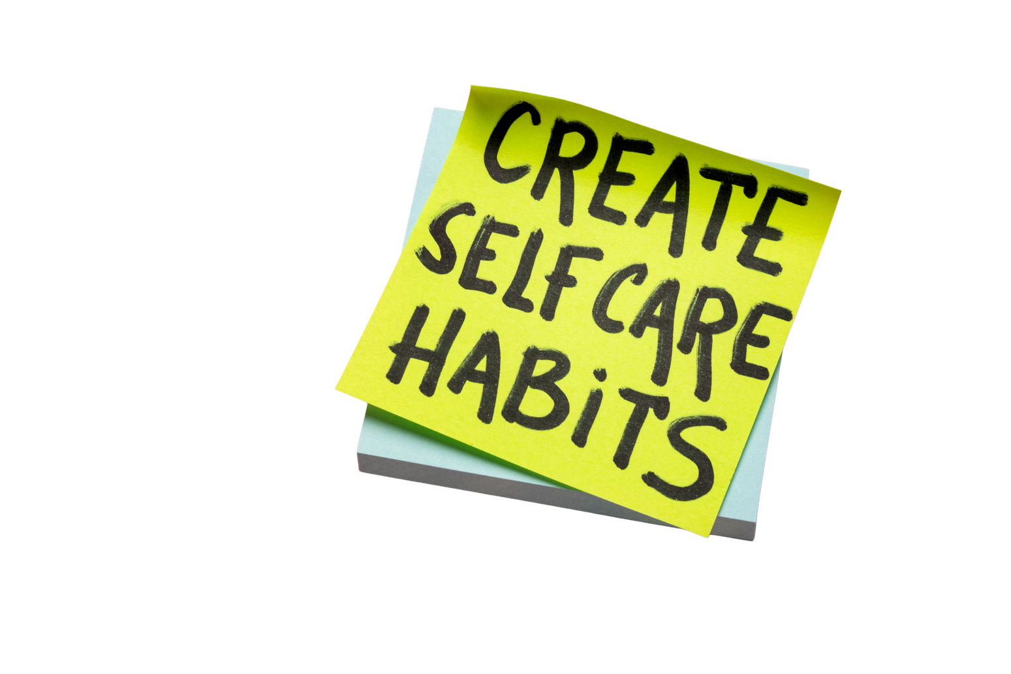
Common Challenges
Self-care matters: rest, stress management, downtime.
Burnout = lower retention!
Plan for breaks & restoration opportunities during your studying season
& Mindset
  Overwhelm is normal — everyone feels it.
  Expect questions you’ve “never seen before” → this is not a reflection of ability.
  Biochem has expanded → expect pathway details (e.g., where metabolites enter Krebs cycle).
  Trick Qs: “What is the best answer?” among several correct ones.
  Retakes happen (not failure, just part of process).
Notes:
Common Challenges & Mindset
Feeling overwhelmed at times is completely normal - the amount of material is substantial.
Expect to encounter questions you’ve never seen before.
Biochemistry has expanded, so be prepared for more detailed pathway questions, including where specific metabolites enter a pathway.
Watch for questions asking for the “best” answer - several choices may be technically correct, but one is most appropriate.
Retakes happen. They are not a failure; sometimes they are simply part of the process.
Please prioritize self-care throughout this season. Rest, stress management, and downtime support learning and retention.
Burnout lowers retention, so intentionally plan breaks and restorative time into your study schedule.
Consistency will serve you better than trying to push at full intensity every day.

Slide 12


Logistics
& Communication
  All of the program information can be found in 2 convenient locations:
  To gain access:
    Join the Facebook group
    You’ll need a password to gain access to the site resource center
    Keep an eye out for emails but outside of our live sessions every other week, this is a self-guided review course
Susan Testa Nutrition Website
(Main Hub!!)
Facebook Group
  Announcements, practice questions, community sharing & support
  Program resources (e.g., modules, practice tests, e-books, etc.)
  Official announcements
  Study group assignments
Notes:
Logistics & Communication
All course info will be available in 2 main places: the Facebook group and Susan Testa Nutrition website.
The website is our primary resource hub for modules, slide decks, practice tests, e-books, study-group assignments, and official announcements.
You’ll need a password to access the course resource center – but if you found this orientation then you likely have it.
The Facebook group is our more interactive community space for announcements, practice questions, discussion, and peer support.
Please check both locations regularly, especially between live sessions.
Keep an eye on your email as well, but remember that this is primarily a self-guided course - we will not send weekly reminders for every assignment or deadline.
If you have trouble accessing either resource, please reach out so we can help.

Slide 13

Participant Experiences
& Tips
  Retakes can happen, this is a big exam!
  Clinical experience improves confidence and recall.
  Taking exam right after school → works better for science-heavy programs.
    Clinical-heavy (MUIH) may benefit from waiting, and brushing up on these topics.
  Teaching, webinars, and mentoring reinforce knowledge.
    Focus study time on biochem, micronutrients, and case application, not on small domains!!
Shared
experiences:
  Feeling unprepared is universal.
    Most of everyone leaves the exam feeling overwhelmed
  Importance of deeper detail, not just mnemonics.
    Understand the why behind what you’re studying to gain better understanding of the whole picture
  Practical case use strengthens recall!
Notes:
Participant Experiences & Tips
These insights come directly from previous participants who have taken the exam.
First, retakes happen. This is a big, challenging exam, and needing another attempt does not define your ability or future as a clinician.
Many participants found that clinical experience improved their confidence and recall because they had real cases to connect with the material.
Timing after graduation may depend on your program:
Those coming from science-heavy programs may benefit from testing while that material is still fresh.
Those from more clinically focused programs may benefit from gaining experience while brushing up on biochemistry and micronutrients.
Teaching, webinars, mentoring, and real-world application can all reinforce what you’re learning.
Be strategic with your time: prioritize biochemistry, micronutrients, and case application rather than overinvesting in smaller domains.
Go beyond memorizing mnemonics. Understanding the “why” helps you connect concepts and answer application-based questions.
Above all, practical case use strengthens recall. The more you apply the material, the easier it becomes to retrieve.

Slide 14

Closing & Next Steps
  Stay engaged with your group.
  Practice exams are learning tools, not just score checks.
    Study the questions you missed, understand the why
  Emphasize mechanisms, patterns, and connections over just memorization.
  Expect announcements in Facebook & on the website next week with study group details.
  Remember: You can use this course for as long as you need to pass the exam. I’ve been in your shoes, I know how this chapter feels. Reach out if you need anything. We’re in this together! You got this!
  Look out for group announcements if you plan to participate in a small group
  Start building a study schedule that fits within your life & gives you enough time to brush up on everything
  Reach out if you have any questions!!
Email: stnexamprep@gmail.com
Notes:
Closing & Next Steps
Stay engaged with your study group and the broader course community.
Treat practice exams as learning tools, not just score checks. Review what you missed and make sure you understand the “why.”
Focus on mechanisms, patterns, and connections rather than memorizing isolated facts.
Watch for announcements next week with study-group details.
Start building a realistic study schedule that gives you enough time to work through and revisit the material.
Remember, you can continue using the course for as long as you need to pass the exam.
I’ve been in your shoes, and I know how overwhelming this chapter can feel - please reach out if you need support.
We’re in this together. You’ve got this!

Slide 15


Thank You!
Questions?

