Slide 1


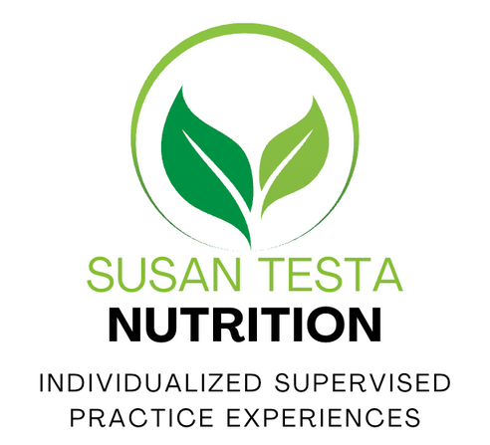
Domain II:
Nutritional Biochemistry
CNS EXAM PREP COURSE
1
Caption

Slide 2
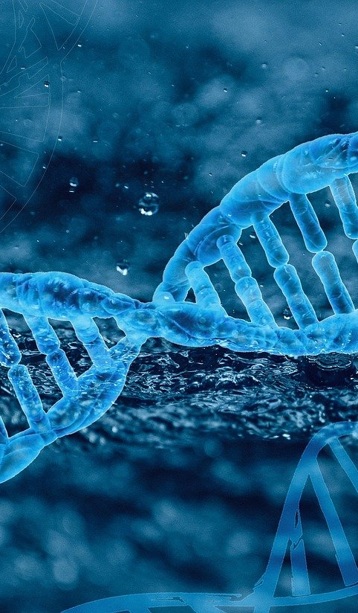
Energy Metabolism
Metabolism (biochemical pathways and reactions) of carbohydrates, lipids, proteins, and micronutrients
Nutritional biochemical pathways, including energy production and detoxification
Role of oxidative stress and detoxification pathways on health status
Lipid metabolism, including cytokine and eicosanoid pathways
**Slides will separate the above domain areas via a blue heading
D
O
M
A
I
N
II
2
Caption

Slide 3

Macronutrient Metabolism-
(biochemical pathways & reactions)
Macronutrient metabolism is the process by which the body breaks down carbohydrates, fats, and proteins to produce ATP, the energy currency of the cell.
Although each macronutrient enters through different pathways, they eventually converge in the TCA cycle and the electron transport chain (ETC) to generate energy.
Macronutrient metabolism allows the body to:
    Produce ATP for all cellular functions
    Maintain blood glucose and energy balance
    Store excess energy (fat storage) or release stored energy (lipolysis)
    Adapt to fed vs fasting states
Notes:
Macronutrient metabolism is how carbs, fats, and proteins are broken down to produce ATP, the cell’s energy currency.
Each macronutrient starts in a different pathway, but they all converge at the TCA cycle and the electron transport chain.
This system allows the body to generate energy, regulate blood glucose, and manage energy storage vs release.
It also helps the body adapt between fed and fasting states.
Quick exam tip: Different entry pathways, but same final energy system — TCA cycle + ETC.

Slide 4
Carbohydrate Metabolism
Primary role: Rapid energy production
Energy yield: 4 kcal/g
After digestion, carbs become glucose, which may be:
Used for energy: Glycolysis → TCA cycle → ETC
Stored for later: Glycogenesis
Released from storage: Glycogenolysis
Made when needed: Gluconeogenesis
Redirected for other functions: Pentose phosphate pathway (PPP)
Hormonal regulation
Insulin: Promotes glucose uptake and storage
Glucagon: Promotes glucose production and release
Glucose-dependent tissues
RBCs rely entirely on glucose because they lack mitochondria
The brain primarily uses glucose under normal conditions
Notes:
Carbs provide 4 calories per gram and are a rapid source of energy.
After digestion, glucose can be used immediately, stored as glycogen, or produced when blood glucose is low.
Glycolysis begins glucose breakdown; its products can continue through the TCA cycle and ETC when oxygen and mitochondria are available.
Insulin generally promotes glucose use and storage, while glucagon promotes its production and release.
RBCs depend entirely on glucose; the brain primarily uses it under normal conditions.
Quick exam tip: Glycogenesis stores glucose, glycogenolysis releases stored glucose, and gluconeogenesis makes new glucose.

Slide 5
Aerobic vs Anaerobic Metabolism
Aerobic metabolism | Anaerobic metabolism
Pyruvate → acetyl-CoA | Pyruvate → lactate
Occurs when oxygen and mitochondrial capacity are sufficient | Increases when energy demand exceeds aerobic capacity
Continues through the TCA cycle + ETC | Regenerates NAD⁺ so glycolysis can continue
Produces about 30–32 ATP per glucose | Produces 2 ATP per glucose through glycolysis
Slower, sustained energy production | Rapid, short-term energy production
Supports lower-intensity, longer-duration activity | Supports high-intensity activity
Requires functioning mitochondria Ex. TCA cycle | Used exclusively by RBCs, which lack mitochondria Ex. Lactate formation
**Lactate can be used as fuel by other tissues or transported to the liver for glucose production through the Cori cycle.
Notes:
Let’s talk about Aerobic vs Anaerobic Metabolism
After glycolysis, pyruvate has 2 primary fates.
When oxygen & mitochondrial capacity are sufficient, pyruvate becomes acetyl-CoA & enters the TCA cycle + ETC.
Aerobic metabolism is slower but highly efficient, producing about 30–32 ATP per glucose.
When energy demand exceeds aerobic capacity, pyruvate becomes lactate.
This regenerates NAD⁺ so glycolysis can continue producing rapid ATP—only 2 ATP per glucose.
RBCs always produce lactate because they lack mitochondria; working muscle increases lactate production during intense activity.
Lactate can be reused as fuel or sent to the liver for glucose production through the Cori cycle.

Slide 6
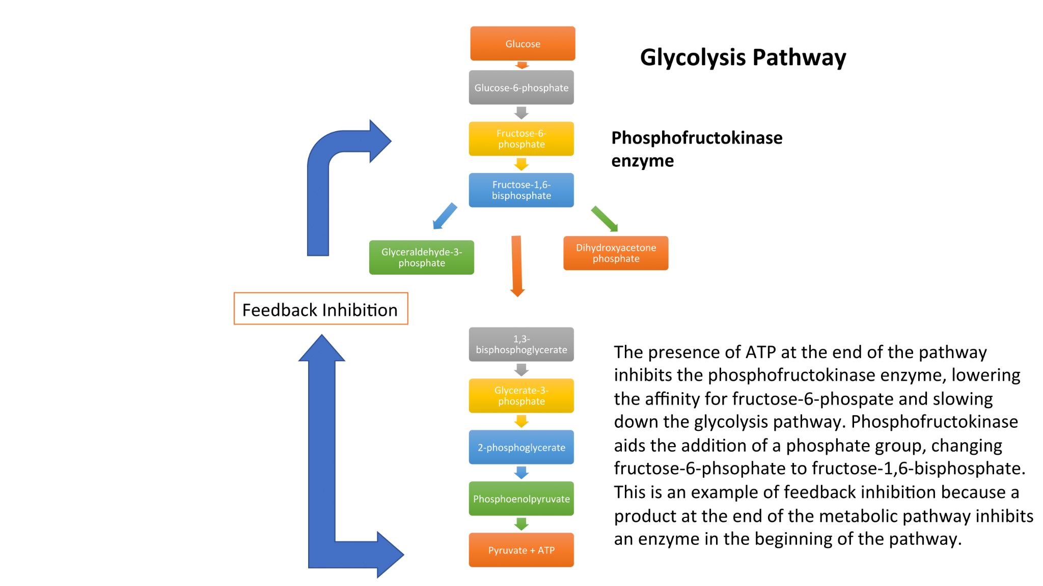
Glycolysis
First major step in glucose metabolism
Occurs in the cytosol of all cells
Does not require oxygen (anaerobic)
Converts 1 molecule of glucose → 2 pyruvate
Produces net 2 ATP and 2 NADH
Key regulatory enzymes:
  Hexokinase/Glucokinase (traps glucose inside cells)
  PFK-1 (rate-limiting step)
  Pyruvate kinase
*This pathway provides quick ATP for cells, especially during high-intensity activity.
Helpful video resource here!
Notes:
Glycolysis is the first major step in breaking down glucose for energy.
It occurs in the cytosol & does not directly require oxygen (an anaerobic pathway)
One glucose produces 2 pyruvate, a net 2 ATP & 2 NADH.
Key regulatory enzymes:
Hexokinase/glucokinase: phosphorylate glucose, trapping it in the cell
PFK-1: rate-limiting enzyme
Pyruvate kinase: catalyzes the final ATP-producing step
Glycolysis provides quick ATP, especially during high-intensity activity

Slide 7
Glucose Sources &
Metabolic Fates
Sources of blood glucose
Dietary carbs
Liver glycogen breakdown
Gluconeogenesis during fasting
Dietary monosaccharides
Glucose
Fructose*
Galactose*
**Fructose and galactose are converted into intermediates that enter glycolysis.
Beyond ATP production:
Glucose and glycolytic intermediates can also support:
Glycogen storage
Pentose phosphate pathway → ribose + NADPH
Fatty acid and triglyceride synthesis
Amino acid synthesis
Key concept: Glucose-6-phosphate is a metabolic crossroads - not the committed step of glycolysis.
PFK-1 is the committed rate-limiting step!!
Notes:
Let’s talk about the fates of glucose sources
Blood glucose comes from dietary carbs, liver glycogen & gluconeogenesis.
Dietary carbs provide glucose, fructose & galactose, which enter glycolysis through different intermediates.
Glucose intermediates aren’t used only for ATP - they also support glycogen, fat, amino acid & nucleotide synthesis.
Glucose-6-phosphate is a metabolic crossroads because it can enter glycolysis, glycogen synthesis or the PPP.
Exam tip: PFK-1 (not G6P formation) is the committed, rate-limiting step of glycolysis.

Slide 8
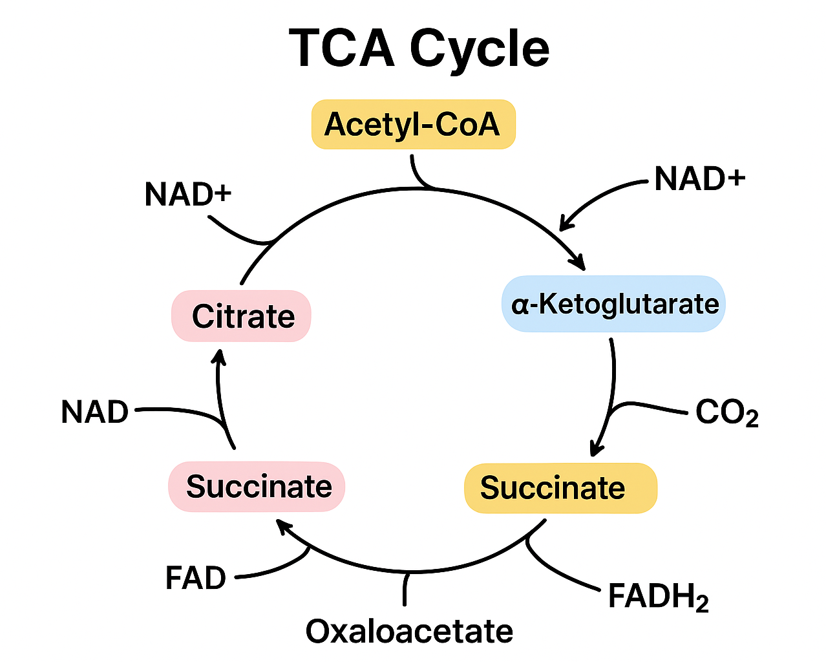
TCA/Krebs Cycle & Carb Metabolism
Glucose → Glycolysis → Pyruvate → Acetyl-CoA → TCA Cycle → ETC
Occurs in the mitochondria
Pyruvate → acetyl-CoA requires several cofactors, including vitamin B1
Acetyl-CoA + oxaloacetate → citrate, beginning the TCA cycle
Each acetyl-CoA produces:
  3 NADH
  1 FADH₂
  1 GTP/ATP (*GTP is energetically equivalent to ATP)
  2 CO₂
NADH & FADH₂ carry electrons to the ETC
Total yield: ~10 ATP per acetyl-CoA
Central metabolic hub connecting carbs, fats & proteins
Helpful video resource here!
Notes:
TCA/Krebs Cycle
This connects carb metabolism to the TCA cycle.
Glycolysis produces pyruvate, which enters the mitochondria & becomes acetyl-CoA.
This step requires several cofactors, including B1.
Acetyl-CoA combines with oxaloacetate to form citrate & begin the cycle.
Each turn produces 3 NADH, 1 FADH₂ & 1 GTP - yielding about 10 ATP after the ETC.
The TCA cycle is a central hub because carbs, fats & proteins can all feed into it.
Remember: The TCA cycle produces little ATP directly - its main role is generating NADH & FADH₂ for the ETC.

Slide 9
Why the TCA Cycle is the "Hub" of Metabolism
All macronutrients → Acetyl-CoA → TCA cycle
Convergence of macronutrient metabolism
Carbs: Glucose → pyruvate → acetyl-CoA
Fats: Fatty acids → β-oxidation → acetyl-CoA
Proteins: Amino acids → acetyl-CoA or TCA intermediates
Requires key micronutrients
B1 (thiamine): Pyruvate dehydrogenase & α-ketoglutarate dehydrogenase
B2 (riboflavin): FAD/FADH₂
B3 (niacin): NAD⁺/NADH
B5 (pantothenic acid): Coenzyme A
Magnesium: Enzyme cofactor
Lipoic acid: Dehydrogenase complexes
Connects major pathways
Glycolysis & pyruvate oxidation
β-oxidation
Amino acid catabolism
Electron transport chain
Anaplerotic reactions that replenish intermediates
Supplies biosynthetic intermediates
α-Ketoglutarate → Glutamate & other amino acids
Succinyl-CoA → Heme
Citrate → Fatty acids & cholesterol
Oxaloacetate → Glucose through gluconeogenesis
Key concept: The TCA cycle is amphibolic - it supports both energy production and biosynthesis.
Notes:
The TCA cycle is called the metabolic hub because carbs, fats & proteins all connect with it.
Carbs and fats primarily enter through acetyl-CoA, while amino acids can enter as acetyl-CoA or directly as TCA intermediates.
The cycle captures energy as NADH and FADH₂, which carry electrons to the ETC for ATP production.
It depends on several micronutrients, especially vitamins B1, B2, B3, B5, magnesium & lipoic acid.
TCA intermediates can also leave the cycle to support glucose, fatty acid, amino acid, neurotransmitter & heme synthesis.
Anaplerotic reactions replenish these intermediates so the cycle can continue functioning.
Remember: The TCA cycle is both catabolic (breaking fuels down for energy) and anabolic (providing building blocks for biosynthesis).

Slide 10

Combined ATP Yield
(from TCA → ETC)
Per acetyl-CoA entering the TCA cycle:
3 NADH → ~7.5 ATP through the ETC
1 FADH₂ → ~1.5 ATP through the ETC
1 GTP → 1 ATP directly
Total → ~10 ATP per acetyl-CoA
Per glucose:
1 glucose → 2 pyruvate → 2 acetyl-CoA
2 TCA turns → ~20 ATP
Pyruvate oxidation → ~5 additional ATP
Pyruvate oxidation + TCA-linked ETC → ~25 ATP
Complete aerobic glucose metabolism → ~30–32 ATP total, including glycolysis
Key concept: The TCA cycle produces only 2 GTP directly per glucose. Most of its ATP yield is produced indirectly when NADH and FADH₂ deliver electrons to the ETC.
Notes:
Each acetyl-CoA completes one turn of the TCA cycle, producing 3 NADH, 1 FADH₂ & 1 GTP.
The GTP (energy equivalent of ATP) is produced directly, while NADH and FADH₂ carry electrons to the ETC, where most ATP is generated.
This equals about 10 ATP per acetyl-CoA or 20 ATP from the two TCA turns produced by one glucose.
The conversion of two pyruvate into two acetyl-CoA produces another 2 NADH, worth about 5 ATP through the ETC.
Together, pyruvate oxidation and the TCA cycle account for about 25 ATP per glucose.
Including glycolysis, complete aerobic glucose metabolism yields approximately 30–32 ATP.
Remember: If a question asks for the yield of the TCA cycle alone, think 10 ATP equivalents per acetyl-CoA. If it includes pyruvate oxidation, think 12.5 ATP per pyruvate.

Slide 11
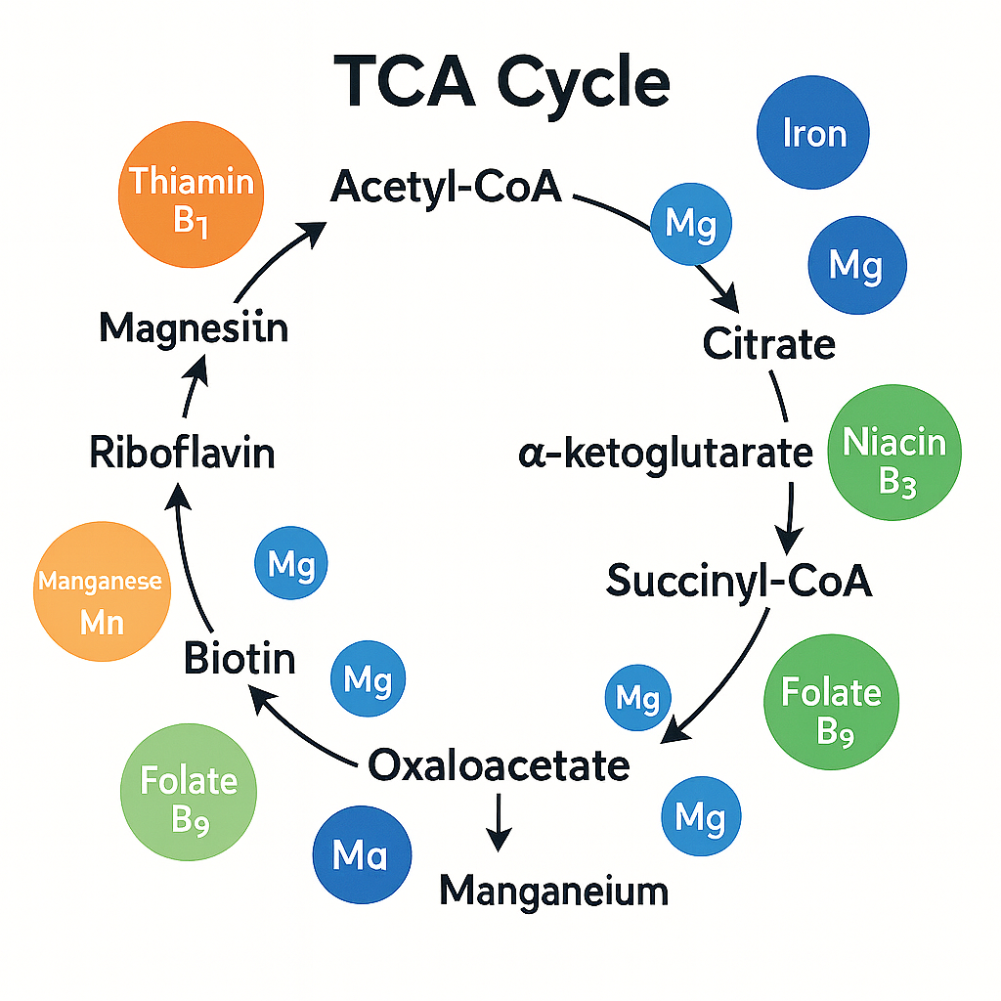
Notes:
Another TCA diagram

Slide 12
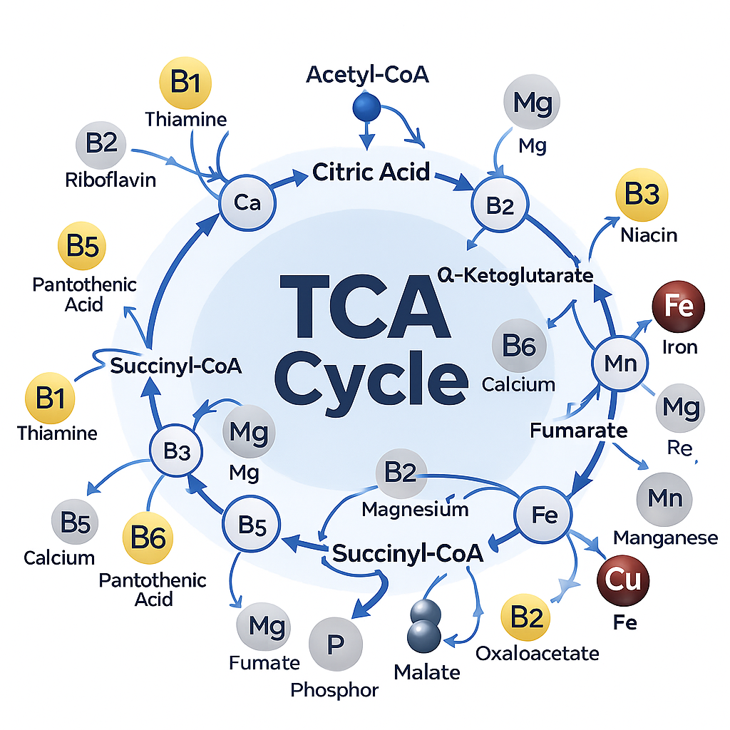
Caption
Notes:
Another TCA diagram

Slide 13
Summary Table - Energy Pathways and Required Nutrients
Pathway | Key Nutrients Required | Why They Matter
Glycolysis | B1, B2, B3, Mg | Glucose → ATP
Pyruvate → Acetyl-CoA | B1, B2, B3, B5, Lipoic acid | Connects glycolysis → TCA
TCA Cycle | B1, B2, B3, B5, Fe, Mg | Generates NADH/FADH₂
ETC | Fe, Cu, CoQ10, O₂ | Produces most ATP
Beta-Oxidation | Carnitine, B2, B3, B5, Mg | Fat → ATP
Amino Acid Catabolism | B6, B12, Folate | Protein → energy
Ketogenesis | B2, B3, CoA | Fats → ketones
Notes:
This table connects the major energy pathways with the nutrients they depend on. These nutrients do not provide energy directly - they act as cofactors, coenzymes or structural components that allow ATP production to occur.
Glycolysis relies especially on B vitamins and magnesium to convert glucose into pyruvate while producing a small amount of ATP and NADH.
Pyruvate dehydrogenase requires B1, B2, B3, B5 & lipoic acid to convert pyruvate into acetyl-CoA. This is the bridge connecting glycolysis with the TCA cycle.
The TCA cycle uses B vitamins, iron & magnesium to generate NADH and FADH₂. These electron carriers are important because they deliver high-energy electrons to the ETC.
The ETC depends on iron, copper, CoQ10 & oxygen to generate most of the ATP made during aerobic metabolism. Oxygen serves as the final electron acceptor.
Beta-oxidation requires carnitine to transport long-chain fatty acids into mitochondria, plus B2, B3, B5 & magnesium to break fats into acetyl-CoA and produce electron carriers.
Amino acid catabolism relies heavily on B6 for removing amino groups, while B12 and folate support one-carbon metabolism and the processing of certain amino acids.
Ketogenesis uses B2, B3 & CoA to convert fat-derived acetyl-CoA into ketones when carb availability or insulin is low.
The key takeaway is that energy production depends on adequate micronutrients. A person can consume enough carbs, fats and protein, but deficiencies in these cofactors may limit how efficiently those fuels are converted into ATP.
Quick concept tip: Think B vitamins help process fuel, minerals support the enzymes and ETC & oxygen completes aerobic ATP production.

Slide 14
Glycogenesis & Glycogenolysis
Glycogenesis = glycogen storage
Glucose → glycogen
Occurs mainly in the liver and skeletal muscle
Stimulated by insulin
Key enzyme: glycogen synthase
Prominent in the fed state
Glycogenolysis = glycogen breakdown
Glycogen → glucose-1-phosphate → glucose-6-phosphate
Stimulated by glucagon in the liver and epinephrine in the liver and muscle
Key enzyme: glycogen phosphorylase
Prominent during fasting, stress & exercise
Liver vs. muscle
Liver glycogen: Maintains blood glucose
Muscle glycogen: Provides energy for the muscle itself
Helpful video resource here!
Notes:
Glycogen Storage & Breakdown
Glycogenesis stores excess glucose as glycogen, primarily in the liver & muscles.
Insulin activates glycogen synthase, making this most active in the fed state.
Glycogenolysis (lysis = to break) breaks glycogen down when glucose or energy is needed.
Glucagon stimulates liver glycogenolysis, while epinephrine acts in both the liver & muscle.
The liver can release free glucose into the blood; muscle glycogen is reserved for local energy.

Slide 15
Gluconeogenesis
Gluconeogenesis is the production of new glucose, mainly in the liver but also in the kidneys, during fasting. This pathway is essential when the body’s carbohydrate stores are depleted.
  Occurs mainly in the liver, some in kidney
  Produces glucose during fasting
  Main substrates: Lactate, glycerol, amino acids (alanine)
  Opposes glycolysis; stimulated by glucagon and cortisol
  Inhibited by insulin
  Essential for maintaining blood glucose during prolonged fasting or low-carb intake.
  Helpful video resource here!
Notes:
Gluconeogenesis
Gluconeogenesis (neogenesis = to create) creates new glucose when glycogen stores are running low.
It occurs mainly in the liver, with the kidneys contributing more during prolonged fasting.
The main substrates are lactate, glycerol & glucogenic amino acids - especially alanine.
It is stimulated by glucagon, cortisol & epinephrine, while insulin inhibits it.
This pathway helps maintain blood glucose during fasting, prolonged exercise or very low-carb intake.
Distinction: Glycogenolysis releases stored glucose; gluconeogenesis makes new glucose.

Slide 16
Lipid Metabolism
Lipids are the most energy-dense nutrient at 9 calories per gram. They are vital for energy storage, insulation, hormone production, and cell membrane structure.
Key processes:
  Lipid digestion & absorption
  Fatty acid transport
  Beta-oxidation (energy production)
  Lipogenesis (fat creation)
  Ketogenesis (fuel during fasting)
Remember: Fat metabolism shifts depending on energy status - storage in the fed state, breakdown during fasting.
Notes:
Okay now that we covered carbs and the various fates of glucose, let’s talk about lipids!
Lipids are the most energy-dense macronutrient, providing 9 kcal/gram.
They play key roles in energy storage, insulation, hormone production, and cell membrane structure.
Major lipid metabolism processes include:
Digestion and absorption
Fatty acid transport
Beta-oxidation for energy production
Lipogenesis for fat storage
Ketogenesis during fasting or low carbohydrate intake
Remember: Fat metabolism shifts depending on energy status - storage in the fed state, breakdown during fasting.

Slide 17
Lipid Digestion & Transport
Begins in small intestine
Bile salts emulsify fats → micelles
Pancreatic lipase breaks triglycerides into FA + monoglycerides
Absorbed into enterocytes → reassembled → packaged into chylomicrons
Chylomicrons enter lymph → bloodstream → deliver dietary fat to tissues
Quick exam tip: Most nutrients enter the bloodstream directly, but long-chain dietary fats are packaged into chylomicrons & travel through the lymph first.
Helpful video resource here!
Notes:
Lipid digestion mainly occurs in the small intestine.
Bile salts emulsify fats, forming micelles that increase surface area for digestion.
Pancreatic lipase breaks triglycerides into fatty acids and monoglycerides.
These are absorbed into enterocytes, reassembled into triglycerides, and packaged into chylomicrons.
Chylomicrons enter the lymph first, then the bloodstream to deliver dietary fat to tissues.

Slide 18
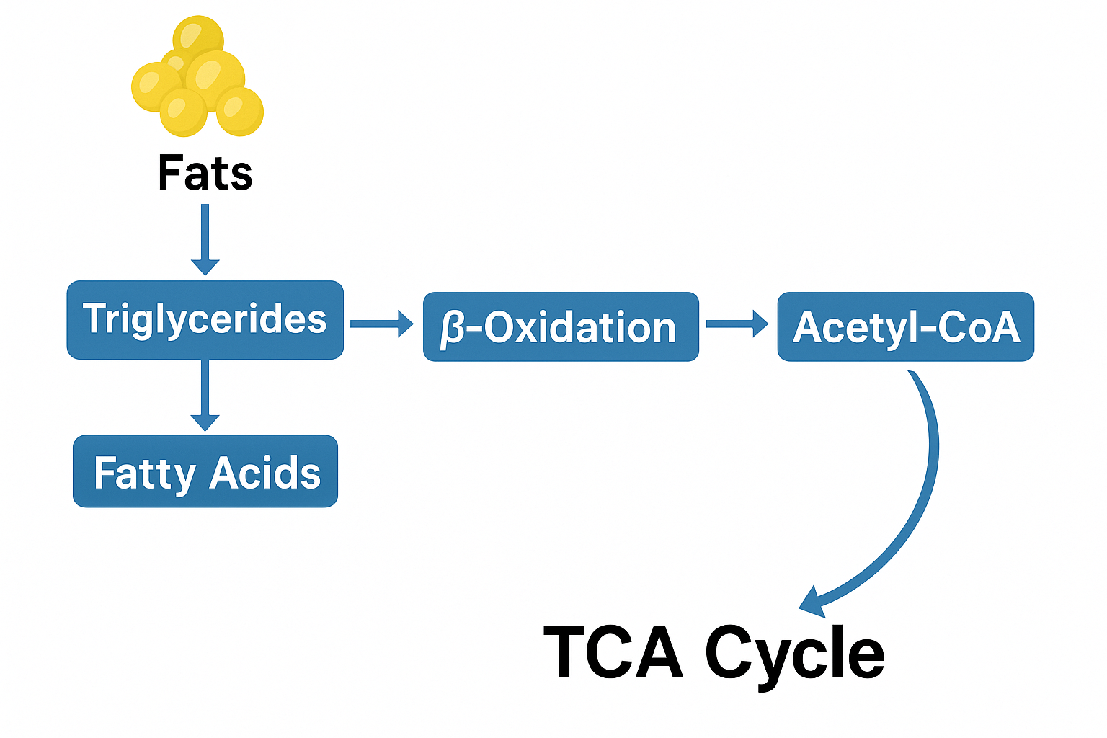
How Fats Feed Into the TCA Cycle
Fat → Fatty Acids → β-oxidation → Acetyl-CoA
    Fatty acids undergo β-oxidation in mitochondria.
    Each cycle of β-oxidation releases one Acetyl-CoA.
    These Acetyl-CoA molecules enter the TCA cycle.
  Why fats produce more ATP:
    Fatty acids have long carbon chains → many Acetyl-CoA units → multiple turns of the TCA cycle.
Exam tip: “Fat burns in the flame of carbs” - adequate OAA helps acetyl-CoA enter the TCA cycle; limited OAA favors ketogenesis.
Notes:
Fat metabolism occurs in 3 steps:
Mobilization of stored fat →
β-oxidation of fatty acids →
acetyl-CoA enters the TCA cycle to produce ATP.
For acetyl-CoA to enter the TCA cycle, it must combine with oxaloacetate ‘ox-uh-loh-AS-uh-tate’ (OAA).
OAA mainly comes from carbs (pyruvate → OAA) and some amino acids (aspartate and asparagine)
When carbs are very low, OAA decreases, so acetyl-CoA cannot efficiently enter the TCA cycle.
The excess acetyl-CoA is then diverted to ketone production.
Quick exam tip: Fat burns in the flame of carbohydrate — carbs help supply the OAA needed for the TCA cycle.

Slide 19
Lipolysis
Lipolysis = breakdown of stored triglycerides
Triglyceride → glycerol + 3 fatty acids
Occurs primarily in adipose tissue
Stimulated during fasting, exercise & stress
Stimulated by epinephrine and norepinephrine
Inhibited by insulin
Fatty acids travel in blood bound to albumin → beta-oxidation
Glycerol travels to the liver → gluconeogenesis or glycolysis
Key enzymes:
Adipose triglyceride lipase (ATGL)
  begins triglyceride breakdown
Hormone-sensitive lipase (HSL)
  acts on diglycerides
Monoglyceride lipase (MGL)
  completes the process
Helpful video resource here!
Notes:
Lipolysis mobilizes stored energy by breaking triglycerides into glycerol & 3 fatty acids.
It occurs mainly in adipose tissue during fasting, exercise or increased energy demand.
Catecholamines (epinephrine and norepinephrine) stimulate lipolysis, while insulin inhibits it.
Fatty acids travel through the blood bound to albumin & can undergo beta-oxidation.
Glycerol travels to the liver, where it can support gluconeogenesis or enter glycolysis.
ATGL begins triglyceride breakdown, HSL acts on diglycerides & MGL completes the process.
Distinction: Lipolysis releases stored fatty acids; beta-oxidation breaks those fatty acids down into acetyl-CoA.

Slide 20
Beta-Oxidation
(Fatty acid oxidation)
Occurs in mitochondria
Fatty acids broken down 2 carbons at a time → acetyl-CoA
Produces large amounts of NADH/FADH₂ → ATP
Example: Palmitate produces ~106 ATP
Activated during fasting, aerobic exercise, and low-carb diets.
Helpful video resource here!
Notes:
Beta-oxidation occurs in the mitochondria and breaks fatty acids down 2 carbons at a time into acetyl-CoA.
The acetyl-CoA then enters the TCA cycle to produce ATP.
This is a very efficient energy pathway. For example, palmitate can generate around 106 ATP, far more than glucose.
Beta-oxidation becomes especially important during fasting, endurance exercise, and low-carbohydrate intake.

Slide 21
Lipogenesis (De Novo Lipogenesis)
Lipogenesis = "Creating fat" from carbohydrates and protein
Occurs in liver & adipose
Insulin stimulates lipogenesis after high-carb meals
Fatty acid synthase is key enzyme
Stores excess energy as triglycerides
Helpful video resource here!
Remember: Insulin promotes fat storage by stimulating lipogenesis.
Notes:
Lipogenesis is the process of creating fat from excess carbs or protein.
It occurs mainly in the liver and adipose tissue.
After high-carb meals, insulin stimulates lipogenesis.
The key enzyme involved is fatty acid synthase.
The end result is storage of excess energy as triglycerides.

Slide 22
Ketogenesis
Occurs in liver mitochondria
When carbs are low: acetyl-CoA builds up → ketone bodies
Provides energy for brain, heart, and muscle during fasting
Ketones: acetoacetate, β-hydroxybutyrate, acetone
Important adaptation for starvation.
Helpful video resource here!
Remember: Low carbs → increased acetyl-CoA → ketone production.
Notes:
Ketogenesis occurs in the liver mitochondria.
When carbohydrate availability is low, acetyl-CoA accumulates and is converted into ketone bodies.
Ketones serve as an alternative fuel for the brain, heart, and muscles during fasting.
The main ketone bodies are acetoacetate, β-hydroxybutyrate, and acetone.
This is an important metabolic adaptation during prolonged fasting or starvation.
Quick exam tip: Low carbs → increased acetyl-CoA → ketone production.

Slide 23
Protein Metabolism
Proteins are broken down into amino acids, used for:
Muscle & tissue growth
Enzymes, hormones, immune function
Energy production when needed
Not a primary energy source unless fasting, illness, or low-carb states.
4 kcal/g
Roles: structure, enzymes, hormones, transport, acid–base balance
Notes:
Okay now that we’ve reviewed carbs & fat metabolism, let’s talk proteins!
Proteins are broken down into amino acids, which support many essential functions.
They are used for muscle and tissue growth, enzymes, hormones, and immune function.
Protein can also provide energy when needed, especially during fasting, illness, or low-carbohydrate states, but it is not the body’s primary energy source.
Protein provides 4 kcal per gram.
Key roles include structure, enzymes, hormones, transport, and acid–base balance.

Slide 24
Proteins:
Digestion & Absorption
Stomach
HCl denatures proteins and activates pepsin
Pepsin begins breaking proteins into smaller polypeptides
Small intestine
Pancreatic proteases continue digestion:
  Trypsin
  Chymotrypsin
  Carboxypeptidases
Brush-border peptidases complete digestion
Absorption and transport
Absorbed as amino acids, dipeptides and tripeptides
Small peptides are broken into amino acids inside enterocytes
Amino acids enter the portal blood → liver → systemic circulation
Pancreatic proteases are secreted as inactive zymogens to protect the pancreas from self-digestion.
Cheat Sheet:
Pepsin = stomach
Pancreatic proteases = small intestine
Amino acids enter portal blood before systemic circulation.
Notes:
Protein digestion begins in the stomach, where HCl unfolds proteins & activates pepsin.
Pepsin begins breaking proteins into smaller polypeptides.
In the small intestine, pancreatic proteases (especially trypsin, chymotrypsin & carboxypeptidases) continue digestion.
Brush-border enzymes help produce amino acids, dipeptides & tripeptides for absorption.
Small peptides are further broken down inside enterocytes.
AAs then enter portal blood & travel to the liver for processing before reaching other tissues.
Pancreatic proteases are released as inactive zymogens to prevent pancreatic self-digestion.

Slide 25
Amino Acid Pool
The amino acid pool is the body’s dynamic supply of free amino acids available in the blood and cells.
Sources:
Dietary protein digestion and absorption
Breakdown and turnover of body proteins
De novo synthesis of nonessential amino acids
Amino acids may be used for:
Protein and tissue synthesis
Enzymes, hormones and neurotransmitters
Immune function
Glucose production through gluconeogenesis
Energy production when needed
Key concept: The body has no dedicated storage form for excess AAs, so the pool must be continuously replenished.
Notes:
The amino acid pool is the supply of free AAs available in the blood & cells.
It is constantly replenished through dietary protein, normal protein turnover & synthesis of nonessential AAs.
These AAs support tissue proteins, enzymes, hormones, neurotransmitters & immune function.
They can also support gluconeogenesis or energy production when needed.
Unlike carbs & fats, AAs do not have a dedicated long-term storage form.

Slide 26
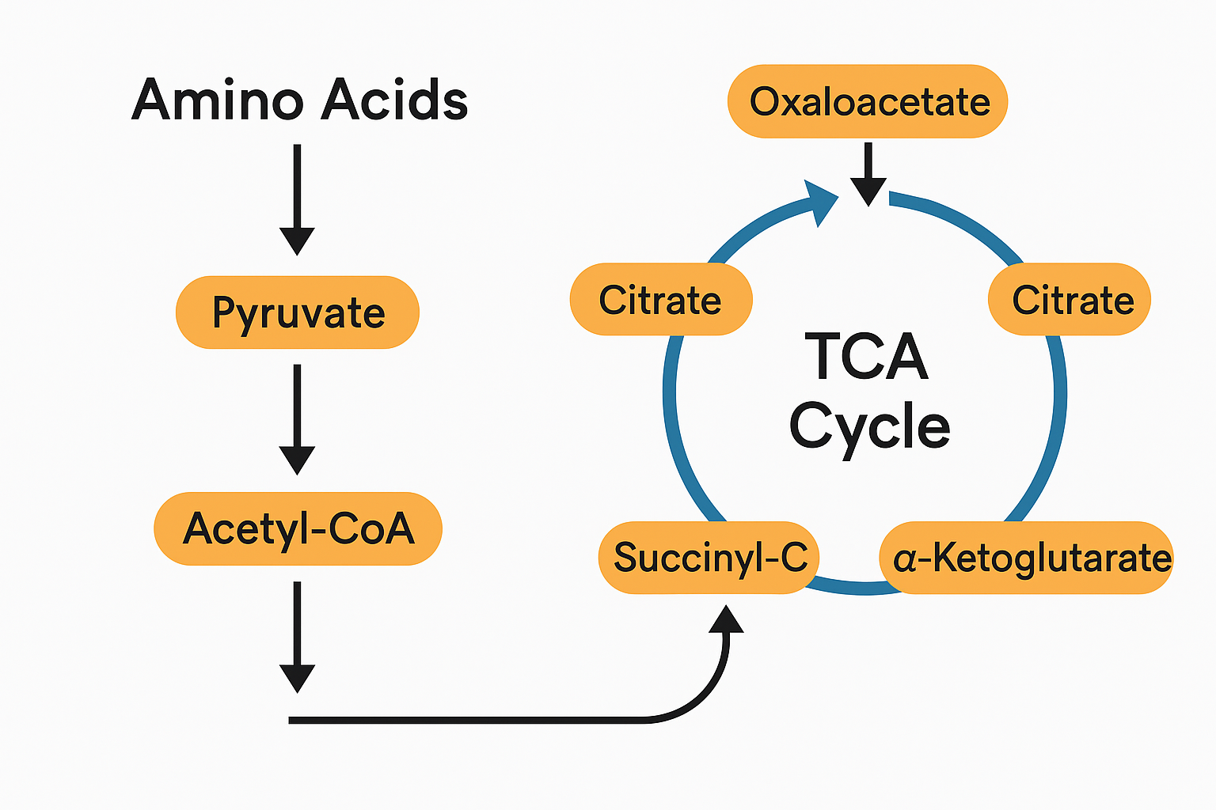
How Amino Acids Feed into
the TCA Cycle
Before AAs can be used for energy, their nitrogen must be removed:
Transamination: Transfers the amino group, leaving an α-keto acid
Deamination: Removes the amino group as ammonia
Ammonia is converted to urea for safe excretion
The remaining carbon skeleton may become:
Pyruvate
Acetyl-CoA
A TCA cycle intermediate
Carbon skeletons can then support:
ATP production
Gluconeogenesis
Ketone production
Key concept: AAs connect protein metabolism with energy production, glucose production and ketogenesis.
Notes:
To use an AAs for energy, the body must first separate its nitrogen-containing amino group from its carbon skeleton.
Transamination transfers the amino group, creating an α-keto acid.
The nitrogen may then be removed through deamination, producing ammonia, which is converted to urea for excretion.
The remaining carbon skeleton can become pyruvate, acetyl-CoA or an intermediate of the TCA cycle.
From there, it may support ATP production, gluconeogenesis or ketone production.

Slide 27
How Amino Acids Feed into
the TCA Cycle
Before AAs can be used for energy, their nitrogen must be removed:
Transamination: Transfers the amino group, leaving an α-keto acid
Deamination: Removes the amino group as ammonia
Ammonia is converted to urea for safe excretion
The remaining carbon skeleton may become:
Pyruvate
Acetyl-CoA
A TCA cycle intermediate
Carbon skeletons can then support:
ATP production
Gluconeogenesis
Ketone production
Key concept: AAs connect protein metabolism with energy production, glucose production and ketogenesis.
Notes:
To use an AAs for energy, the body must first separate its nitrogen-containing amino group from its carbon skeleton.
Transamination transfers the amino group, creating an α-keto acid.
The nitrogen may then be removed through deamination, producing ammonia, which is converted to urea for excretion.
The remaining carbon skeleton can become pyruvate, acetyl-CoA or an intermediate of the TCA cycle.
From there, it may support ATP production, gluconeogenesis or ketone production.

Slide 28
Amino Acid Entry Points into Energy Metabolism
Amino acids are highly tested! We’ll revisit individual amino acids as they apply throughout the course. For now, focus on how their carbon skeletons connect protein metabolism with energy metabolism.
Metabolic entry point | Amino acids
Pyruvate | Alanine, cysteine, glycine, serine, threonine, tryptophan
Acetyl-CoA or acetoacetate | Leucine, lysine + portions of isoleucine, phenylalanine, threonine, tryptophan and tyrosine
α-Ketoglutarate | Glutamate, glutamine, proline, arginine, histidine
Succinyl-CoA | Valine, isoleucine, methionine, threonine
Fumarate | Phenylalanine, tyrosine
Oxaloacetate | Aspartate, asparagine
Quick exam tip: Leucine and lysine are the only exclusively ketogenic amino acids; all others are at least partly glucogenic.
Notes:
Amino acids are heavily tested, and we’ll revisit them throughout the course.
For now, use the table to see where their carbon skeletons enter energy metabolism after nitrogen is removed.
These entry points determine whether an amino acid is glucogenic, ketogenic, or both.
Quick exam tip: Leucine and lysine are the only exclusively ketogenic amino acids; all others are at least partly glucogenic.

Slide 29
Deamination & Transamination
Transamination = transfers nitrogen
Transfers an amino group to an α-keto acid
Often collects nitrogen in glutamate
Produces a new amino acid + carbon skeleton
Requires vitamin B6 (PLP)
Deamination = releases nitrogen
Removes the amino group from glutamate
Releases ammonia (NH₃/NH₄⁺)
Ammonia enters the urea cycle for safe excretion
Carbon skeletons can support energy, glucose or fat production
Transamination moves nitrogen → Deamination releases it → Urea cycle removes it
Notes:
Transamination safely transfers nitrogen, usually collecting it in glutamate, and requires vitamin B6.
Deamination then releases that nitrogen as ammonia.
Ammonia is converted to urea, while the remaining carbon skeleton can enter other metabolic pathways.
In summary: Transamination transfers nitrogen; deamination releases it; the urea cycle eliminates it (more on that in just a sec).

Slide 30
Urea Cycle
The urea cycle (also called the ornithine cycle) is the body’s primary pathway for safely eliminating ammonia, a toxic byproduct of amino acid catabolism. It primarily occurs in the liver, with some activity also present in the kidneys.
Amino acids are deaminated, removing the amino (NH₂) group.
This produces ammonia (NH₃) — extremely toxic to the brain even at modest levels.
The liver converts ammonia → urea, which is far less toxic and water-soluble.
Urea travels via the bloodstream → kidneys → urine.
Helpful video resource here!
Remember this flow: Ammonia → liver → converted to urea → excreted by kidneys.
Notes:
The urea cycle (or ornithine cycle) safely removes ammonia, a toxic byproduct of amino acid metabolism.
It occurs primarily in the liver, with minor activity in the kidneys.
During amino acid breakdown, the amino group is removed, producing ammonia (NH₃), which is toxic to the brain.
The liver converts ammonia into urea, which is far less toxic and water-soluble.
Urea is transported in the blood to the kidneys and excreted in urine.

Slide 31
Summary Table: Metabolism & Biochemical Pathways of Macronutrients
Macronutrient | Entry to TCA Cycle | Key Notes
Carbohydrates | Pyruvate → Acetyl-CoA | Requires O₂; depends on B1
Fats | β-oxidation → Acetyl-CoA | High ATP yield; requires B2, B3, B5, Carnitine
Proteins | Various intermediates | Requires B6, B9, B12

Slide 32
Micronutrient Metabolism-
(biochemical pathways & reactions)
B-vitamins:
  act as coenzymes in metabolic pathways (glycolysis, TCA, AA metabolism)
Vitamin C:
  collagen synthesis, immune support, antioxidant
Minerals & trace elements:
  support enzyme activity, structural functions, and many metabolic reactions.
*Excess water-soluble vitamins are generally excreted, not stored
Notes:
B-vitamins act as coenzymes in many metabolic pathways, including glycolysis, the TCA cycle, and amino acid metabolism.
Vitamin C is important for collagen synthesis, immune function, and antioxidant protection.
Water-soluble vitamins (like B vitamins and vitamin C) are generally not stored in large amounts and excess is excreted in urine.
Minerals and trace elements support enzyme activity, structural functions, and many metabolic reactions.

Slide 33
Key Water-Soluble Vitamins
Water-soluble vitamins serve primarily as coenzymes - helpers that activate metabolic enzymes. They are not stored extensively, so regular dietary intake is essential.
B-vitamins as coenzymes in:
    Carbohydrate metabolism (B1, B2, B3)
    Amino acid metabolism (B6)
    DNA synthesis (B9, B12)
Vitamin C: antioxidant, collagen synthesis
Notes:
Water-soluble vitamins primarily act as coenzymes, helping activate metabolic enzymes.
Because they are not stored in large amounts, regular intake is important.
Key roles include:
B1, B2, B3: carbohydrate metabolism
B6: amino acid metabolism
B9 and B12: DNA synthesis
Vitamin C: antioxidant and collagen synthesis

Slide 34
Vitamin B1 (Thiamine)
Active coenzyme form: Thiamin pyrophosphate (TPP)
TPP is required for:
Pyruvate → acetyl-CoA
Connects glycolysis to the TCA cycle
α-Ketoglutarate → succinyl-CoA
Supports the TCA cycle
Branched-chain amino acid metabolism
Leucine, isoleucine & valine
Pentose phosphate pathway
Transketolase helps generate NADPH
Key concept: B1 is essential for carbohydrate oxidation, ATP production & antioxidant defense.
Notes:
Thiamin is converted into its active coenzyme form, TPP.
TPP supports carbohydrate metabolism, the TCA cycle, BCAA metabolism & the pentose phosphate pathway.
Without enough B1, pyruvate cannot efficiently become acetyl-CoA, contributing to low ATP and lactate accumulation.
Quick exam tip: B1 deficiency impairs carbohydrate oxidation where pyruvate is then diverted toward lactate = low ATP and possible lactic acidosis

Slide 35
Vitamin B2 (Riboflavin)
Metabolic Role
Converted to:
FAD (Flavin Adenine Dinucleotide)
FMN (Flavin Mononucleotide)
These are critical electron carriers.
Key Pathways Requiring FAD or FMN
TCA cycle: succinate → fumarate (succinate dehydrogenase uses FAD)
Fatty acid β-oxidation: acyl-CoA dehydrogenase requires FAD
Electron Transport Chain: Complex I and II use FMN/FAD
Why It Matters
Riboflavin deficiency reduces ATP generation from both fats and carbohydrates.
Notes:
B2 is converted into the coenzymes FAD and FMN which have critical roles.
These molecules transfer electrons during the TCA cycle, beta-oxidation and electron transport chain.
Without enough B2, the body cannot efficiently generate ATP from carbohydrates, fats or proteins.

Slide 36
Vitamin B3 (Niacin)
Active coenzyme forms: NAD⁺ and NADP⁺
NAD⁺ supports catabolic pathways:
Glycolysis
Pyruvate → acetyl-CoA
TCA cycle
Fatty acid beta-oxidation
NADPH supports anabolic and protective pathways:
Fatty acid and cholesterol synthesis
Cytochrome P450 detoxification
Antioxidant defense
Special Note - The body can synthesize niacin from tryptophan but it needs B6 for conversion.
Notes:
Niacin is converted into NAD⁺ and NADP⁺.
NAD⁺ primarily accepts electrons during fuel breakdown and ATP production.
NADPH provides reducing power for biosynthesis, detoxification and antioxidant defense.
The body can make niacin from tryptophan, but this conversion requires vitamin B6.
Quick exam tip: NAD⁺ is primarily used in catabolic energy pathways; NADPH is primarily used in anabolic and antioxidant pathways.

Slide 37
Vitamin B5 (Pantothenic Acid)
Coenzyme forms: Coenzyme A (CoA) and Acyl Carrier Protein (ACP)
B5 supports:
Acetyl-CoA formation
Connects carbohydrate, fat and protein metabolism
Fatty acid metabolism
Required for fatty acid synthesis and oxidation
Cholesterol synthesis
Steroid hormone synthesis
Key concept: B5 helps transfer acyl groups throughout energy metabolism and biosynthesis.
Pantothenic acid is everywhere in metabolism - deficiency is rare.
*The name pantothenic actually comes from the Greek word “pantothen,” meaning “from everywhere.”
Notes:
Pantothenic acid is a component of CoA and ACP.
These molecules help carry carbon-containing groups through carbohydrate, fat and protein metabolism.
B5 is required for fatty acid metabolism and the production of cholesterol and steroid hormones.
It is widely distributed in foods, making deficiency rare.

Slide 38
Vitamin B6 (Pyridoxine)
Active coenzyme form: Pyridoxal phosphate (PLP)
PLP is required for:
Amino acid metabolism
Transamination and deamination reactions
Neurotransmitter synthesis
Serotonin, dopamine, GABA and norepinephrine
Glycogen breakdown
Cofactor for glycogen phosphorylase
Heme synthesis
Key amino acid conversions
Tryptophan → niacin
Homocysteine → cysteine
Key concept: B6 is central to amino acid metabolism, neurotransmitter production and glycogen utilization.
Notes:
Vitamin B6 is converted into its active coenzyme form, PLP.
PLP is especially important for amino acid metabolism and neurotransmitter synthesis.
It also supports glycogen breakdown, heme production and the conversion of homocysteine to cysteine.
B6 is also required to make niacin from tryptophan (as mentioned previously)

Slide 39
Vitamin B7 (Biotin)
Coenzyme role: Transfers CO₂ in carboxylation reactions (if you see anything involving carboxyl - think biotin!)
Key Functions
Carboxylation reactions → fatty acid synthesis and metabolic regulation
Gluconeogenesis: pyruvate carboxylase requires biotin
Fatty acid synthesis: acetyl-CoA carboxylase requires biotin
Amino acid metabolism (especially leucine metabolism)
Odd-chain fatty acid metabolism
Supports gene regulation through histone biotinylation
Required for conversion of:
pyruvate → oxaloacetate
acetyl-CoA → malonyl-CoA
propionyl-CoA → methylmalonyl-CoA
Importance: Central to energy metabolism, fatty acid synthesis, and glucose regulation, while also supporting skin, hair, and nail integrity and proper cellular metabolic function.
Notes:
Biotin functions as an enzyme-bound cofactor in carboxylation reactions.
It supports gluconeogenesis, fatty acid synthesis and the metabolism of certain fatty acids and amino acids.
Major biotin-dependent enzymes include pyruvate carboxylase, acetyl-CoA carboxylase and propionyl-CoA carboxylase.
Quick exam tip: B7 = carboxylation - think pyruvate carboxylase and acetyl-CoA carboxylase.

Slide 40
Vitamin B9 (Folate)
Active coenzyme forms: Tetrahydrofolate (THF) derivatives
Folate carries one-carbon units needed for:
DNA & RNA synthesis
Purine and thymidine production
Methionine cycle
Homocysteine → methionine
Cell division & growth
Especially important during pregnancy
RBC production
Key concept: Folate works closely with vitamin B12 to support DNA synthesis, methylation & homocysteine metabolism.
Notes:
Folate is converted into THF derivatives that carry one-carbon units.
These one-carbon units are essential for DNA synthesis, cell division & methionine cycling.
Folate is especially important during pregnancy because of rapid cell division and neural tube development.
Folate & B12 work closely together, particularly in the conversion of homocysteine to methionine.
Quick exam tip: B9 = THF, one-carbon metabolism & DNA synthesis. B12 deficiency can trap folate in its methylated form, creating a functional folate deficiency.

Slide 41
Vitamin B12 (Cobalamin)
Active coenzyme forms: Methylcobalamin & adenosylcobalamin
B12 is required for:
Methionine synthase
Homocysteine → methionine
Works with folate in methylation & DNA synthesis
Methylmalonyl-CoA mutase
Methylmalonyl-CoA → succinyl-CoA
Connects fat & amino acid metabolism to the TCA cycle
Absorption requires:
Stomach acid to release food-bound B12
Intrinsic factor -> really important to remember for compromised populations including aging adults
A healthy terminal ileum
Key concept: B12 supports neurological function, RBC production, DNA synthesis & energy metabolism.
Notes:
B12 works with folate to convert homocysteine to methionine.
It also converts methylmalonyl-CoA to succinyl-CoA, linking fat & amino acid metabolism to the TCA cycle.
Absorption depends on intrinsic factor & a healthy terminal ileum; stomach acid helps release B12 from food.
Deficiency can cause megaloblastic anemia and neurological symptoms.
Remember: B12 deficiency can increase both homocysteine & methylmalonic acid and causes neurological + hematologic problems.

Slide 42
Vitamin C (Ascorbic Acid)
Metabolic role: Antioxidant & enzyme cofactor
Vitamin C supports:
Collagen synthesis
Cofactor for prolyl & lysyl hydroxylases
Non-heme iron absorption
Converts Fe³⁺ → Fe²⁺
Catecholamine synthesis
Dopamine → norepinephrine
Bile acid synthesis
Antioxidant defense
Regenerates vitamin E
Immune function
Key concept: Vitamin C supports connective tissue integrity, wound healing, iron absorption & antioxidant protection.
Notes:
Vitamin C is an antioxidant and cofactor for several enzymes.
It is essential for collagen formation, supporting connective tissue strength and wound healing.
It improves non-heme iron absorption by reducing ferric iron, Fe³⁺, to ferrous iron, Fe²⁺.
It also supports catecholamine and bile acid synthesis, immune function & vitamin E regeneration.
Think: Vitamin C = collagen synthesis + improved non-heme iron absorption.

Slide 43
Summary Table: Metabolism & Biochemical Pathways of Water-Soluble Vitamins
Vitamin | Coenzyme Form | Major Metabolic Role
B1 | TPP | Carbohydrate metabolism, TCA entry, PPP
B2 | FAD/FMN | Redox reactions, ETC, beta-oxidation
B3 | NAD⁺/NADP⁺ | Energy metabolism & anabolic synthesis
B5 | CoA | Central hub for carbs, fats, proteins
B6 | PLP | Amino acid metabolism, neurotransmitters
B7 | Biotin | Carboxylation reactions
B9 | THF | DNA synthesis, one-carbon metabolism
B12 | Methylcobalamin/adenosylcobalamin | Fat & amino acid metabolism, methionine cycle
C | Ascorbate | Antioxidant, collagen formation
Notes:
Summary review for water soluble vitamins:
Unlike fat-soluble vitamins, most are stored only in limited amounts and therefore need to be consumed regularly. B12 is the major exception because substantial stores can be maintained in the liver.
B1, B2, B3 & B5 are closely connected to energy metabolism:
B1 helps fuels enter and move through the TCA cycle.
B2 and B3 act as electron carriers.
B5 forms CoA, which transports carbon groups throughout metabolism.
B6 is especially important for amino acid metabolism, neurotransmitter production, heme synthesis & homocysteine metabolism.
Biotin supports carboxylation reactions - think adding CO₂ during gluconeogenesis and fatty acid synthesis.
Folate and B12 work together in one-carbon metabolism, DNA synthesis & the methionine cycle. Deficiency in either can cause megaloblastic anemia, but neurological symptoms are particularly associated with B12 deficiency.
Vitamin C is different from the B vitamins: it primarily acts as an antioxidant and enzyme cofactor, especially in collagen synthesis and non-heme iron absorption.

Slide 44
Fat Soluble Vitamins
Vitamins A, D, E & K require dietary fat for absorption
They are:
Absorbed with dietary lipids in the small intestine
Packaged into chylomicrons for transport
Stored primarily in the liver and adipose tissue
Dependent on normal fat digestion, bile flow & intestinal absorption
Key functions:
Vitamin A: Vision, epithelial health & gene expression
Vitamin D: Calcium absorption & bone health
Vitamin E: Antioxidant protection
Vitamin K: Blood clotting & bone proteins
Key concept: Impaired fat absorption can cause deficiencies in vitamins A, D, E & K.
Notes:
Let’s talk about fat soluble vitamins -
Fat-soluble vitamins are absorbed and transported with dietary fats, so their status depends on normal lipid digestion and bile flow.
Because they can be stored, deficiencies may develop more slowly, but excessive supplementation can increase toxicity risk.
Think A = vision, D = calcium, E = antioxidant & K = clotting.

Slide 45
Vitamin A:
Retinoids & Carotenoids
Active forms: Retinal & retinoic acid
Vitamin A supports:
Vision
11-cis-retinal forms rhodopsin for low-light vision
Gene regulation
Retinoic acid binds RAR & RXR nuclear receptors
Epithelial integrity
Supports the skin, GI tract & respiratory tissues
Immune function, growth, reproduction & tissue repair
Transport & storage:
Retinol is transported in chylomicrons to the liver
Stored primarily as retinyl esters
Released bound to retinol-binding protein (RBP)
Key concept: Retinal supports vision, while retinoic acid regulates gene expression and cell differentiation.
Notes:
Vitamin A is absorbed with fat, transported to the liver in chylomicrons & stored as retinyl esters.
Retinol can become retinal for vision or retinoic acid for gene regulation.
Deficiency can cause night blindness, impaired immunity & epithelial damage.
Preformed vitamin A can accumulate in the liver, increasing toxicity risk.
Remember: Vitamin A = vision, epithelial integrity, immune function & gene regulation.

Slide 46
Vitamin D (D₂/D₃)
Vitamin D functions as a steroid-like hormone
Sources & absorption
Skin: UVB converts 7-dehydrocholesterol → vitamin D₃
Diet: D₂ and D₃ are absorbed with fat → transported in chylomicrons
Two-step activation
Liver: Vitamin D → 25(OH)D (calcidiol)
Main circulating form & best marker of vitamin D status
Kidney: 25(OH)D → 1,25(OH)₂D (calcitriol)
Active hormone; regulated by PTH, calcium & phosphate
Major actions of calcitriol
Increases intestinal calcium & phosphate absorption
Supports bone mineralization & remodeling
Supports muscle and neuromuscular function
Binds VDR–RXR receptors to regulate gene expression
Influences immune function
Deficiency: Rickets in children; osteomalacia and muscle weakness in adults
Key concept: Liver or kidney dysfunction can impair vitamin D activation.
Notes:
Vitamin D comes from UVB exposure or dietary D₂/D₃ and requires normal fat absorption.
The liver produces 25(OH)D, our primary status marker, while the kidney produces active calcitriol.
Calcitriol works through VDR–RXR receptors to influence calcium balance, bones, muscles & immune function.
Quick tip: Liver makes 25(OH)D = status marker → kidney makes 1,25(OH)₂D = active hormone.

Slide 47
Vitamin E (α-Tocopherol)
Primary fat-soluble antioxidant
Absorption & transport
Absorbed with dietary fat in micelles
Packaged into chylomicrons → transported to the liver
Liver uses α-tocopherol transfer protein (α-TTP) to preferentially retain α-tocopherol
Distributed to tissues primarily through VLDL and other lipoproteins
Major functions
Protects PUFAs in cell and mitochondrial membranes from lipid peroxidation
Protects LDL particles from oxidation
Helps maintain RBC membrane integrity and prevents hemolysis
Supports immune function and inflammatory regulation
Helps protect vitamin A from oxidation
Antioxidant cycle
Vitamin E neutralizes lipid radicals → becomes a tocopheroxyl radical → regenerated primarily by vitamin C
Works alongside selenium-dependent glutathione peroxidase to protect membrane lipids.
Deficiency: Hemolytic anemia, neuropathy, ataxia & muscle weakness, most often associated with fat malabsorption.
Key concept: Vitamin E requirements and antioxidant activity become especially important when PUFA intake is high.
Notes:
Vitamin E is the body’s primary fat-soluble antioxidant, protecting PUFAs in cell membranes from lipid peroxidation.
It is absorbed with fat, transported in chylomicrons & distributed through lipoproteins.
The liver selectively retains α-tocopherol using α-TTP.
Deficiency is rare but may occur with fat malabsorption, causing neurological problems or hemolytic anemia.
Remember: Vitamin E protects PUFAs and cell membranes from oxidative damage; vitamin C helps regenerate it.

Slide 48
Vitamin K (K₁ & K₂)
Major forms
K₁ (phylloquinone): Primarily from green plants
K₂ (menaquinones): Found in fermented foods and produced by gut bacteria
Vitamin K cycle
Vitamin K is reduced to its active hydroquinone form.
Hydroquinone serves as a cofactor for γ-glutamyl carboxylase.
Carboxylation creates Gla residues, allowing proteins to bind calcium.
Vitamin K epoxide is recycled by VKORC1.
Vitamin K–dependent proteins
Clotting factors II, VII, IX & X
Anticoagulant proteins C & S
Osteocalcin: Supports bone mineralization
Matrix Gla protein (MGP): Helps regulate vascular calcification
Medication connection: Warfarin inhibits VKORC1, reducing vitamin K recycling and activation of clotting proteins.
Newborn protection: Babies have low vitamin K stores and limited intestinal bacterial production. A vitamin K₁ injection shortly after birth helps prevent vitamin K deficiency bleeding (VKDB).
Key concept: Vitamin K–dependent carboxylation allows clotting and bone-related proteins to bind calcium and function properly.
Notes:
Vitamin K is absorbed with fat and supports γ-carboxylation, which allows specific proteins to bind calcium.
This activates clotting factors, proteins C and S, osteocalcin & MGP.
Warfarin blocks VKORC1 and interferes with vitamin K recycling.
Newborns receive a vitamin K₁ shot because their stores are low, helping prevent potentially life-threatening bleeding.
Quick tip: Vitamin K activates factors II, VII, IX & X and warfarin blocks vitamin K recycling.

Slide 49
Summary Table: Metabolism & Biochemical Pathways of Fat-Soluble Vitamins
Vitamin | Main Metabolic Role | Biochemical Pathways | Why It Matters
A | Gene regulation, vision | Retinoid cycle, RA nuclear signaling | Immunity, epithelial health, vision, development
D | Hormone regulating Ca/P | Liver 25-hydroxylation, kidney 1-α-hydroxylation | Bone, muscle, immune health
E | Lipid antioxidant | Antioxidant cycle, α-TTP transport | Protects cells from oxidation, neurological health
K | Ca-binding protein activation | Vitamin K epoxide cycle | Coagulation, bone health, prevents calcification
Notes:
Summary review for fat-soluble vitamins
All 4 vitamins require normal fat digestion, bile flow & intestinal absorption, and because they are stored, toxicity is generally more likely than with water-soluble vitamins.
Vitamin A works through two major pathways: retinal supports vision, while retinoic acid binds RAR/RXR (RAR: Retinoic Acid Receptor
RXR: Retinoid X Receptor) receptors to regulate gene expression, cell differentiation & epithelial integrity.
Vitamin D acts like a hormone. The liver produces calcidiol, our primary status marker, and the kidney produces active calcitriol, which regulates calcium, phosphate, bone & muscle function.
Vitamin E is the major lipid-soluble antioxidant. It protects PUFAs and cell membranes from lipid peroxidation and can be regenerated by vitamin C.
Vitamin K supports γ-carboxylation, allowing clotting and bone-related proteins to bind calcium. Warfarin interferes with vitamin K recycling through VKORC1.
Clinically, always think about fat-soluble vitamin deficiencies when fat absorption is impaired—for example, with pancreatic insufficiency, reduced bile flow, intestinal disease or fat-blocking medications.
Summary:
A = vision & gene regulation
D = calcium regulation & hormone signaling
E = lipid antioxidant protection
K = clotting & calcium-binding protein activation

Slide 50
Minerals
Minerals are essential inorganic elements that support metabolism without providing energy.
They function at three major levels:
1. Structural roles
Calcium & phosphorus form the hydroxyapatite crystals in bones and teeth
Magnesium & fluoride also support bone and tooth structure
Deficiencies can weaken skeletal integrity
2. Enzyme cofactor roles
Minerals activate or stabilize enzymes involved in:
  Energy metabolism
  Antioxidant defense
  DNA synthesis
  Protein and hormone production
Examples include magnesium, zinc, iron, copper, manganese & selenium
3. Regulatory & signaling roles
Sodium, potassium & chloride: Fluid balance, electrical gradients & nerve impulses
Calcium: Muscle contraction, neurotransmitter release & cellular signaling
Magnesium: Enzyme regulation, ATP utilization & neuromuscular function
Key concept: Minerals provide structure, activate enzymes & coordinate communication between cells and organs.
Notes:
Minerals are inorganic elements, meaning they retain their chemical identity and cannot be broken down for energy.
Instead, they allow the body to build tissues, activate enzymes and regulate physiological processes.
Structurally, calcium and phosphorus form hydroxyapatite, the mineral matrix that gives bones and teeth their strength. Magnesium and fluoride also contribute to skeletal and dental integrity.
Many minerals function as enzyme cofactors. You can think of them as helpers that allow enzymes to perform biochemical reactions efficiently.
Minerals also support electrical and chemical signaling. Sodium and potassium create membrane potentials, calcium triggers muscle contraction and neurotransmitter release & magnesium helps regulate ATP-dependent reactions.
Mineral balance matters just as much as mineral intake because excesses and deficiencies can both disrupt metabolism.
Remember: Minerals do not provide calories/energy, they support metabolism through structure, enzyme activation & regulation/signaling.

Slide 51
Major Minerals - Calcium
Absorption & regulation
Intestinal absorption is increased by active vitamin D, or calcitriol
Blood calcium is tightly regulated by PTH, vitamin D & the kidneys
Bone serves as the body’s major calcium reservoir
Magnesium supports normal PTH secretion and calcium balance
Deficiency: Reduced bone mineralization, osteoporosis risk, muscle cramps or tetany & cardiac rhythm disturbances
Key concept: Calcium is both a structural mineral and a tightly regulated signaling molecule.
Primary roles
Structural support
Major component of hydroxyapatite in bones & teeth
Muscle contraction
Ca²⁺ binds troponin C → allows actin–myosin interaction
Nerve function
Triggers neurotransmitter release at synapses
Cell signaling
Functions as a second messenger, often through calmodulin
Blood clotting
Required for multiple steps in the coagulation cascade
Vascular function
Helps regulate vascular smooth muscle contraction
Notes:
Calcium is not just a bone mineral - it also supports cell signaling, muscle contraction, nerve transmission, vascular function & blood clotting.
About 99% is stored in bones and teeth. The remaining calcium is tightly regulated because small changes can affect nerves, muscles & the heart.
In skeletal muscle, calcium binds troponin C, allowing actin and myosin to interact.
In nerve cells, calcium triggers neurotransmitter release.
Calcium also acts as a second messenger, often through calmodulin, to activate hormonal and metabolic pathways.
Calcium is called clotting factor IV and supports several steps in coagulation.
Calcitriol increases intestinal calcium absorption. When blood calcium falls, PTH increases kidney reabsorption, activates vitamin D & can mobilize calcium from bone.
Magnesium also supports PTH secretion and healthy calcium regulation.
Quick exam tip: Calcium is both structural (bones and teeth) and functional (muscles, nerves, signaling & clotting)

Slide 52
Phosphorus
Primary roles
Energy metabolism
Structural component of ATP, ADP & AMP
Bones & teeth
Combines with calcium to form hydroxyapatite
Cell membranes
Component of phospholipids
DNA & RNA
Forms part of the phosphate backbone
Metabolic regulation
Phosphorylation activates or regulates enzymes and metabolic molecules
Acid–base balance
Functions as an important intracellular and urinary buffer
RBC oxygen delivery
Required for 2,3-BPG, which promotes oxygen release from hemoglobin
Key concept: Phosphorus supports energy transfer, cellular structure, bone mineralization & acid–base balance.
Deficiency: Rare, but severe deficiency can cause muscle weakness, impaired energy production & poor bone mineralization.
Remember: No phosphorus → no ATP → no energy metabolism.
Notes:
Phosphorus is central to energy metabolism because it forms part of ATP, ADP & AMP.
Phosphate groups are added or removed through phosphorylation reactions, helping regulate enzymes and metabolic pathways.
Phosphorus also combines with calcium to form hydroxyapatite in bones and teeth.
It forms part of DNA, RNA and phospholipid cell membranes.
In RBCs, phosphorus is required to make 2,3-BPG, which helps hemoglobin release oxygen to tissues.
It also supports acid–base balance by acting as an important buffer.

Slide 53
Magnesium
Primary roles
Energy metabolism
Forms Mg-ATP, the biologically active form used in ATP-dependent reactions
Enzyme cofactor
Required by more than 300 enzymes
Carb metabolism
Supports enzymes in glycolysis and the TCA cycle
DNA, RNA & protein synthesis
Stabilizes nucleic acids and supports polymerase and ribosomal activity
Muscle & nerve function
Regulates neuromuscular signaling and muscle relaxation
Calcium regulation
Helps regulate calcium movement, PTH secretion and bone metabolism
Cardiovascular function
Supports normal heart rhythm, vascular tone and blood pressure regulation
Key concept: Magnesium makes ATP usable and supports enzyme activity, neuromuscular function & calcium balance.
Deficiency: Muscle cramps, weakness, tremors, arrhythmias, impaired glucose regulation & potentially low calcium or potassium
Quick exam tip: Magnesium = Mg-ATP, enzyme activation, muscle relaxation & calcium regulation.
Notes:
Magnesium is essential for energy metabolism because ATP is primarily used in the body as Mg-ATP.
It acts as a cofactor for more than 300 enzymes, including enzymes involved in glycolysis, the TCA cycle & protein synthesis.
Magnesium also stabilizes DNA and RNA and supports polymerase and ribosomal activity.
In nerves and muscles, it helps regulate calcium movement, muscle relaxation & electrical signaling.
Deficiency can contribute to cramps, weakness, arrhythmias & impaired glucose regulation.

Slide 54
Sodium
Primary roles
Major extracellular cation
Maintains extracellular fluid volume, blood volume & blood pressure
Nerve signaling
Sodium influx creates the depolarization phase of action potentials
Muscle function
Supports electrical signaling needed for muscle contraction
Na⁺/K⁺ ATPase
Pumps 3 Na⁺ out and 2 K⁺ into cells using ATP
Nutrient absorption
Drives intestinal co-transport of glucose and amino acids
Acid–base balance
Participates in bicarbonate transport and hydrogen ion exchange
Hormonal regulation
The kidneys regulate sodium through aldosterone, RAAS, ADH & natriuretic peptides
Water generally follows sodium, linking sodium balance to fluid volume and blood pressure
Key concept: Sodium maintains extracellular fluid volume and creates the electrochemical gradients required for nerve signaling, muscle function & nutrient absorption.
Imbalance: Excess intake may contribute to hypertension in salt-sensitive individuals; sodium or fluid losses can cause hypovolemia, while severe hyponatremia can cause confusion, seizures or coma.
Exam tip: Sodium gradients power secondary active transport, including glucose absorption.
Notes:
Sodium is essential for electrical activity and fluid balance in the body.
It helps maintain extracellular fluid volume
Sodium also powers nutrient absorption in the intestine, including glucose and amino acids through sodium-dependent transporters.
It plays key roles in nerve transmission, electrochemical gradients, and kidney regulation via aldosterone.

Slide 55
Potassium
Key concept: Potassium maintains the intracellular electrical environment required for normal nerve signaling, muscle contraction & heart rhythm.
Deficiency: Muscle weakness, fatigue, cramps, constipation & cardiac arrhythmias
Excess: Hyperkalemia can also disrupt cardiac conduction and cause dangerous arrhythmias.
Quick exam tip: Potassium = major intracellular cation, resting membrane potential & normal heart rhythm.
Primary roles
Major intracellular cation
Maintains intracellular fluid balance and cell volume
Resting membrane potential
Creates the electrical gradient needed for nerve and muscle activity
Na⁺/K⁺ ATPase
Pumps 3 Na⁺ out and 2 K⁺ into cells using ATP
Muscle contraction
Supports skeletal, smooth & cardiac muscle function
Heart rhythm
Essential for normal cardiac electrical activity
Metabolic function
Supports insulin secretion, glucose metabolism & protein synthesis
Blood pressure regulation
Helps counterbalance sodium’s effects and supports vascular function
Notes:
Potassium is the primary intracellular ion and is critical for maintaining resting membrane potential.
It supports nerve signaling, muscle contraction, and cardiac electrical activity.
Potassium moves through the Na⁺/K⁺ ATPase pump, entering cells while sodium exits.
It also plays roles in insulin secretion and protein synthesis within cells.

Slide 56
Chloride
Primary roles
Major extracellular anion
Balances positively charged ions, especially sodium, to maintain electroneutrality
Fluid & acid–base balance
Helps regulate extracellular fluid volume, osmotic pressure & blood pH
Digestion
Combines with hydrogen to form hydrochloric acid (HCl) in the stomach
CO₂ transport
Participates in the chloride shift in RBCs
Electrical balance
Contributes to membrane potential and neuromuscular function
Chloride shift: As bicarbonate exits RBCs into the blood, chloride enters the RBCs to maintain electrical neutrality, allowing efficient CO₂ transport from tissues to the lungs.
Key concept: Chloride maintains electrical and fluid balance while supporting stomach acid production and CO₂ transport.
Imbalance: Low chloride may occur with prolonged vomiting or diuretic use and can contribute to metabolic alkalosis; excess chloride may contribute to metabolic acidosis.
Quick exam tip: Chloride = major extracellular anion, stomach acid & the RBC chloride shift.
Notes:
Chloride helps maintain fluid balance and electrical neutrality alongside sodium and potassium.
It is essential for digestion, as it forms hydrochloric acid (HCl) in the stomach.
Chloride also plays a role in CO₂ transport in red blood cells through the chloride shift.
It contributes to acid–base balance via bicarbonate–chloride exchange.
Quick exam tip: Chloride is critical for stomach acid production and CO₂ transport in blood.

Slide 57
Trace Minerals - Iron
Primary roles
Oxygen transport & storage
Component of hemoglobin in RBCs & myoglobin in muscle
Energy production
Part of cytochromes in the electron transport chain
Antioxidant enzyme activity
Cofactor for catalase & peroxidase enzymes
DNA synthesis
Required by ribonucleotide reductase
Immune & neurological function
Supports immune responses, neurotransmitter synthesis & brain development
Iron forms
Heme iron: Found in animal foods; generally absorbed more efficiently
Non-heme iron: Found in plant foods; vitamin C improves absorption by converting Fe³⁺ → Fe²⁺
Key concept: Iron allows oxygen delivery to tissues and supports mitochondrial ATP production.
Deficiency: Microcytic, hypochromic anemia, fatigue, weakness, impaired cognition & reduced exercise tolerance
Excess: Promotes oxidative stress through free-radical formation and can damage tissues
Notes:
Iron is essential for oxygen transport and energy production.
It is a key component of hemoglobin, which carries oxygen in RBCs, and myoglobin, which stores oxygen in muscle.
Iron is also part of cytochromes in the electron transport chain, making it essential for mitochondrial ATP production.
Additional roles include DNA synthesis, antioxidant enzyme activity, immune function & brain development.
Both deficiency and excess matter: too little limits oxygen delivery and energy production, while too much promotes oxidative stress.
Memory tip: Iron = hemoglobin, myoglobin, cytochromes & DNA synthesis. ATP production falls when iron deficiency disrupts oxygen delivery and the electron transport chain.

Slide 58
Zinc
Primary roles
Enzyme cofactor
Required by more than 300 enzymes (like mg!) involved in metabolism
DNA & protein synthesis
Supports RNA/DNA polymerases, cell division, growth & tissue repair
Gene regulation
Stabilizes zinc-finger transcription factors that bind DNA and regulate gene expression
Immune function
Supports immune-cell development, signaling & defense
Antioxidant defense
Component of copper–zinc superoxide dismutase (Cu/Zn SOD)
Acid–base balance & digestion
Cofactor for carbonic anhydrase
Wound healing
Supports collagen formation, epithelial integrity & tissue regeneration
Taste & smell
Required for normal sensory function
Key concept: Zinc supports enzyme activity, gene expression, immune function, cell growth & tissue repair.
Deficiency: Poor wound healing, impaired immunity, hair loss, reduced taste or smell, dermatitis & impaired growth
Excess: Can interfere with copper absorption and lead to copper deficiency.
Quick exam tip: Zinc is critical for gene expression, immune function, and tissue repair.
Notes:
Zinc is essential for DNA and protein synthesis and acts as a cofactor for over 300 enzymes.
It plays a major role in gene regulation through zinc-finger transcription factors.
Zinc is also involved in key enzymes such as carbonic anhydrase for acid–base balance and superoxide dismutase for antioxidant defense.
It supports DNA and RNA polymerases, which are required for cell growth and repair.

Slide 59
Copper
Primary roles
Energy production
Component of cytochrome c oxidase (Complex IV) in the ETC
Iron transport & utilization
Ceruloplasmin oxidizes Fe²⁺ → Fe³⁺, allowing iron to bind transferrin
Connective tissue formation
Cofactor for lysyl oxidase, which cross-links collagen & elastin
Neurotransmitter synthesis
Required by dopamine β-hydroxylase for dopamine → norepinephrine
Antioxidant defense
Component of copper–zinc superoxide dismutase (Cu/Zn SOD)
Pigmentation
Cofactor for tyrosinase in melanin synthesis
Key concept: Copper links mitochondrial energy production, iron metabolism, antioxidant defense & connective tissue integrity.
Deficiency: Anemia that may resemble iron deficiency, neutropenia, impaired immunity, neurological changes & weakened connective tissue
Excess: Can promote oxidative damage and liver injury
Nutrient interaction: Excess zinc can impair copper absorption and contribute to deficiency.
Quick exam tip: Copper and iron metabolism are closely linked and copper deficiency can resemble anemia.
Notes:
Copper is important for redox reactions and energy production.
It plays a key role in the electron transport chain through cytochrome c oxidase (Complex IV).
Copper is also required for iron metabolism, helping convert Fe²⁺ to Fe³⁺ via ceruloplasmin (seer-uh-loh-PLAZ-min) so iron can be transported.
It supports collagen crosslinking through lysyl (‘LYE-sil’) oxidase and contributes to antioxidant defense via superoxide dismutase.

Slide 60
Selenium
Primary roles
Antioxidant defense
Component of glutathione peroxidases, which reduce hydrogen peroxide and lipid peroxides
Thyroid hormone metabolism
Deiodinase enzymes help convert T4 → active T3 and inactive reverse T3
Redox regulation
Thioredoxin reductase supports antioxidant recycling and cellular redox balance
Immune function
Supports immune-cell activity and regulation
Cellular protection
Helps protect cell membranes, DNA and thyroid tissue from oxidative damage
Key concept: Selenium functions primarily through selenoproteins that regulate antioxidant defense, thyroid hormone metabolism & cellular redox balance.
Deficiency: Impaired T4 → T3 conversion, weakened antioxidant defense, altered immune function & cardiomyopathy in severe cases
Excess: Selenium toxicity can cause brittle hair and nails, garlic-like breath, GI symptoms & neurological changes.
Nutrient interaction: Selenium works alongside vitamin E to protect cell membranes from oxidative damage.
Notes:
Selenium functions mainly through selenoproteins, which support antioxidant defense and thyroid metabolism.
It is a key component of glutathione peroxidase, which helps neutralize hydrogen peroxide and reduce oxidative stress.
Selenium also supports thioredoxin (‘THIGH-oh-red-OKS-in’) reductase, another antioxidant system.
It plays an important role in thyroid hormone metabolism, helping convert T4 into the active hormone T3 through deiodinase enzymes.

Slide 61
Iodine
Primary roles
Thyroid hormone synthesis
Essential structural component of T3 and T4
Metabolic regulation
Thyroid hormones regulate basal metabolic rate, energy expenditure & heat production
Growth & development
Supports normal brain, nervous system & skeletal development
Macronutrient metabolism
Thyroid hormones influence carb, fat & protein metabolism
Thyroid hormone synthesis
Iodide is transported from the blood into thyroid cells by the sodium–iodide symporter (NIS).
Thyroid peroxidase (TPO) oxidizes iodide and attaches iodine to tyrosine residues on thyroglobulin.
Iodination produces MIT and DIT:
  MIT + DIT → T3
  DIT + DIT → T4
T3 and T4 are stored in thyroglobulin and released when stimulated by TSH.
Key concept: Iodine supplies the essential building blocks for thyroid hormones, which regulate metabolism, growth & development.
Deficiency: Goiter, hypothyroidism, fatigue & impaired fetal or childhood neurological development
Excess: Can also disrupt thyroid function, particularly in susceptible individuals.
Notes:
Iodine is required for thyroid hormone production.
It is used to iodinate tyrosine on thyroglobulin, producing T3 and T4, which regulate metabolic rate and energy use.
Historically, iodine deficiency caused widespread goiter and hypothyroidism, especially in inland regions with iodine-poor soil.
To prevent this, iodine was added to table salt in the early 1900s, making iodized salt a major public health intervention.
Memory tip: Iodine → thyroid hormones → metabolic rate regulation.

Slide 62
Manganese
Primary roles
Antioxidant defense
Component of mitochondrial manganese superoxide dismutase (Mn-SOD)
Urea cycle
Cofactor for arginase, which converts arginine → ornithine + urea
Gluconeogenesis
Supports pyruvate carboxylase, which converts pyruvate → oxaloacetate
Bone & connective tissue formation
Supports enzymes involved in cartilage, bone matrix & proteoglycan synthesis
Macronutrient metabolism
Assists enzymes involved in carb, amino acid & cholesterol metabolism
Key concept: Manganese supports mitochondrial antioxidant protection, nitrogen disposal, gluconeogenesis & skeletal development.
Deficiency: Rare, but may contribute to impaired growth, skeletal abnormalities & altered metabolism
Excess: Can cause neurological toxicity, particularly with chronic occupational exposure or impaired biliary excretion.
Notes:
Manganese acts as a cofactor for several enzymes involved in metabolism and antioxidant defense.
It supports bone formation and participates in the urea cycle.
Mn is a cofactor for the following enzymes:
Mn-superoxide dismutase (Mn-SOD) in mitochondria for antioxidant protection
Arginase in the urea cycle (Uses manganese to help convert arginine → urea + ornithine.)
Pyruvate carboxylase in gluconeogenesis (Uses manganese as a cofactor to convert pyruvate → oxaloacetate.)

Slide 63
Chromium
Primary roles
Insulin signaling
Enhances insulin action and supports normal glucose uptake into cells
Blood sugar regulation
Helps support normal carb metabolism and glucose tolerance
Macronutrient metabolism
Influences the metabolism of carbs, fats & proteins
Proposed mechanism
Chromium may associate with chromodulin, a chromium-binding peptide involved in insulin receptor signaling.
Chromodulin is proposed to enhance insulin receptor activity after insulin binds, strengthening the intracellular signal and supporting glucose uptake.
The exact biological mechanism and essentiality of chromium in humans remain debated.
Key concept: Chromium is associated with insulin signaling and glucose metabolism, although its precise mechanism in humans is not fully established.
Deficiency: True deficiency is rare but has been reported with long-term parenteral nutrition and may cause impaired glucose tolerance that improves with chromium replacement.
Notes:
Chromium is best known for its proposed role in enhancing insulin action and supporting normal glucose metabolism.
It may work through chromodulin, which is thought to strengthen insulin receptor signaling after insulin binds.
This may help promote glucose uptake into cells and support blood sugar regulation.
True deficiency is rare but may impair glucose tolerance, particularly in people receiving long-term parenteral nutrition.
Chromium’s exact mechanism and essentiality in humans are still debated, so avoid overstating its effects or presenting supplementation as a proven treatment for insulin resistance.
Exam tip: Chromium is traditionally associated with insulin sensitivity and glucose control.

Slide 64
Molybdenum
Primary roles
Enzyme cofactor
Component of the molybdenum cofactor used by several metabolic enzymes
Sulfite metabolism
Sulfite oxidase converts sulfite → sulfate during sulfur amino acid metabolism
Purine metabolism
Xanthine oxidase helps convert hypoxanthine → xanthine → uric acid
Aldehyde metabolism
Aldehyde oxidase helps metabolize aldehydes, medications & other compounds
Key concept: Molybdenum supports sulfur, purine & aldehyde metabolism by serving as an essential enzyme cofactor.
Deficiency: Extremely rare, but may impair sulfite metabolism and cause neurological abnormalities
Excess: May increase uric acid production and contribute to gout-like symptoms.
Notes:
Molybdenum acts as a cofactor for several enzymes involved in sulfur, purine & aldehyde metabolism.
Sulfite oxidase converts potentially reactive sulfite into sulfate during sulfur amino acid metabolism.
Xanthine oxidase participates in purine breakdown and the production of uric acid.
Aldehyde oxidase helps metabolize aldehydes, medications & other compounds.
Deficiency is extremely rare but can impair sulfite metabolism.
Memory tip: Molybdenum => sulfite oxidase, xanthine oxidase & aldehyde oxidase.

Slide 65
Flouride
Primary roles
Tooth enamel strength
Replaces hydroxyl groups in hydroxyapatite to form fluorapatite, which is more resistant to acid demineralization
Enamel remineralization
Promotes the redeposition of calcium and phosphate into early areas of enamel damage
Cavity prevention
Reduces enamel breakdown and can inhibit acid production by cavity-causing bacteria
Bone mineralization
Fluoride can be incorporated into bone mineral, although its clearest benefit is dental health
Key concept: Fluoride protects teeth by strengthening enamel, promoting remineralization & reducing bacterial acid damage.
Low exposure: Increased risk of dental caries
Excess exposure: Dental fluorosis during tooth development; very high chronic exposure can cause skeletal fluorosis
Notes:
Fluoride primarily supports dental health by strengthening the mineral structure of tooth enamel.
It can replace hydroxyl groups in hydroxyapatite to form fluorapatite, which is more resistant to acid damage.
Fluoride also promotes enamel remineralization by helping calcium and phosphate return to areas of early decay.
It further reduces cavity risk by limiting acid production from oral bacteria.
Fluoride can be incorporated into bone, but excess exposure can cause dental or skeletal fluorosis.

Slide 66
Summary Table: Metabolism & Biochemical Pathways of Minerals
Mineral | Metabolic Role | Key Biochemical Pathways | Functions | Why It Matters
Calcium | Second messenger; bone mineral; neuromuscular signaling | Calmodulin system; muscle contraction; blood clotting; vitamin D–regulated absorption | Muscle contraction, nerve transmission, coagulation, bone structure | Deficiency → osteoporosis, tetany, arrhythmias
Phosphorus | Component of ATP, DNA, RNA, phospholipids | Phosphorylation reactions; glycolysis; TCA cycle; 2,3-BPG formation | Energy metabolism, bone health, genetic material | ATP cannot form without phosphorus
Magnesium | Cofactor for >300 enzymes; activates ATP | Glycolysis; TCA; β-oxidation; nucleic acid synthesis | Energy production, muscle/nerve function, protein synthesis | Deficiency → arrhythmias, cramps, insulin resistance
Sodium | Major extracellular cation; drives membrane potential | Na⁺/K⁺ ATPase; co-transport systems; acid–base regulation | Nerve conduction, muscle contraction, fluid balance | Critical for neurological function & hydration
Potassium | Major intracellular cation; regulates electrical activity | Na⁺/K⁺ ATPase; action potentials; insulin signaling | Heart function, muscle contraction, nerve impulses | Deficiency → arrhythmia, muscle weakness
Chloride | Major extracellular anion; acid-base balance | HCl production; chloride shift (CO₂ transport) | Digestion, fluid balance, pH regulation | Needed for CO₂ transport & stomach acid
Notes:
Let’s use this table to review all the minerals and their roles.
Calcium is both structural and functional. It supports bones and teeth, but it also acts as a second messenger and is required for muscle contraction, nerve transmission & coagulation. Its regulation is closely tied to vitamin D, PTH & magnesium.
Phosphorus is central to energy metabolism because it forms ATP and participates in phosphorylation reactions. It also supports DNA, RNA, phospholipid membranes, bone mineralization & 2,3-BPG production in RBCs.
Magnesium makes ATP biologically usable as Mg-ATP and serves as a cofactor for more than 300 enzymes. It supports glycolysis, the TCA cycle, beta-oxidation, nucleic acid synthesis & neuromuscular function.
Sodium and potassium work together through the Na⁺/K⁺ ATPase. Sodium is the major extracellular cation, while potassium is the major intracellular cation. Together, they establish the electrical gradients required for nerve impulses, muscle contraction & normal cardiac rhythm.
Sodium’s gradient also drives the intestinal co-transport of glucose and amino acids, while potassium is especially important for resting membrane potential and heart function.
Chloride is the major extracellular anion. It balances sodium, contributes to fluid and acid–base regulation, forms stomach acid & participates in the chloride shift for CO₂ transport in RBCs.
The biggest theme is that these minerals do not provide energy themselves - they make energy metabolism, electrical signaling, fluid balance & structural integrity possible.
Quick recap:
Calcium: Bones, signaling, contraction & clotting
Phosphorus: ATP, phosphorylation & structure
Magnesium: Mg-ATP & enzyme activation
Sodium: Extracellular fluid & depolarization
Potassium: Intracellular fluid, resting potential & heart rhythm
Chloride: Stomach acid, fluid balance & CO₂ transport

Slide 67
Detoxification Overview -
(biochemical pathways)
Detoxification is a two-phase enzymatic system, primarily located in the liver, that transforms fat-soluble toxins, hormones, drugs, xenobiotics, and metabolic byproducts into safer, water-soluble forms for excretion.
Key locations:
Liver (primary)
Intestines
Kidneys
Lungs
Skin
Detoxification requires micronutrient cofactors, amino acids, antioxidants, and functional enzymes.
Detoxification happens in 3 coordinated steps:
Phase I: Activation (Cytochrome P450 system)
Phase II: Conjugation (biosynthetic pathways)
Phase III: Transport (excretion via kidneys or bile)
All three phases must be balanced.
Helpful video resource for phase I & II here!
Notes:
Detoxification converts fat-soluble toxins into water-soluble compounds so they can be excreted.
The liver is the primary detox organ, but detox also occurs in the gut, kidneys, lungs, and skin.
Detoxification is enzyme-driven chemistry, not simply “flushing toxins,” and it requires micronutrients and antioxidants.
There are 3 phases:
Phase I: activation
Phase II: conjugation
Phase III: transport and excretion
Quick exam tip: If Phase I is faster than Phase II, reactive intermediates can accumulate and increase toxicity.

Slide 68
Phase I Detoxification — Activation (CYP450 System)
Purpose:
Convert a toxin → reactive intermediate (more polar, but often more dangerous).
Biochemical Mechanism:
Phase I uses oxidation, reduction, and hydrolysis reactions.
Main enzymes:
Cytochrome P450 monooxygenases (CYP enzymes)
Flavin-containing monooxygenases (FMO)
Epoxide hydrolases
Alcohol dehydrogenases
Aldehyde dehydrogenases
Key CYP450 Reactions:
Hydroxylation (most common)
Deamination
Dealkylation
Epoxidation
Reduction
Nutrients Required for Phase I:
B2 (FAD)
B3 (NAD⁺/NADP⁺)
Iron (Fe) → cytochrome heme center
Magnesium
Flavonoids (modulate CYP activity)
Notes:
Phase I is the activation phase of detoxification and is driven by cytochrome P450 enzymes (CYPs) in the liver.
These enzymes modify toxins by adding or exposing reactive groups through reactions like hydroxylation, demethylation, and oxidation.
Phase I often creates reactive intermediates and free radicals, so antioxidants are needed to neutralize oxidative stress.
This process relies on nutrients like B2, B3, iron, magnesium, and glutathione.
Quick exam tip: Phase I makes toxins more reactive, so strong Phase II detox is needed to neutralize them.

Slide 69
Summary Table -
Phase I Detoxification Pathways
Category | Details
Location | Smooth endoplasmic reticulum (primarily liver hepatocytes)
Primary Enzymes | Cytochrome P450 monooxygenases (CYP1, CYP2, CYP3 families)
Main Reactions | • Oxidation (most common) • Reduction • Hydrolysis • Dealkylation • Epoxidation
Purpose | Convert fat-soluble toxins → reactive, polar intermediates (prepare for Phase II)
Inputs Required | • NADPH (reducing power) • O₂ (acts as electron acceptor)
Key Nutrient Cofactors | • B2 (FAD) – electron transfer • B3 (NAD/NADPH) – redox cycling • Iron (heme) – catalytic core of CYP450 • Magnesium – stabilizes ATP-dependent enzymes • Phospholipids – ER membrane structure
Inducers (speed up Phase I) | Alcohol, nicotine, caffeine, charred meats, steroids, many drugs, environmental toxins
Inhibitors (slow down Phase I) | Grapefruit, curcumin, quercetin, certain medications, liver dysfunction
Outputs | • More polar compounds • Often more reactive and dangerous metabolites • Reactive oxygen species (ROS)
Risks When Unbalanced | • If Phase I is fast and Phase II is slow → buildup of reactive intermediates → oxidative damage
Antioxidant Needs | • Glutathione • Vitamin C • Vitamin E • Selenium • Superoxide dismutase (Zn/Cu/Mn)
Examples of Compounds Detoxified | Alcohol, caffeine, benzoate, BPA, pollutants, medications, steroids, aromatic hydrocarbons
Notes:
Phase 1 Detox Pathways:
Location: Smooth endoplasmic reticulum, primarily in the liver (hepatocytes)
Enzymes: Cytochrome P450 (CYP1, CYP2 & CYP3)
Purpose: Converts fat-soluble compounds into reactive intermediates for Phase II
Reactions: Oxidation, reduction & hydrolysis
Needs: O₂, NADPH, B2, B3, iron, Mg & phospholipids
Outputs: More polar metabolites, ROS & potentially reactive intermediates
Inducers: Alcohol, caffeine, nicotine, charred meats, drugs & toxins
Inhibitors: Grapefruit, certain phytonutrients/medications & liver dysfunction
Protection: Glutathione, vitamins C & E, selenium, Zn, Cu & Mn

Slide 70
Phase II Detoxification — Conjugation Pathways
Phase II detoxification is the biochemical process that neutralizes Phase I intermediates by conjugating polar groups to them.
Uses amino acids to neutralize acids and bile-related toxins.
Most common amino acids: glycine, taurine, arginine, glutamine.
Important for detoxifying:
  Benzoates
  Salicylates
  Bile acids
Glycine conjugation produces hippurate, a urinary biomarker of detox capacity.
Protein malnutrition limits amino acid conjugation.
Notes:
Phase II detoxification neutralizes the reactive intermediates produced in Phase I.
It does this through conjugation, meaning the toxin is chemically linked to another molecule.
This makes toxins less reactive, more water-soluble, and easier to eliminate through urine or bile.
Phase II reactions rely heavily on ATP, amino acids, B vitamins, minerals, glutathione, and healthy methylation and sulfur pathways.

Slide 71
Phase II Detoxification — Glutathione Conjugation
Enzyme: Glutathione-S-transferase (GST)
Location: Cytosol and mitochondria
Biochemical Steps
Toxin (electrophile) attacks the -SH (thiol) group of cysteine in glutathione.
GST catalyzes the formation of a GS–R conjugate.
Conjugate is exported via MRP transporters.
In kidneys, conjugate is processed → mercapturic acids → urine.
Why this pathway is vital
Neutralizes the most dangerous Phase I metabolites (epoxides, peroxides).
Prevents damage to proteins, membranes, and DNA.
Is the primary antioxidant buffering system in human cells.
What this requires
Cysteine (rate-limiting)
Glycine, glutamate
Selenium (for glutathione peroxidase)
NADPH (to regenerate GSH from GSSG)
Vitamins B2, B3, B6 for recycling
Healthy mitochondria (NADPH supply)
If glutathione is low, Phase I becomes toxic rather than helpful.
Notes:
We can’t talk about Phase II detoxification without talking about glutathione.
Glutathione (GSH) is the body’s primary antioxidant detox molecule.
It is a tripeptide made from glutamate, cysteine, and glycine and binds directly to reactive toxins to neutralize them.
This reaction is catalyzed by glutathione-S-transferase (GST) and allows toxins to be safely excreted in urine or bile.
Glutathione is especially important for detoxifying hydroperoxides, heavy metals, and drug metabolites like acetaminophen.
It must be regenerated using NADPH, linking detoxification to the pentose phosphate pathway and cellular energy metabolism.

Slide 72
Phase II Detoxification: Methylation (SAMe-dependent conjugation)
Enzymes: Methyltransferases (COMT, NNMT, PEMT, etc.)
Donor molecule: SAMe (S-adenosylmethionine)
Biochemical Steps
Methionine → SAMe (activated form of methionine).
SAMe transfers a CH₃ group to the toxin or molecule.
SAMe → SAH → homocysteine → must be recycled to methionine (B12/folate).
Methylation detoxifies:
Catecholamines (dopamine, epi, norepi)
Histamine
Estrogens
Some environmental toxins
Many xenobiotics
What this requires
Folate (5-MTHF)
Vitamin B12
Vitamin B6
Choline and betaine
Methionine
ATP (energy-intensive pathway)
Why this pathway matters clinically
Impaired methylation = estrogen dominance, anxiety, neurotransmitter imbalances
MTHFR gene variants slow methylation
Low methylation → high homocysteine → cardiovascular risk
Notes:
Methylation is a Phase II detox pathway that helps regulate hormones, neurotransmitters, toxins, and estrogens.
It works by adding a methyl group to a compound, making it easier to eliminate.
This reaction uses SAMe as the methyl donor.
Methylation requires nutrients like B12, folate (B9), B6, and choline.
Remember: Methylation is critical for estrogen detox, neurotransmitter balance, and DNA stability.

Slide 73
Phase II Detoxification —Sulfation (SULT pathway)
Enzymes: Sulfotransferases
Donor molecule: PAPS (activated sulfate)
Biochemical Steps
Sulfate (SO₄²⁻) is activated to PAPS using ATP.
SULT enzymes transfer sulfate to toxin/hormone.
The product becomes highly water-soluble.
Detoxifies:
Steroid hormones (estrogen, DHEA)
Thyroid hormone (T3 → inactive forms)
Neurotransmitters
Phenolic compounds
Drugs and environmental xenobiotics
What this requires
Methionine, cysteine, taurine (sulfur donors)
Vitamin B6
Molybdenum (sulfite oxidase)
ATP
Adequate protein intake
Healthy gut (for sulfate recycling)
Clinical relevance
Highly sensitive to low protein and inflammation
Overloaded by acetaminophen, salicylates
Impaired sulfation → hormone buildup
Notes:
Sulfation is a Phase II detox pathway that attaches a sulfate group (SO₄²⁻) to compounds.
This makes toxins more water-soluble and easier to eliminate through urine or bile.
Sulfation helps detoxify excess hormones, neurotransmitters, medications, environmental chemicals, and phenols from foods or additives.
If you only take one thing from this slide - Sulfation helps neutralize hormones and phenolic compounds for safe elimination.

Slide 74
Phase II Detoxification —Glucuronidation (UGT pathway)
Enzymes: UDP-glucuronosyltransferases
Donor molecule: UDP-glucuronic acid
Biochemical Steps
Glucose → UDP-glucuronic acid (requires Mg²⁺).
UGT transfers glucuronic acid onto the toxin.
Glucuronide conjugates are excreted into the bile or urine.
Detoxifies:
Steroid hormones
Thyroid hormone
Bilirubin
Alcohol metabolites
Pharmaceuticals
Environmental toxins
What this requires
Magnesium
UDP-glucuronic acid
Healthy carbohydrate metabolism
Critical clinical detail
Gut bacteria produce β-glucuronidase, which can
cleave off glucuronic acid, releasing reactivated toxins.
High β-glucuronidase = higher cancer and toxin recirculation risk.
Dietary fiber reduces this.
Notes:
Glucuronidation is a major Phase II detox pathway in the liver.
It works by attaching glucuronic acid to toxins, hormones, drugs, and metabolic by-products.
This makes compounds larger, more water-soluble, and less reactive, allowing them to be excreted in bile or urine.
It helps eliminate excess estrogens, bilirubin, thyroid hormones, medications, environmental toxins, and carcinogens.
Just remember that glucuronidation is a key pathway for clearing hormones and many medications.

Slide 75
Phase II Detoxification —
Amino Acid Conjugation
Enzymes: various acyl-S-CoA synthetases and conjugases
Biochemical Steps
Toxic acids are activated to acyl-CoA forms.
Conjugated to amino acids (glycine, taurine, glutamine, etc.).
Excreted via urine.
Amino acids used:
Glycine – most common
Taurine – bile acid conjugation
Glutamine
Arginine and ornithine
Detoxifies:
Benzoic acid → hippuric acid
Salicylic acid
Aromatic acids
Bile acids
Requires
Adequate dietary protein
B6 (for transamination)
ATP
This pathway is often stressed in people with high xenobiotic (certain rx, pollutants, additives) exposure.
Notes:
Amino acid conjugation is a Phase II detox pathway where the liver attaches amino acids to toxins to make them water-soluble and easier to excrete.
Common amino acids used include glycine, taurine, glutamine, arginine, and ornithine -> amino acids are a big component of the exam. Spend time on these!
This pathway helps detoxify compounds like benzoate, salicylates, bile acids, certain drugs, and metabolic by-products.
It is especially important for converting benzoic acid → hippurate, which can be safely excreted in urine.
Remember: Amino acid conjugation depends on adequate protein intake.

Slide 76
Phase II Detoxification —Acetylation (NAT pathway)
Enzymes: NAT1, NAT2
Donor molecule: Acetyl-CoA
Biochemical Steps
The acetyl group is transferred to the toxin → increasing solubility.
Used heavily for pharmaceuticals.
Requires:
Vitamin B5 (for coenzyme A)
Vitamins B2 and B3 (redox)
Protein
Clinically important
People with “slow acetylator” genetics have a higher risk for adverse drug reactions, especially from isoniazid and sulfa drugs.
Notes:
Acetylation is a Phase II detox pathway where an acetyl group from acetyl-CoA is attached to toxins or drugs.
This reaction is carried out by N-acetyltransferase (NAT) enzymes, mainly in the liver.
Acetylation helps detoxify certain medications, aromatic amines, caffeine, and environmental toxins.
The process makes compounds less reactive and easier to eliminate through the kidneys.
Tip: Genetic differences in NAT enzymes create “slow” and “fast” acetylators, affecting drug metabolism.

Slide 77
Why Phase II Detox is
Energy Dependent
Many Phase II pathways rely on:
ATP (especially sulfation and amino acid conjugation)
NADPH (glutathione regeneration)
Acetyl-CoA (acetylation)
Methionine cycle energy flux
This links detoxification DIRECTLY to:
⚡ Energy metabolism pathways
Glycolysis
Pentose phosphate pathway
TCA cycle
Beta-oxidation
Amino acid metabolism
If cellular energy is low → Phase II slows down → toxins accumulate.
Notes:
Phase II detoxification is energy dependent and requires ATP, NADPH, and activated molecules to attach conjugate groups to toxins.
Many pathways rely on ATP, acetyl-CoA, and the methionine cycle, linking detox directly to cellular energy metabolism.
This means detox is connected to pathways like glycolysis, the pentose phosphate pathway, the TCA cycle, beta-oxidation, and amino acid metabolism.
So remember that low cellular energy slows Phase II detox, allowing reactive toxins to accumulate.

Slide 78
The Relationship Between
Phase I & Phase II
Key concept:
Phase I makes toxins MORE reactive.
Phase II makes them safe and excretable.
Phase II must be:
well-fueled,
nutritionally supported,
and not overloaded for safe detoxification.
Notes:
Phase I and Phase II detoxification are two connected steps that work together to neutralize and eliminate toxins.
They must stay balanced for safe, effective detoxification.
If Phase I is fast but Phase II is slow →
🔸 Reactive intermediates build up
🔸 Increased oxidative stress
🔸 Tissue damage and inflammation
🔸 Chemical sensitivity increases
If Phase II is strong but Phase I is slow →
🔸 Detox is sluggish
🔸 Toxins persist longer
Optimal detox requires both phases working at the same speed.

Slide 79
Table Summary - Phase II Pathway
Phase II Pathway | Enzyme(s) | Conjugate | Nutrients Needed | Removes | Clinical Notes
Glutathione Conjugation | GST | GSH | Cysteine, Glycine, Gln, Se, B2/B3/B6, NADPH | Electrophiles, ROS | Protection from oxidative stress
Methylation | Methyltransferases | CH₃ | B12, Folate, B6, Choline, Methionine, ATP | Estrogens, NTs | Impaired in MTHFR variants
Sulfation | SULT | SO₄ | Methionine, Cys, B6, Molybdenum, ATP | Hormones, NTs, toxins | Overloaded by acetaminophen
Glucuronidation | UGT | Glucuronic acid | Mg, UDP-GA | Hormones, drugs | Reversible by β-glucuronidase
Amino Acid Conjugation | Various | Gly/Tau/Gln | Amino acids, B6, ATP | Aromatic acids | Requires protein sufficiency
Acetylation | NAT | Acetyl group | B5, B2, B3, protein | Drugs, xenobiotics | Slow acetylators = drug toxicity risk

Slide 80
Phase III Detoxification —
Transport & Excretion
Phase III detoxification is the final step in detoxification.
Once toxins have been activated (Phase I) and conjugated (Phase II), Phase III:
✔ Pumps the conjugated toxins out of cells
✔ Delivers them to organs of elimination
✔ Prevents reabsorption and recirculation
Phase III uses energy-dependent transporter proteins to export toxins into:
Bile → feces
Kidney → urine
Lymphatic system
Sweat/skin
Lungs (for volatile compounds)
Think of Phase III as the body’s export logistics system.
Phase III is critical because Phase II conjugates cannot leave the cell by diffusion.
They are too large and too polar.
Phase III prevents:
Reaccumulation of toxic intermediates
Oxidative stress
Hormone recirculation (estrogen dominance)
Bile stagnation
Enterohepatic recirculation
Without Phase III, detox STOPS — regardless of how strong Phase I or II are.
Notes:
Phase III detoxification transports conjugated toxins out of cells for elimination.
This step uses membrane transporter proteins, including:
ATP-Binding Cassette (ABC) transporters
Multidrug Resistance Proteins (MRPs)
Organic Anion Transporters (OAT/OATP)
These systems move detoxified compounds into bile, urine, or the intestinal tract for excretion.
Phase III requires ATP, magnesium, healthy mitochondria, and intact cell membranes.
Reminder: Phase III uses ATP-powered transporters to export detoxified compounds out of cells.

Slide 81
Table Summary - Phase III Pathways
Component | Description | Key Biomolecules | Clinical Relevance
Main Role | Export conjugated toxins | ATP, transporters | Prevents buildup of reactive metabolites
Transporters | ABC, MRP, OAT | ABCB1, MRPs | Determines bile & urine toxin export
Energy Needs | ATP-dependent | Mg, mitochondria | Low ATP = slowed detox
Bile Pathway | Toxins excreted with bile | PC, taurine, glycine | Cholestasis stops Phase III
Kidney Pathway | Water-soluble toxins → urine | Hydration, electrolytes | Dehydration slows elimination
Gut Role | Prevents toxin reabsorption | Fiber, microbiome balance | Constipation → enterohepatic recirculation
Nutrients | Mg, choline, PC, taurine, glycine | Supports transport & bile flow | Deficiencies impair detox
Notes:
Phase III Summary:
Main role: Exports conjugated toxins through bile or urine
Transporters: ABC, MRP & OAT proteins
Energy needs: ATP-dependent; low ATP may slow transport
Bile pathway: Requires healthy bile flow, phosphatidylcholine, taurine & glycine
Kidney pathway: Requires adequate hydration & electrolytes
Gut role: Fiber, regular bowel movements & microbiome balance limit toxin reabsorption
Key risk: Cholestasis, dehydration or constipation can impair elimination
Exam tip: Phase III = transport & excretion; it prevents conjugated compounds from accumulating or recirculating.

Slide 82
Table Summary - All Detoxification Pathways
Detox Phase | Primary Processes | Key Nutrients | Purpose
Phase I | Oxidation, reduction, hydrolysis | B2, B3, Fe, Mg | Activate toxins; make them reactive
Phase II: GSH | Glutathione conjugation | GSH, selenium, B2, B6 | Neutralize reactive metabolites
Phase II: Methylation | SAMe methylation | B12, folate, B6, choline | Hormone detox, neurotransmitter balance
Phase II: Glucuronidation | Add glucuronic acid | Magnesium | Hormone/drug detox
Phase II: Sulfation | Sulfate addition | Methionine, cysteine, B6, molybdenum | Steroid & neurotransmitter detox
Phase II: AA Conjugation | Add amino acids | Glycine, taurine | Acid & bile detox
Phase III | Transport/excretion | Minerals, ATP | Removal from body
10
Notes:
Detoxification Pathway Summary:
Detoxification is nutrient-dependent, requiring amino acids, B vitamins, minerals, and antioxidants.
Phase I activates toxins, often making them more reactive, while Phase II neutralizes them for safe elimination.
Glutathione is the primary antioxidant involved in detox pathways.
As detox load increases, oxidative stress rises, increasing the need for antioxidants.
Proper detox also depends on hydration, bile flow, gut motility, and overall nutrient status.

Slide 83
Role of Oxidative Stress and
Detoxification Pathways on Health Status
Oxidative stress occurs when the production of reactive oxygen species (ROS) exceeds the body’s ability to neutralize them with antioxidants.
Sources of ROS:
    Normal mitochondrial energy production
    Inflammation
    Environmental toxins
    Poor diet, smoking, and alcohol
    Chronic stress
    UV radiation, pollution
    Certain medications
Impact on the body:
  Excess ROS can damage lipids, proteins, DNA, and cell membranes, leading to dysfunction across multiple systems.
Notes:
Oxidative stress occurs when reactive oxygen species (ROS) exceed the body’s antioxidant defenses.
ROS are produced naturally during mitochondrial energy production, but levels increase with inflammation, toxins, smoking, alcohol, stress, UV exposure, and certain medications.
When ROS accumulate, they can damage lipids, proteins, DNA, and cell membranes.
Oxidative stress reflects an imbalance between ROS production and antioxidant protection.

Slide 84
How Oxidative Stress & Detoxification Interact
Oxidative stress directly influences the workload and efficiency of detox pathways
A. Excess ROS increases the burden on detoxification.
Phase I generates ROS; if antioxidant systems are overwhelmed, oxidative stress worsens.
High toxin exposure accelerates ROS production.
B. Phase II requires antioxidants to neutralize reactive intermediates.
Glutathione (GSH), vitamin C, vitamin E, selenium, NAC
If unavailable, toxins accumulate or remain reactive → cellular damage.
C. Oxidative stress can impair detox enzymes.
Chronic oxidative damage can reduce:
Liver enzyme activity
Cell membrane function
Energy production is needed for conjugation and transport
D. Impaired detox leads to more oxidative stress.
A vicious cycle:
ROS ↑ → detox overload ↑ → ROS ↑ even more.
Notes:
Oxidative stress and detoxification are closely linked.
Phase I detox generates ROS, so high toxin exposure can increase oxidative stress.
Phase II detox relies on antioxidants like glutathione, vitamin C, vitamin E, selenium, and NAC to neutralize reactive intermediates.
If antioxidant support is low, toxins remain reactive and can damage cells.
Over time, oxidative stress can impair detox enzymes and energy production, creating a vicious cycle of ROS and detox overload.

Slide 85
Effects on Overall Health Status
Metabolic Health
Insulin resistance
Fatty liver disease
Dyslipidemia
Inflammation & Immune Function
Increased pro-inflammatory cytokines
Reduced immune resilience
Higher infection susceptibility
Mitochondrial Dysfunction
Fatigue
Reduced physical + cognitive performance
Hormone Balance
Reduced clearance of estrogen and cortisol
Symptoms of estrogen dominance
HPA axis dysregulation
Neurological Health
Oxidative damage to neurons
Mood disorders
Cognitive decline
Digestive & Liver Health
Impaired bile flow
Malabsorption of fats
Liver stress or reduced conjugation capacity
Chronic Disease Risk
Long-term oxidative stress is linked to:
Cardiovascular disease
Type 2 diabetes
Certain cancers
Neurodegenerative diseases
Autoimmunity
Notes:
Chronic oxidative stress and impaired detoxification can affect multiple systems.
Metabolic health: linked to insulin resistance, fatty liver, and dyslipidemia.
Inflammation and immunity: increases pro-inflammatory cytokines and lowers immune resilience.
Mitochondria: contributes to fatigue and reduced physical and cognitive performance.
Hormones: impaired detox can reduce estrogen and cortisol clearance, affecting hormone balance.
Long-term oxidative stress is associated with cardiovascular disease, type 2 diabetes, neurodegeneration, and some cancers.

Slide 86
Factors That Support Detoxification & Reduce Oxidative Stress
Adequate protein & amino acids (glycine, cysteine, methionine)
Antioxidant-rich diet (fruits, vegetables, polyphenols)
Glutathione precursors (NAC, selenium, sulfur-containing foods)
B vitamins (Phase I & II cofactors)
Magnesium, zinc, copper, and iron (enzyme cofactors)
Hydration
Healthy bile flow (fiber, bitters, movement)
Avoiding excessive toxins (alcohol, smoking, endocrine disruptors)
Reducing inflammation
Stress management & sleep
Notes:
Detoxification depends heavily on nutrient status and lifestyle factors.
Key supports include adequate protein and amino acids, an antioxidant-rich diet, and glutathione precursors like NAC and sulfur-containing foods.
B vitamins and minerals such as magnesium, zinc, copper, and iron act as enzyme cofactors.
Proper detox also requires hydration, healthy bile flow, reduced toxin exposure, stress management, and good sleep.

Slide 87
Summary Table: Oxidative Stress & Detoxification Pathways
Category | Key Points
Oxidative Stress | Imbalance between free radicals (ROS) and antioxidant defenses; caused by inflammation, toxins, poor diet, smoking, stress, pollution, mitochondrial activity. Leads to cellular damage (lipids, proteins, DNA).
Major Sources of ROS | Mitochondria, immune activity, toxins, chronic stress, environmental pollutants, medications, UV/radiation, high blood sugar.
Primary Effects on Health | Fatigue, inflammation, mitochondrial dysfunction, immune dysregulation, accelerated aging, hormonal imbalance, increased chronic disease risk (CVD, diabetes, cancer).
Detoxification Pathways | Liver-based system that processes internal and external toxins for elimination through Phase I, Phase II, and Phase III pathways.
Phase I (Oxidation) | Cytochrome P450 enzymes modify toxins to more reactive intermediates; generates ROS. Requires B2, B3, B6, folate, B12, antioxidants.
Phase II (Conjugation) | Adds molecules (glutathione, sulfate, glycine, glucuronic acid) to neutralize and solubilize toxins. Nutrient-dependent (protein, sulfur compounds, magnesium, antioxidants). Critical for reducing oxidative stress.
Phase III (Elimination) | Transporters move conjugated toxins out via bile, urine, feces. Requires adequate bile flow, hydration, fiber, and cell membrane integrity.
Interaction Between Oxidative Stress & Detox | Excess ROS overwhelms detox capacity; impaired detox increases oxidative stress; poor nutrient status weakens both systems → vicious cycle.
Impact on Health Status | Influences metabolic health, inflammation, immunity, cognitive function, hormone balance, and chronic disease risk.
Supportive Factors | Antioxidant-rich diet, adequate protein, sulfur-containing foods, B vitamins, minerals (Mg, Se, Zn), hydration, fiber, healthy bile flow, reduced toxin exposure, stress management.
Notes:
Summary for oxidative stress & detox pathways:
Oxidative stress: ROS production exceeds antioxidant defenses, damaging lipids, proteins & DNA
ROS sources: Mitochondria, inflammation, toxins, stress, medications, pollution, UV exposure & high blood sugar
Phase I: CYP450 enzymes modify toxins but can generate ROS
Phase II: Conjugates & neutralizes reactive intermediates
Phase III: Eliminates conjugated compounds through bile, urine & stool
Key relationship: Excess ROS can impair detox, while impaired detox can increase ROS—creating a vicious cycle
Support needs: Adequate protein, antioxidants, B vitamins, Mg, Se, Zn, sulfur-containing foods, fiber, hydration & healthy bile flow
Exam tip: Balanced detoxification and antioxidant defenses protect cells from oxidative damage.

Slide 88
Lipid Metabolism, Including Cytokine and Eicosanoid Pathways
Lipid metabolism includes the digestion, absorption, transport, storage, and breakdown of fats. Its main purpose is to provide energy, build cell membranes, support hormone synthesis, and generate important signaling molecules. Helpful video resource here!
Key lipid categories:
    Triglycerides → major energy storage
    Phospholipids → membranes, signaling
    Cholesterol → membranes, steroid hormones, bile acids
    Fatty acids → fuel, precursors to eicosanoids
Notes:
Now onto lipid metabolism which includes the digestion, absorption, transport, storage, and breakdown of fats.
Its main roles are energy production, cell membrane structure, hormone synthesis, and signaling molecules.
Major lipid types include:
Triglycerides → primary energy storage
Phospholipids → cell membranes and signaling
Cholesterol → membranes, steroid hormones, bile acids
Fatty acids → fuel and precursors for eicosanoids
Quick exam tip: Triglycerides store energy, while phospholipids and cholesterol support cell structure and signaling.

Slide 89
Digestion and Absorption
1. Emulsification
Bile acids emulsify large fat droplets in the small intestine, increasing surface area for digestion.
2. Enzymatic Digestion
Pancreatic lipase + colipase break triglycerides into free fatty acids & monoglycerides.
3. Micelle Formation
Bile salts form micelles that carry lipids & fat-soluble vitamins (A, D, E & K) to enterocytes.
4. Absorption & Reassembly
Lipids enter intestinal cells and are reassembled into triglycerides.
5. Transport
Triglycerides are packaged into chylomicrons → lymph → bloodstream → tissues.
Exception: Short- & medium-chain fatty acids enter the portal blood directly.
Notes:
Most fat digestion occurs in the small intestine.
Bile emulsifies fat but does not enzymatically digest it.
Pancreatic lipase + colipase break triglycerides into fatty acids & monoglycerides.
Bile salts form micelles, which deliver lipids & vitamins A, D, E & K to enterocytes.
Inside enterocytes, long-chain fatty acids are rebuilt into triglycerides & packaged into chylomicrons.
Chylomicrons travel through the lymph before entering the bloodstream.
Short- & medium-chain fatty acids bypass chylomicrons and enter portal blood directly.

Slide 90
Transport of Lipids
Lipoprotein | Primary Role
Chylomicrons | Transport dietary triglycerides from intestine → tissues
VLDL | Liver → tissues (endogenous triglycerides)
LDL | Delivers cholesterol to cells
HDL | Reverse cholesterol transport to liver
Learning tip: Chylomicrons = dietary fat; VLDL = liver triglycerides; LDL = cholesterol delivery; HDL = cholesterol return.
Notes:
Much of this will feel like review - let’s talk about the transportation of lipids.
Lipoproteins transport triglycerides & cholesterol through the blood.
Chylomicrons: Carry dietary triglycerides from the intestines to tissues.
VLDL: Carries triglycerides made or packaged by the liver to tissues.
LDL: Delivers cholesterol from the liver to peripheral cells.
HDL: Collects excess cholesterol and returns it to the liver.

Slide 91
Triglyceride Storage & Mobilization
Fed State: Storage
Excess fatty acids are assembled into triglycerides.
Triglycerides are stored primarily in adipose tissue.
Insulin promotes fat storage & inhibits lipolysis.
Fasting or Exercise: Mobilization
Low insulin plus glucagon & epinephrine activate hormone-sensitive lipase.
Lipolysis: Triglycerides → free fatty acids + glycerol
Free fatty acids travel bound to albumin → tissues for β-oxidation & ATP production.
Glycerol travels to the liver → gluconeogenesis or triglyceride synthesis.
Key distinction: Lipolysis releases fatty acids; β-oxidation breaks them down for energy.
Notes:
Triglycerides are the body’s primary stored form of fat.
In the fed state, insulin promotes triglyceride storage in adipose tissue.
During fasting or exercise, lower insulin and higher glucagon/epinephrine stimulate hormone-sensitive lipase.
Lipolysis releases free fatty acids & glycerol from stored triglycerides.
Fatty acids circulate bound to albumin and enter tissues for β-oxidation.
Glycerol travels to the liver and may support gluconeogenesis.

Slide 92
Fatty Acid Oxidation & Synthesis
β-Oxidation: Fat → Energy
Occurs primarily in the mitochondria
Long-chain fatty acids enter through the carnitine shuttle
Fatty acids → acetyl-CoA + NADH + FADH₂
Acetyl-CoA enters the TCA cycle; NADH & FADH₂ fuel the ETC
Favored during fasting, exercise & low-insulin states
Lipogenesis: Excess Energy → Fat Storage
Occurs primarily in the cytosol of the liver & adipose tissue
Excess acetyl-CoA → malonyl-CoA → fatty acids
Requires ATP, NADPH, acetyl-CoA carboxylase & fatty acid synthase
Fatty acids are assembled into triglycerides for storage
Stimulated by insulin and excess energy, especially excess carbs
Key distinction: β-oxidation breaks fatty acids down; lipogenesis builds them.
Notes:
β-oxidation breaks fatty acids into two-carbon acetyl-CoA units in the mitochondria.
Long-chain fatty acids require carnitine to cross the inner mitochondrial membrane.
Each cycle produces acetyl-CoA, NADH & FADH₂, which support ATP production.
Lipogenesis occurs when energy and acetyl-CoA are abundant.
Acetyl-CoA carboxylase produces malonyl-CoA; fatty acid synthase builds the fatty-acid chain.
Insulin promotes lipogenesis and suppresses fat mobilization.
Malonyl-CoA inhibits the carnitine shuttle, helping prevent synthesis & oxidation from occurring simultaneously.

Slide 93
Integration With Inflammation: Cytokines & Lipids
Visceral Adiposity
Enlarged adipocytes become stressed and attract immune cells.
Adipose tissue releases more TNF-α, IL-6 & IL-1β.
Anti-inflammatory adiponectin often decreases.
Metabolic Effects
Impaired insulin signaling → insulin resistance
Increased lipolysis → excess free fatty acids delivered to the liver
Increased hepatic triglyceride synthesis & VLDL release
Ectopic fat accumulation and further inflammation
Lipids as Signaling Molecules
Lipid-derived mediators can be pro-inflammatory or pro-resolving.
Omega-3 fats support production of inflammation-resolving mediators.
Improved energy balance and reduced visceral fat generally lower inflammatory signaling.
Key cycle: Visceral fat → cytokines & excess FFAs → insulin resistance → impaired lipid handling → further fat accumulation
Notes:
Lipid metabolism is tightly connected to inflammation. I
Adipose tissue is an active endocrine and immune organ, not simply fat storage.
Enlarged visceral adipocytes release cytokines and recruit inflammatory immune cells.
TNF-α, IL-6 & IL-1β interfere with insulin signaling.
Insulin resistance increases fatty-acid release from adipose tissue.
Excess FFAs reach the liver, promoting triglyceride production, VLDL release & fatty-liver risk.
Lipids also form signaling molecules that can promote or resolve inflammation.
Fasting or ketosis may reduce inflammatory signaling in some contexts, but effects depend on duration, energy balance & overall health.
Tip: Excess visceral fat promotes chronic inflammation, insulin resistance & abnormal lipid handling.

Slide 94
Eicosanoid Pathways
(Arachidonic Acid Cascade)
Eicosanoids are short-lived, locally acting signaling molecules derived from membrane fatty acids - primarily arachidonic acid (omega-6) and EPA (omega-3).
Core Pathway:
Membrane phospholipids
↓ Phospholipase A₂
Arachidonic acid
↓
COX pathway → prostaglandins & thromboxanes
LOX pathway → leukotrienes & lipoxins
Major Functions
Inflammation, pain & fever
Blood-vessel tone & blood flow
Platelet aggregation & clotting
Immune-cell activity
Initiation and resolution of inflammation
Key concept: Eicosanoid effects depend on the fatty-acid source, enzyme pathway & specific mediator produced.
Helpful video resource about the arachidonic acid pathway here!
Notes:
Eicosanoids (‘eye-KOH-suh-noydz”) are signaling molecules made from fatty acids in cell membranes, mainly omega-6 and omega-3 fats.
They regulate inflammation, pain, blood flow, clotting, and immune responses.
The pathway starts when phospholipase A₂ releases arachidonic acid from membrane phospholipids.
That arachidonic acid is then converted into prostaglandins, leukotrienes, and thromboxanes, which drive many inflammatory and vascular responses.

Slide 95
Classes of Eicosanoids
Prostaglandins (PGs)
Produced via COX-1 and COX-2 enzymes
Regulate inflammation, fever, pain, GI protection
B. Thromboxanes (TXs)
Promote platelet aggregation & vasoconstriction
C. Leukotrienes (LTs)
Produced via lipoxygenase (LOX) pathway
Involved in asthma, allergy, bronchoconstriction
D. Specialized Pro-Resolving Mediators (SPMs)
Derived from omega-3s:
Resolvins
Protectins
Maresins
Functions:
Resolve inflammation
Promote healing
Lower cytokine production
Notes:
Let’s talk about the classes of eicosanoids -
Prostaglandins (PGs): Made via COX enzymes (Cyclooxygenase) → regulate inflammation, pain, fever, GI protection.
Thromboxanes (TXs): Promote platelet aggregation and vasoconstriction.
Leukotrienes (LTs): Produced via LOX (Lipoxygenase) pathway → involved in asthma, allergies, bronchoconstriction.
SPMs (Specialized Pro-Resolving Mediators) (from omega-3s): Resolvins, protectins, maresins → resolve inflammation and promote healing.

Slide 96
Omega-6 vs Omega-3 Balance
Fatty Acid | Source | Impact
Omega-6 (AA) | vegetable oils, meat | more pro-inflammatory eicosanoids
Omega-3 (EPA/DHA) | fish, algae | anti-inflammatory & pro-resolving eicosanoids
Notes:
On the topic of lipids and inflammation, let’s shift gears to review some of our anti-inflammatory lipids.
Both omega-6 and omega-3 fats are essential and have important physiological roles.
Omega-6 arachidonic acid can produce eicosanoids involved in inflammation, clotting & immune activation.
Omega-3 EPA and DHA support less-inflammatory and pro-resolving mediators, including resolvins.
These fatty acids compete for some of the same enzymes, so their relative availability influences eicosanoid production.
The goal is not to eliminate omega-6, but to ensure adequate omega-3 intake and an overall balanced dietary pattern.
Exam tip: Omega-6 tends to support inflammatory signaling; omega-3 tends to support inflammation resolution.

Slide 97
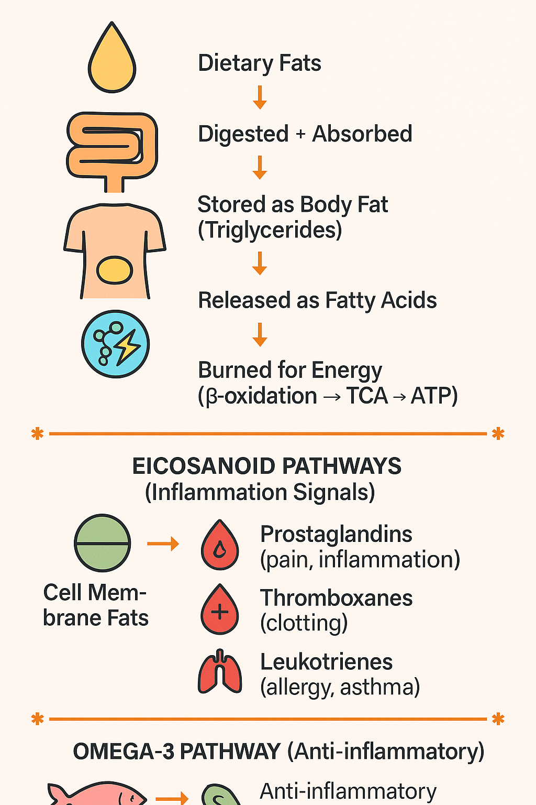
Caption

Slide 98
Lipid Metabolism
Eicosanoid Pathways
Inflammatory Pathway
Cell Membrane Phospholipids
↓
Phospholipase A2 (PLA2)
↓
Arachidonic Acid (AA)
↓
┌──────────────┼────────────────┐
▼ ▼ ▼
COX LOX CYP450
▼ ▼ ▼
Prostaglandins Leukotrienes Epoxides
Thromboxanes (LTs) (vascular)
(PGs/TXs) mediators
Anti-Inflammatory Pathway
EPA / DHA (Omega-3)
↓
Anti-inflammatory mediators:
- Series-3 PGs
- Series-5 LTs
- Resolvins, Protectins, Maresins
Dietary Fat
↓
Digestion (bile + lipase)
↓
Chylomicrons
↓
Adipose Storage (TG)
↓
Lipolysis
↓
Free Fatty Acids (FFA)
↓
β-Oxidation
↓
Acetyl-CoA
↓
TCA Cycle
↓
ATP

Slide 99
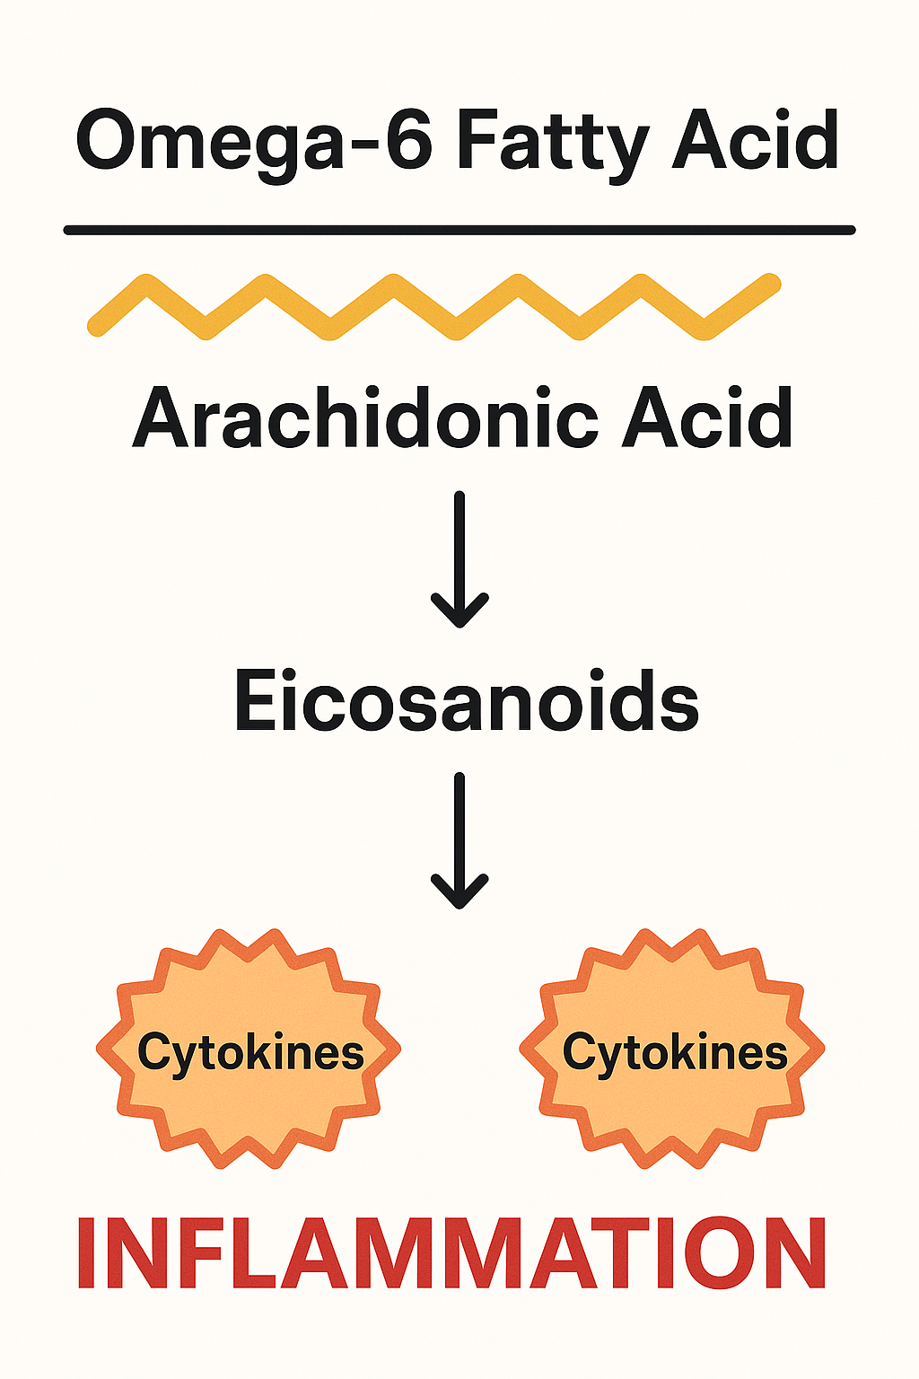
Cytokine-Mediated Inflammation
Chronic elevation of TNF-α, IL-6 & IL-1β disrupts normal fat storage, use & transport.
Adipose Tissue
Increases lipolysis → more free fatty acids released
Impairs insulin signaling & triglyceride storage
Liver & Circulation
Increases hepatic triglyceride synthesis & VLDL production
Reduces triglyceride clearance from the blood
Promotes ectopic fat accumulation
Mitochondria
Impairs fatty-acid oxidation
Increases oxidative stress & metabolic dysfunction
Clinical consequences: Insulin resistance, high triglycerides, fatty liver, metabolic syndrome & cardiovascular disease
Key cycle: Inflammation → disrupted lipid metabolism → ectopic fat & oxidative stress → further inflammation
Notes:
TNF-α, IL-6 & IL-1β alter how fats are stored, transported & used.
Cytokines increase adipose lipolysis, releasing excess free fatty acids (FFAs) into circulation.
The liver converts more FFAs into triglycerides and exports them as VLDL.
Inflammation may also reduce triglyceride clearance and impair mitochondrial fat oxidation.
This promotes insulin resistance, dyslipidemia, fatty liver & cardiovascular risk.
Nutrition, movement, sleep, stress management & medical care can help interrupt this cycle.
Exam tip: Chronic inflammation increases circulating FFAs & triglycerides while impairing insulin signaling & fat oxidation.

Slide 100
Clinical Relevance: Why This Matters
Lipid metabolism, cytokines, and eicosanoids play major roles in:
Metabolic Health
Insulin resistance
Fatty liver
Dyslipidemia
Cardiovascular Health
Blood clotting (thromboxanes)
Endothelial inflammation
Immunity & Inflammation
Cytokine-mediated chronic inflammation
Eicosanoid-driven acute inflammation
Hormones
Steroid hormones are derived from cholesterol
Neurology
Neuronal membranes depend on DHA
Eicosanoids influence neuroinflammation
Notes:
Okay so why does all of this matter?
Lipid metabolism, cytokines, and eicosanoids strongly influence cardiometabolic health.
Dysregulation contributes to insulin resistance, fatty liver, and dyslipidemia.
They also affect cardiovascular function, including blood clotting (thromboxanes) and endothelial inflammation.
“These pathways link metabolism, inflammation, and cardiovascular disease.”

Slide 101
Summary Table: Lipid Metabolism & Inflammatory Signaling - Key Pathways
Pathway | Key Function | Health Impact
Lipolysis | Releases stored fat for energy | Fasting energy, metabolic flexibility
β-Oxidation | Converts fatty acids → ATP | Endurance, mitochondrial health
Lipogenesis | Creates new fat for storage | Excess promotes obesity, NAFLD
Lipoprotein transport | Moves fats in blood | LDL/HDL balance affects CVD risk
Cytokine pathways | Immune signaling | Inflammation, insulin resistance
Eicosanoids | Rapid-response signaling (PGs, TXs, LTs) | Pain, inflammation, clotting, immunity
Omega-3 SPMs | Resolve inflammation | Healing, anti-inflammatory balance

Slide 102
Genomics & Epigenetics
Chemistry of enzymes, co-factors, and organic acids
Basic understanding of nutritional genomics research in practice
Impact of nutritional genomics on health
Epigenetics: methyl donor biochemistry and hypo- and hypermethylation specific to life cycle stage
**Slides will separate the above domain areas via a blue heading
D
O
M
A
I
N
II
2
Caption
Notes:
Okay, now onto the next topic within this domain!
Genomics & Epigenetics
Remember that these topics are full careers within themselves. Can we review everything, no, but let’s at least familiarize ourselves with the big boulders and if you find yourself with free time, you can explore more of the pebbles of this topic.

Slide 103
Chemistry of Enzymes, Co-factors, and Organic Acids
Enzymes: Run the Reaction
Biological catalysts—usually proteins
Lower activation energy to accelerate reactions
Bind specific substrates → form specific products
Are not consumed during the reaction
Cofactors: Enable the Reaction
Non-protein helpers required by many enzymes
Coenzymes: Organic molecules, often derived from B vitamins
Mineral cofactors: Metal ions such as Mg, Zn, Fe & Cu
Deficiencies can slow or disrupt metabolic pathways
Organic Acids: Reflect the Reaction
Intermediates or end products of metabolism
Produced during glycolysis, the TCA cycle, amino acid metabolism & fatty-acid oxidation
Abnormal levels may suggest nutrient insufficiency, altered enzyme activity or metabolic dysfunction
Key relationship: Enzymes perform reactions → cofactors support enzymes → organic acids provide clues about pathway function.
Notes:
We’re going to kick off this section talking about the chemistry of enzymes, cofactors & organic acids.
Enzymes accelerate biochemical reactions by lowering activation energy.
The active site binds a specific substrate, which is converted into a product.
Many enzymes require cofactors to function.
Coenzymes are organic helpers (often derived from B vitamins) while minerals act as inorganic cofactors.
Without the needed cofactor, an enzyme reaction may slow or stop.
Organic acids are intermediates or end products from major metabolic pathways.
Their levels can provide indirect clues about enzyme activity, nutrient availability, mitochondrial function & metabolic stress.
Memory tip: Enzyme = catalyst; cofactor = helper; organic acid = metabolic clue.

Slide 104
Enzymes: Chemical Catalysts
of the Body
Enzymes accelerate biochemical reactions by lowering the activation energy needed for the reaction to occur.
Structure & Specificity
Usually proteins made of folded amino-acid chains
Contain an active site that binds a specific substrate
Shape determines which substrates and reactions the enzyme can catalyze
Can accelerate reactions millions of times
Remain unchanged and can be reused
Induced-Fit Model
A substrate binds to the active site.
The enzyme changes shape slightly around the substrate.
Bonds are positioned, strained or weakened.
The substrate is converted into one or more products.
Products are released, and the enzyme is ready to work again.
Enzyme + Substrate ⇌ Enzyme–Substrate Complex → Enzyme + Product(s)
Notes:
Enzymes are biological catalysts (usually proteins) that increase the rate of biochemical reactions.
They lower activation energy but do not change the reaction’s overall energy or equilibrium.
An enzyme’s three-dimensional shape creates an active site with affinity for particular substrates.
In the induced-fit model, substrate binding causes the enzyme to change shape slightly.
This positions or weakens chemical bonds, making the reaction easier to complete.
The resulting products are released, while the enzyme remains unchanged and can be reused.
Memory tip: Enzymes increase reaction speed; they do not supply energy, alter equilibrium or become consumed.

Slide 105
Cofactors: Essential Enzyme Helpers
Many enzymes require a non-protein cofactor to perform their reactions.
Organic Cofactors: Coenzymes
Often vitamins or vitamin-derived molecules that transfer electrons, atoms or functional groups.
B3 → NAD⁺/NADP⁺: Electron transfer
B2 → FAD/FMN: Electron transfer
B1 → TPP: Carbon transfer
B6 → PLP: Amino-acid metabolism
B5 → CoA: Acyl-group transfer
Vitamin C: Hydroxylation reactions
Vitamin K: Activates proteins through carboxylation
Inorganic Cofactors: Minerals
Metal ions that support enzyme structure, substrate binding or catalysis.
Mg²⁺: ATP-dependent reactions
Zn²⁺: Alcohol dehydrogenase & many other enzymes
Cu²⁺: Oxidative enzymes and Cu/Zn superoxide dismutase
Fe²⁺/Fe³⁺: Heme enzymes & electron transport
Key Terms
Apoenzyme: Enzyme without its required cofactor—inactive
Holoenzyme: Apoenzyme + cofactor—active
Notes:
Let’s talk about co-factors!
Cofactors are non-protein helpers required for many enzyme reactions.
Coenzymes are organic molecules, often derived from vitamins.
They commonly carry electrons, atoms or functional groups between reactions.
Mineral cofactors help stabilize enzyme structure, bind substrates or directly participate in catalysis.
For example, Mg supports ATP reactions, while iron & copper participate in redox reactions.
An apoenzyme is the inactive protein portion without its cofactor.
A holoenzyme is the complete, active enzyme–cofactor complex.
Remember: Coenzymes are organic and often vitamin-derived; metal-ion cofactors are inorganic.

Slide 106
Organic Acids: Intermediates in Metabolic Chemistry
Organic acids are carbon-containing compounds [typically with one or more carboxyl groups (–COOH)]produced as intermediates or end products of metabolism.
Why They Matter
Organic-acid patterns may provide clues about:
Enzyme activity & pathway bottlenecks
Vitamin and mineral cofactor availability
Mitochondrial energy production
Amino acid and fatty-acid metabolism
Key concept: Organic acids are metabolic “breadcrumbs” that help reveal how nutrients are being processed.
Pathway | Organic Acids / Related Markers
Glycolysis | Pyruvate, lactate
TCA cycle | Citrate, α-ketoglutarate, succinate, fumarate, malate, oxaloacetate
Amino acid metabolism | Homocysteine, glutamate, α-keto acids
Fatty-acid oxidation | Acylcarnitines
Ketone metabolism | Acetoacetate, β-hydroxybutyrate
Notes:
Organic acids are produced as intermediates or end products of metabolic reactions.
They appear throughout glycolysis, the TCA cycle, amino acid metabolism, fatty-acid oxidation & ketone metabolism.
Some are temporary pathway intermediates, while others accumulate and enter the blood or urine.
An abnormal level may suggest an enzyme bottleneck, altered substrate use, cofactor insufficiency or increased metabolic demand.
Interpretation requires context because levels may also be affected by diet, medications, exercise, kidney function & microbial metabolism.
Concept tip: Organic acids reflect metabolic pathway activity; accumulation often occurs before or at a blocked or slowed reaction.

Slide 107
Enzymes, Cofactors & Organic Acids: The Metabolic Connection
Cofactors enable enzymes → enzymes convert organic acids → organic-acid patterns reflect pathway activity
Metabolic Reaction | Enzyme Support Required
Pyruvate → acetyl-CoA | B1, B2, B3, B5 & lipoic acid
α-Ketoglutarate → succinyl-CoA | B1, B2, B3, B5 & lipoic acid
Succinate → fumarate | FAD from B2 & iron-sulfur centers
Amino acid transamination | PLP from B6
ATP-dependent reactions | Mg²⁺–ATP complex
Notes:
So how do enzymes, cofactors, and organic acids work together?
Cofactors enable enzymes to perform specific metabolic reactions.
Enzymes convert one organic-acid intermediate into the next metabolite in a pathway.
For example, pyruvate dehydrogenase requires B1, B2, B3, B5 & lipoic acid to convert pyruvate into acetyl-CoA.
α-Ketoglutarate dehydrogenase uses similar cofactors to produce succinyl-CoA.
Succinate dehydrogenase requires FAD from B2 and iron-sulfur centers to convert succinate into fumarate.
B6 as PLP supports amino acid reactions, while Mg²⁺ stabilizes ATP during kinase reactions.

Slide 108
What Happens When a Pathway Slows?
Missing cofactor or impaired enzyme → reduced conversion → upstream organic acid may accumulate
Organic-acid patterns may provide clues about:
B-vitamin or mineral insufficiency
Mitochondrial dysfunction
Oxidative stress
Detoxification pathway activity
Microbial overgrowth or dysbiosis
Key concept: Organic acids do not diagnose a deficiency alone - they reveal patterns that must be interpreted in context.
Notes:
What happens when a pathway slows?
A missing cofactor or impaired enzyme can slow the conversion of one metabolite into the next.
When this happens, an upstream organic acid may accumulate, while downstream products may decrease.
Organic-acid patterns can provide indirect clues about B-vitamin or mineral insufficiency, mitochondrial dysfunction, oxidative stress & detoxification activity.
Some organic acids are produced by gut microbes, so certain patterns may also suggest microbial overgrowth or dysbiosis.
Results can also be affected by diet, medications, genetics, exercise & kidney function.
Key concept: Organic acids identify possible metabolic bottlenecks; they do not diagnose a nutrient deficiency or condition on their own.

Slide 109
Clinical & Functional Significance
Why these relationships matter
Cofactor insufficiency can slow enzyme activity
Nutrient status influences how efficiently metabolic pathways function
Enzyme activity determines pathway flow
Enzymes support digestion, energy production, detoxification, hormone synthesis & neurotransmitter metabolism
Organic acids reflect metabolic activity
Patterns may reveal where pathways are slowing or becoming imbalanced
Organic-acid patterns may provide clues about:
Mitochondrial energy production
B-vitamin & mineral needs
Oxidative stress
Amino acid & neurotransmitter metabolism
Detoxification activity
Microbial metabolism
Key concept: Organic acids do not diagnose a deficiency or dysfunction alone - they identify patterns that must be interpreted alongside symptoms, diet, medications & other labs.
Notes:
These relationships matter because metabolic pathways depend on both enzymes & their required cofactors.
When a vitamin or mineral cofactor is insufficient, enzyme activity may slow, reducing pathway efficiency.
Enzymes influence the flow of digestion, energy production, detoxification, hormone synthesis & neurotransmitter metabolism.
Organic acids provide a snapshot of this activity because they are produced as metabolic intermediates or end products.
Their patterns may reveal clues about mitochondrial function, nutrient needs, oxidative stress, amino acid metabolism, detoxification & microbial activity.
However, these patterns are not diagnostic on their own and may also be influenced by diet, symptoms, medications, exercise, kidney function & other labs.

Slide 110
Summary Table: Enzymes,
Cofactors & Organic Acids
Component | What It Is | Role in Metabolism | Key Examples
Enzymes | Protein-based biological catalysts | Speed up biochemical reactions by lowering activation energy; convert substrates into products | Amylase, dehydrogenases, kinases, lipases
Cofactors | Non-protein helpers (vitamins or minerals) needed for enzyme activity | Activate enzymes, stabilize reactions, transfer electrons or chemical groups | Coenzymes: NAD⁺ (B3), FAD (B2), CoA (B5), PLP (B6); Minerals: Mg²⁺, Zn²⁺, Cu²⁺, Fe²⁺
Organic Acids | Small carbon-based metabolic intermediates with a carboxyl group | Reflect enzyme activity and cofactor sufficiency; essential steps in energy, amino acid, and detox pathways | Pyruvate, lactate, citrate, α-ketoglutarate, succinate, malate

Slide 111
Basic Understanding of Nutritional Genomics Research in Practice
Nutritional genomics examines how genes, nutrients, diet & lifestyle interact to influence metabolism and health.
Two Related Areas:
Nutrigenetics: How genetic variants influence an individual’s response to nutrients and dietary patterns
Nutrigenomics: How nutrients and dietary patterns influence gene expression
Potential Applications
Personalize dietary recommendations
Identify differences in nutrient metabolism
Guide targeted supplementation when clinically appropriate
Support chronic disease prevention strategies
Better understand methylation, detoxification & antioxidant pathways
Clinical Interpretation:
Genetic variants indicate potential tendencies - not diagnoses or guaranteed outcomes. Findings must be interpreted alongside:
Health history + symptoms + diet + lifestyle + environment + labs
Key concept: Genes may influence risk and nutrient response, but their expression is shaped by many modifiable factors.
Notes:
Nutritional genomics explores the interaction between genetics, nutrition, lifestyle & health outcomes.
Nutrigenetics asks how a person’s genetic variants affect their response to foods or nutrients.
Nutrigenomics asks how nutrients and dietary patterns affect gene expression.
This may help explain why individuals respond differently to the same diet, supplement or lifestyle intervention.
Clinically, genetic information may provide context for nutrient metabolism, methylation, detoxification, antioxidant defenses & chronic disease susceptibility.
However, a genetic variant usually represents a potential influence - not a diagnosis, deficiency or predetermined outcome.
Results should always be integrated with clinical history, symptoms, diet, lifestyle, environment & laboratory data.

Slide 112
Nutrigenetics: SNPs
Nutrigenetics examines how inherited genetic variations [often single nucleotide polymorphisms (SNPs)] influence an individual’s response to foods, nutrients & dietary patterns.
Examples
Genetic variants may affect:
Lactose digestion and tolerance
Caffeine metabolism
Folate metabolism and methylation (MTHFR variants)
Lipid metabolism and cholesterol response
Detoxification and antioxidant enzyme activity
Clinical Application
Genetic information may help personalize:
Food and dietary recommendations
Nutrient intake or supplementation
Lifestyle and risk-reduction strategies
Key concept: A genetic variant suggests a potential tendency - not a diagnosis or guaranteed outcome.
Notes:
Nutrigenetics examines how genetic variations, including SNPs, influence responses to foods & nutrients.
Variants may affect lactose tolerance, caffeine metabolism, folate metabolism, cholesterol response & detoxification enzymes.
For example, CYP1A2 affects caffeine metabolism, while MTHFR influences folate processing.
These variants suggest tendencies - not diagnoses or automatic supplementation needs.

Slide 113
Nutrigenomics
Nutrigenomics examines how nutrients and dietary patterns influence gene expression without changing the underlying DNA sequence.
How It Works -
Food components may influence epigenetic mechanisms, including:
DNA methylation
Histone modification
Regulation of cellular signaling pathways
Examples:
Polyphenols may decrease inflammatory gene expression
Omega-3 fats may reduce expression of pro-inflammatory cytokines
High-sugar diets may increase expression of genes involved in lipogenesis
Key concept: Diet can influence which genes are more or less active, but gene expression is also shaped by lifestyle, environment & health status.
Notes:
Nutrigenomics examines how foods and nutrients affect gene expression.
Nutrients do not usually change the DNA sequence; they influence whether certain genes are more or less active.
This may occur through DNA methylation, histone modification & cell-signaling pathways.
For example, polyphenols and omega-3 fats may reduce inflammatory signaling, while excess sugar may activate lipogenesis genes.
These effects depend on the person’s overall diet, lifestyle, environment & genetics.

Slide 114
Common Genetic Pathways
Evaluated in Practice
Methylation genes: MTHFR, MTRR, COMT
Detox pathways: GST, CYP450 variants
Lipid metabolism: APOE, FADS1/2
Carbohydrate metabolism: TCF7L2 (diabetes risk)
Inflammation: IL-6, TNF-α
Antioxidant defense: SOD2, GPX1
Caffeine/alcohol metabolism: CYP1A2, ADH genes
These variants do not diagnose disease, they show tendencies or susceptibilities.
Notes:
Let’s explore some of these genetic pathways -
Genetic testing may evaluate variants involved in methylation, detoxification, lipid & glucose metabolism, inflammation and antioxidant defense.
MTHFR, MTRR & COMT influence methylation-related pathways, including folate metabolism and neurotransmitter processing.
GST & CYP450 variants may affect the metabolism of medications, hormones and environmental compounds.
APOE & FADS1/2 influence lipid transport and fatty-acid metabolism, while TCF7L2 is associated with glucose regulation and type 2 diabetes susceptibility.
Variants in IL-6, TNF-α, SOD2 & GPX1 may influence inflammatory signaling and antioxidant defenses.
CYP1A2 & ADH genes affect the metabolism of caffeine and alcohol.

Slide 115
Limitations & Best Practices
Genetic tests identify risk, not destiny.
Results must not be used in isolation.
Many variants have modest effects unless combined with lifestyle factors.
Accredited, scientifically validated labs should be used.
Interpretation requires understanding biochemical pathways, not single SNPs.
Notes:
Genetic testing identifies possible susceptibilities, but genes do not determine destiny.
Most SNPs have relatively modest effects and become more meaningful when considered alongside diet, lifestyle, environment & other variants.
Avoid making recommendations based on a single SNP without supporting clinical evidence.
Results should be interpreted at the pathway level and compared with symptoms, health history & laboratory findings.
Testing should come from an accredited lab using validated methods.

Slide 116
Impact of Nutritional Genomics
on Health
Personalized Nutrition
Genetic variants may influence:
Nutrient absorption & metabolism
Responses to carbs, fats & supplements
Lactose and caffeine tolerance
Alcohol metabolism and gluten-related disease susceptibility
Impact: Dietary recommendations can be better tailored to the individual.
Metabolic Health
Variants may contribute to susceptibility to:
Insulin resistance & obesity
Dyslipidemia
Hypertension
Impact: Gene-informed strategies may support blood sugar regulation, lipid management & long-term cardiometabolic health.
Detoxification & Antioxidant Defense
Variants in pathways such as GST, SOD & CYP450 may influence:
Metabolism of medications & environmental compounds
Antioxidant defenses
Susceptibility to oxidative stress
Impact: Nutrition may help support these pathways through adequate antioxidant and cofactor intake.
Notes:
Nutritional genomics may help explain why individuals respond differently to the same foods, nutrients & dietary patterns.
Genetic variants can influence nutrient metabolism, macronutrient response and susceptibility to certain cardiometabolic conditions.
This information may help personalize strategies for blood sugar, lipid levels, blood pressure & weight management.
Variants in GST, SOD & CYP450 pathways may also influence detoxification, antioxidant defenses and responses to environmental exposures.
Genetics may provide insight into lactose tolerance, caffeine and alcohol metabolism and gluten-related disease susceptibility.
GST = Glutathione S-Transferase - these enzymes use glutathione to neutralize toxins and prepare them for elimination.
SOD = Superoxide Dismutase - one of the body’s primary antioxidant defense enzymes.
CYP = Cytochrome P450 enzymes are a major part of Phase I detox to help modify drugs, hormones, and toxins get to phase II

Slide 117
Impact of Nutritional Genomics
on Health (Cont.)
Inflammation Regulation
Variants in genes such as IL-6, TNF-α & CRP may influence susceptibility to chronic inflammation.
Application: Omega-3s, polyphenols, fiber-rich foods & other lifestyle factors may help regulate inflammatory signaling.
Methylation & Neurotransmitter Health
Variants in MTHFR, MTRR & COMT may influence:
Folate and methylation pathways
Neurotransmitter metabolism
Hormone metabolism
Application: Findings may help guide adequate intake of folate, B12, choline & other pathway-supporting nutrients.
Chronic Disease Prevention
Genetic information may identify susceptibility to:
Cardiovascular disease
Type 2 diabetes
Certain cancers
Autoimmune conditions
Application: Earlier nutrition and lifestyle intervention may help modify risk.
Consumer Empowerment
Understanding genetic tendencies may encourage more informed dietary choices, consistent health habits & proactive prevention.
Key concept: Genetic information can guide personalized prevention, but lifestyle, environment & other health factors still strongly influence outcomes.
Notes:
Variants involving IL-6, TNF-α & CRP may influence a person’s tendency toward inflammatory signaling.
Nutrition (including omega-3 fats, polyphenols & fiber-rich foods) may help support a healthier inflammatory response.
MTHFR, MTRR & COMT may affect methylation, folate metabolism, neurotransmitter processing & hormone metabolism.
Genetic findings may help identify areas to support, but they do not automatically justify high-dose methylated supplements.
Nutritional genomics may also reveal susceptibility to certain chronic conditions, allowing earlier attention to modifiable risk factors.
For some individuals, understanding these tendencies can improve motivation and engagement with nutrition and lifestyle habits.

Slide 118
A Summary Table
Impact Area | How Genetics Influences Health | How Nutrition Modifies Outcomes
Personalized Nutrition | Genetic variations alter nutrient metabolism, absorption, and tolerance | Tailored diets improve digestion, nutrient status, and overall response
Metabolic Health | SNPs affect insulin sensitivity, lipid metabolism, weight regulation | Targeted diets help regulate blood sugar, cholesterol, and weight
Detoxification & Oxidative Stress | Variants in detox/antioxidant genes affect toxin clearance and ROS balance | Antioxidant-rich diets, sulfur foods, and phytochemicals support weak pathways
Inflammation | Genes regulate cytokine production and chronic inflammation risk | Omega-3s, polyphenols, fiber, and anti-inflammatory diets improve outcomes
Methylation & Mental Health | MTHFR/COMT variants influence neurotransmitter balance and methylation | Folate, B12, choline, and stress-support nutrients optimize brain and hormone function
Chronic Disease Risk | Genetics predispose individuals to CVD, diabetes, obesity, cancer | Diet and lifestyle choices can reduce expression of risk genes
Behavior & Engagement | Genetic insights increase motivation and adherence | Personalized plans improve long-term dietary consistency

Slide 119
Epigenetics: Methyl Donor Biochemistry and Hypo-and Hypermethylation Specific to Life Cycle Stage
Epigenetics changes gene expression without changing the underlying DNA sequence. DNA methylation is one major epigenetic mechanism.
Methyl Donor Nutrients =
Folate (5-MTHF) • B12 • Choline • Betaine • Methionine
These nutrients support production of SAMe, the body’s primary methyl donor.
Why Methylation Matters
Gene expression & DNA stability
DNA synthesis and repair
Neurotransmitter & hormone metabolism
Detoxification pathways
Needs Across the Life Cycle
Life Stage | Major Role
Pregnancy | DNA synthesis, neural-tube development & fetal epigenetic programming
Infancy– adolescence | Rapid growth & brain development
Adulthood | Metabolic regulation, detoxification & cardiovascular health
Older adulthood | Nutrient absorption and oxidative stress may alter methylation patterns
Notes:
Epigenetics describes changes in gene activity that occur without changing the DNA sequence.
One major mechanism is DNA methylation, where a methyl group is added to DNA and generally reduces expression of that gene.
Folate, B12, choline, betaine & methionine help supply methyl groups through the one-carbon cycle, ultimately supporting production of SAMe.
Methylation needs are especially high during pregnancy and early development because cells are rapidly dividing and the nervous system is developing.
It remains important throughout childhood and adolescence for growth, and during adulthood for metabolic regulation, detoxification & cellular maintenance.
With aging, lower nutrient absorption and greater oxidative stress may contribute to broad hypomethylation, while certain gene regions may become hypermethylated.

Slide 120
Methyl Donor Biochemistry
(The Methylation Cycle)
Core Process
Folate → 5-MTHF → B12 → Homocysteine → Methionine → SAMe
5-MTHF transfers a methyl group to vitamin B12
B12 transfers it to homocysteine, forming methionine
Methionine is converted into SAMe, the body’s primary methyl donor
After donating its methyl group:
SAMe → SAH → Homocysteine
What SAMe Methylates
DNA, RNA & histones
Neurotransmitters
Phospholipids
Hormones and other compounds
Nutrient Support
Methyl donors: Folate, B12, choline/betaine & methionine
Supporting cofactors: B2, B3 & B6
Homocysteine Pathways
Homocysteine may be:
Re-methylated back into methionine
Directed through transsulfuration to support cysteine & glutathione production
Key concept: Healthy methylation requires balanced pathway flow, not simply more methyl donors.
Pathway video here!
Notes:
Methylation -
Methylation is the transfer of a methyl group to another molecule.
In the folate-dependent pathway, 5-MTHF transfers its methyl group to B12, and B12 transfers it to homocysteine to form methionine.
Methionine is then converted into SAMe, the body’s primary methyl donor.
SAMe donates methyl groups for the regulation or metabolism of DNA, RNA, histones, neurotransmitters, phospholipids & other compounds.
After donation, SAMe becomes SAH and then homocysteine.
Homocysteine can be recycled into methionine or enter the B6-dependent transsulfuration pathway to support cysteine and glutathione production.
Folate, B12, choline, betaine & methionine provide methyl groups, while B2, B3 & B6 support related enzyme reactions.

Slide 121
Hypermethylation vs. Hypomethylation
Hypermethylation
= Too much methylation
→ Often suppresses gene expression
→ Can silence tumor suppressor genes, alter hormone pathways, affect detox enzymes
Hypomethylation
= Too little methylation
→ Can activate genes excessively
→ Often associated with inflammation, oxidative stress, genomic instability, high homocysteine
Methylation balance depends on:
nutrient adequacy
inflammation
oxidative stress
metabolic demands
life stage (very important!) - Quick summary below (more details to come!)
  Preconception & pregnancy: Increased need for DNA synthesis, placental development, neural-tube formation & fetal programming
  Infancy & childhood: Rapid cell division, growth & brain development
  Adolescence: Growth, hormonal changes & continued brain development
  Adulthood: Cellular repair, hormone and neurotransmitter metabolism, detoxification & cardiovascular health
  Older adulthood: Reduced nutrient absorption and increased oxidative stress may promote broad hypomethylation, while specific genes may become hypermethylated
Notes:
Healthy methylation depends on balance (more is not better).
Methylation patterns are influenced by nutrient status, inflammation, oxidative stress, metabolic demand & life stage.
Hypermethylation in a gene’s regulatory region generally suppresses gene expression. If this affects tumor suppressor genes, detox enzymes or hormone-related genes, normal protective functions may be reduced.
Hypomethylation generally increases gene activity and can reduce genomic stability. It is often associated with inflammation, oxidative stress & sometimes elevated homocysteine.
Methylation demands and patterns vary across the life cycle.

Slide 122
Life-Cycle Differences in Methylation Needs: Preconception & Pregnancy
Preconception: Both Parents
Methylation supports:
DNA integrity
Egg and sperm development
Early epigenetic programming
Key nutrients: Folate, B12, choline & betaine
Pregnancy: Increased Demand
Maternal methyl-donor needs increase to support:
Rapid cell division & DNA synthesis
Neural-tube development
Placental growth
Fetal brain development
Epigenetic programming
Why Balance Matters
Inadequate folate or methyl-donor status may impair fetal development and increase pregnancy-related risks
Supplementation should be adequate and individualized—more is not always better
Key concept: Preconception establishes the nutritional foundation; pregnancy substantially increases demand for one-carbon metabolism and methylation support.
Notes:
Methylation needs increase during periods of rapid growth, especially preconception & pregnancy.
Before conception, methylation supports DNA integrity, egg and sperm development & early epigenetic programming.
During pregnancy, demand rises to support rapid cell division, neural-tube formation, placental growth & fetal brain development.
Key nutrients include folate, B12, choline & betaine.
Inadequate status may interfere with development, but more supplementation is not always better.

Slide 123
Life-Cycle Differences in Methylation Needs: Infancy - Adulthood
Infancy and Early Childhood
Rapid growth = high DNA turnover → high methylation demand
Examples:
Brain development
Immune system programming
Metabolic pathway imprinting
Behavior/neurotransmitter gene regulation
Environmental inputs (breastfeeding, choline intake, stress exposure) shape epigenetic patterns long-term.
Adolescence
Another growth surge → increased methyl donors needed.
Methylation supports:
Hormone development
Brain maturation
Growth and metabolism
Stress-response programming
Deficiency can contribute to mood disorders, poor detox capacity, or inflammatory tendencies.
Adulthood
Methylation stabilizes but remains essential for:
Detox pathways
Hormone metabolism
Immune regulation
Cardiovascular health (homocysteine control)
DNA repair
Hypomethylation tends to increase with chronic inflammation, stress, and poor diet.
Older Adults
Aging is associated with:
Global hypomethylation (gene activation, inflammation)
Local hypermethylation (gene silencing—often tumor suppressor genes)
This imbalance contributes to:
cognitive decline
cancer risk
immune dysregulation
reduced detoxification
frailty and sarcopenia
Older adults often need more B12, folate, and choline for methylation support due to reduced absorption.
Notes:
Methylation demand also shift as we grow up -
Infancy & Childhood: High demand for growth, brain development, and immune programming.
Adolescence: Supports hormone development, brain maturation, and metabolism.
Adulthood: Maintains detoxification, hormone balance, immune function, and homocysteine control.
Older Adults: Aging often shows hypomethylation and gene dysregulation; needs for B12, folate, and choline may increase.

Slide 124
Summary Table: Epigenetics & Methylation Across the Life Cycle
Topic | Key Points
Epigenetics (General) | Regulates gene expression without changing DNA sequence; primarily through DNA methylation and histone modification.
Methyl Donor Biochemistry | Uses folate (5-MTHF), B12, choline, betaine, methionine, and SAMe to transfer methyl groups in the one-carbon cycle.
Role of Methylation | Controls gene activity, supports detoxification, neurotransmitter synthesis, hormone metabolism, inflammation regulation, and DNA integrity.
Hypomethylation | Too little methylation → can increase inflammation, oxidative stress, genomic instability, and activate harmful genes.
Hypermethylation | Too much methylation → can silence important genes (e.g., tumor suppressor genes), affecting cellular function.
Pregnancy (Highest Demand) | Rapid fetal DNA synthesis and neural tube formation require high methyl donor intake; maternal status influences lifelong epigenetic programming.
Infancy & Early Childhood | High methylation needs due to rapid growth, brain development, and immune system programming.
Adolescence | Growth surge and hormonal maturation increase demand for methyl donors and stable epigenetic regulation.
Adulthood | Methylation supports detoxification, cardiovascular health, cognitive function, inflammation control, and hormone balance.
Older Adults | Tendency toward global hypomethylation and local hypermethylation; increased need for B12, folate, and choline due to reduced absorption and higher oxidative stress.

Slide 125
Sample Quiz Questions
1. Which metabolic pathway represents the common final route for carbohydrate, fat, and protein metabolism toward energy production?
A. Glycolysis
B. Pentose phosphate pathway
C. Tricarboxylic acid (TCA) cycle
D. Urea cycle
2. Which phase of detoxification is primarily responsible for making reactive toxin intermediates water-soluble for excretion?
A. Phase I (Oxidation)
B. Phase II (Conjugation)
C. Phase III (Transport)
D. Antioxidant neutralization
3 .Oxidative stress occurs when:
A. Antioxidant levels exceed reactive oxygen species
B. Detoxification enzymes become hyperactive
C. Reactive oxygen species production exceeds antioxidant capacity
D. Phase II conjugation decreases free radical formation
Notes:
1. Correct Answer: C — TCA cycle
Explanation:
All macronutrients are converted into acetyl-CoA or TCA intermediates before entering the TCA cycle for ATP generation.
2 . Correct Answer: B — Phase II (Conjugation)
Explanation:
Phase II attaches molecules such as glutathione, sulfate, or glycine to detox metabolites to make them excretable.
3. Correct Answer: C
Explanation:
Oxidative stress reflects an imbalance between ROS generation and antioxidant defenses.

Slide 126
Sample Quiz Questions
4. Which eicosanoid class is most directly involved in bronchoconstriction and allergic responses?
A. Prostaglandins
B. Thromboxanes
C. Leukotrienes
D. Resolvins
5. Which nutrient acts as a key cofactor for transamination reactions in amino acid metabolism?
A. Riboflavin (B2)
B. Niacin (B3)
C. Pyridoxal-5-phosphate (B6)
D. Cobalamin (B12)
6. During which life-cycle stage is methyl donor demand highest due to intense DNA synthesis and epigenetic programming?
A. Adolescence
B. Pregnancy
C. Adulthood
D. Older age
Notes:
4. Correct Answer: C — Leukotrienes
Explanation:
Leukotrienes produced via the LOX pathway are major mediators of asthma and allergic inflammation.
5. Correct Answer: C — Vitamin B6 (PLP)
Explanation:
PLP is required for aminotransferase enzymes involved in amino acid metabolism.
6. Correct Answer: B — Pregnancy
Explanation:
Fetal development requires substantial methylation for neural tube formation and long-term gene programming, making pregnancy the highest-demand stage.

Slide 127
References
Berg, J. M., Tymoczko, J. L., Gatto, G. J., & Stryer, L. (2023). Biochemistry (9th ed.). W.H. Freeman & Company.
Nelson, D. L., & Cox, M. M. (2021). Lehninger Principles of Biochemistry (8th ed.). W.H. Freeman & Company.
Ferrier, D. (2021). Lippincott’s Illustrated Reviews: Biochemistry (8th ed.). Wolters Kluwer.
Murray, R. K., Bender, D. A., Botham, K. M., Kennelly, P. J., Rodwell, V. W., & Weil, P. A. (2022). Harper’s Illustrated Biochemistry (32nd ed.). McGraw-Hill Education.
Institute of Medicine. (2005).Dietary Reference Intakes for Energy, Carbohydrate, Fiber, Fat, Fatty Acids, Cholesterol, Protein, and Amino Acids. National Academies Press.
Frayn, K. N. (2019).Metabolic Regulation: A Human Perspective (4th ed.). Wiley-Blackwell.
Ferrannini, E., & DeFronzo, R. A. (2015).Insulin action in normal and altered physiological states.European Journal of Clinical Investigation, 45(4), 447–457.
Klaassen, C. D. (2018). Casarett & Doull’s Toxicology: The Basic Science of Poisons (9th ed.). McGraw-Hill.
Jancova, P., Anzenbacher, P., & Anzenbacherova, E. (2010). Phase II drug metabolizing enzymes. Biomedical Papers, 154(2), 103–116.
Lu, S. C. (2013). Glutathione synthesis.Biochimica et Biophysica Acta, 1830(5), 3143–3153.
Halliwell, B., & Gutteridge, J. M. C. (2015). Free Radicals in Biology and Medicine (5th ed.). Oxford University Press.
Pizzino, G., et al. (2017). Oxidative stress: Harms and benefits for human health. Oxidative Medicine and Cellular Longevity.
Jones, D. P. (2006). Redefining oxidative stress. Antioxidants & Redox Signaling, 8(9–10), 1865–1879.
Halliwell, B., & Gutteridge, J. M. C. (2015). Free Radicals in Biology and Medicine (5th ed.). Oxford University Press.
Pizzino, G., et al. (2017). Oxidative stress: Harms and benefits for human health. Oxidative Medicine and Cellular Longevity.
Jones, D. P. (2006). Redefining oxidative stress. Antioxidants & Redox Signaling, 8(9–10), 1865–1879.

Slide 128
References
Voet, D., Voet, J. G., & Pratt, C. W. (2016). Fundamentals of Biochemistry: Life at the Molecular Level (5th ed.). Wiley.
Butterworth, R. F. (2005). Coenzyme function of B vitamins. American Journal of Clinical Nutrition, 82(5), 1126S–1131S.
O’Dell, B. L. (2000). Role of zinc in enzyme structure and function. Journal of Nutrition, 130(5S), 1432S–1436S.
Ferguson, L. R. (2013). Nutrigenomics approaches to functional food development. Journal of the American College of Nutrition, 29(6), 521–526.
Zeisel, S. H. (2020). Precision nutrition: The role of genetics. American Journal of Clinical Nutrition, 112(4), 873–874.
Fenech, M., et al. (2011). Nutrigenetics and nutrigenomics: View to improve health. Mutagenesis, 26(2), 207–214.
Anderson, O. S., Sant, K. E., & Dolinoy, D. C. (2012). Nutrition and epigenetics: Mechanisms and impacts. Annual Review of Nutrition, 32, 81–110.
Zeisel, S. H., & da Costa, K. A. (2009). Choline and the epigenetic regulation of gene expression. Current Opinion in Clinical Nutrition & Metabolic Care, 12(3), 264–270.
Niculescu, M. D., & Zeisel, S. H. (2002). Diet, methyl donors, and DNA methylation. American Journal of Clinical Nutrition, 76(2), 275–282.
Crider, K. S., et al. (2012). Folic acid and neural tube defect prevention. The American Journal of Clinical Nutrition, 85(1), 345–358.
Institute of Medicine. (2006). Dietary Reference Intakes for Folate, Vitamin B12, and Choline. National Academies Press.
Black, M. M. (2012). Effects of vitamin B12 and folate deficiency during pregnancy. American Journal of Clinical Nutrition, 89(2), 702S–706S.
Steegers-Theunissen, R. P. M., et al. (2014). Periconceptional maternal folate status and epigenetic outcomes. Human Reproduction Update, 20(1), 39–55.
American College of Nutrition (ACN). Certified Nutrition Specialist Examination Content Guidelines.
Institute for Functional Medicine. Applying Functional Medicine in Clinical Practice.
World Health Organization. Guidelines on nutrient requirements and maternal nutrition.

